Slide 1
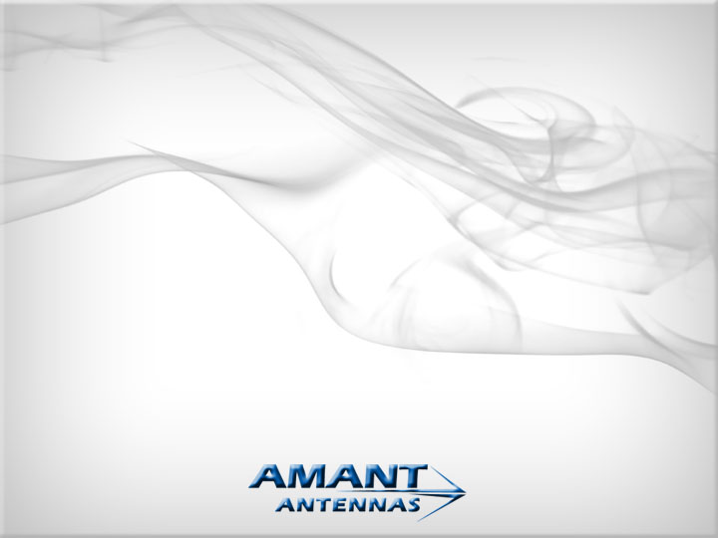
A Novel Wideband Antenna Technology for All the New Wireless Generations
(a) Handset Antennas
(b) Base Station Antennas
Mohamed Sanad, CTO
AMANT Antennas
www.amantantennas.com

Slide 2
Amant - CTO - Mohamed Sanad
Professor, Faculty of Engineering, Cairo University
Adjunct professor, University of Nevada, Reno, USA.
Founder of Amant-Antennas, USA – Egypt
Several international R&D antenna projects
(Nokia, Texas Instruments, Vodafone, ------ etc)
Several antenna patents, USA
Director of Antenna Engineering, Nokia, USA
First embedded antenna for cellular phones in the world
Innovation Prize for Africa “IPA” ($100,000), 2012
Ph.D., University of Manitoba, Canada, 1986

Slide 3
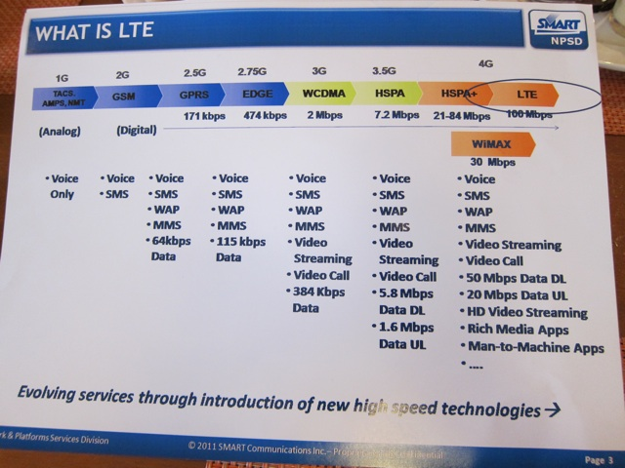
4G - LTE (Long-Term Evolution)
There is a continuous need for more speed, efficiency and new applications .
4G is the fourth generation of mobile phone communication technology standards

Slide 4
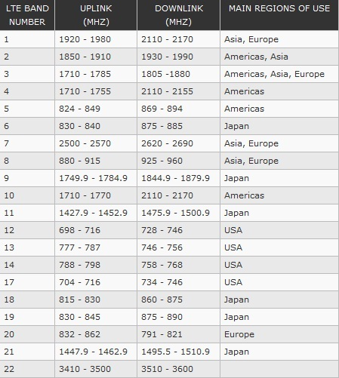
LTE Spectrum fragmentation (40 bands)
Current 4G Handset Antenna Problems
Limited number of applications
No global roaming - Narrow band

Slide 5
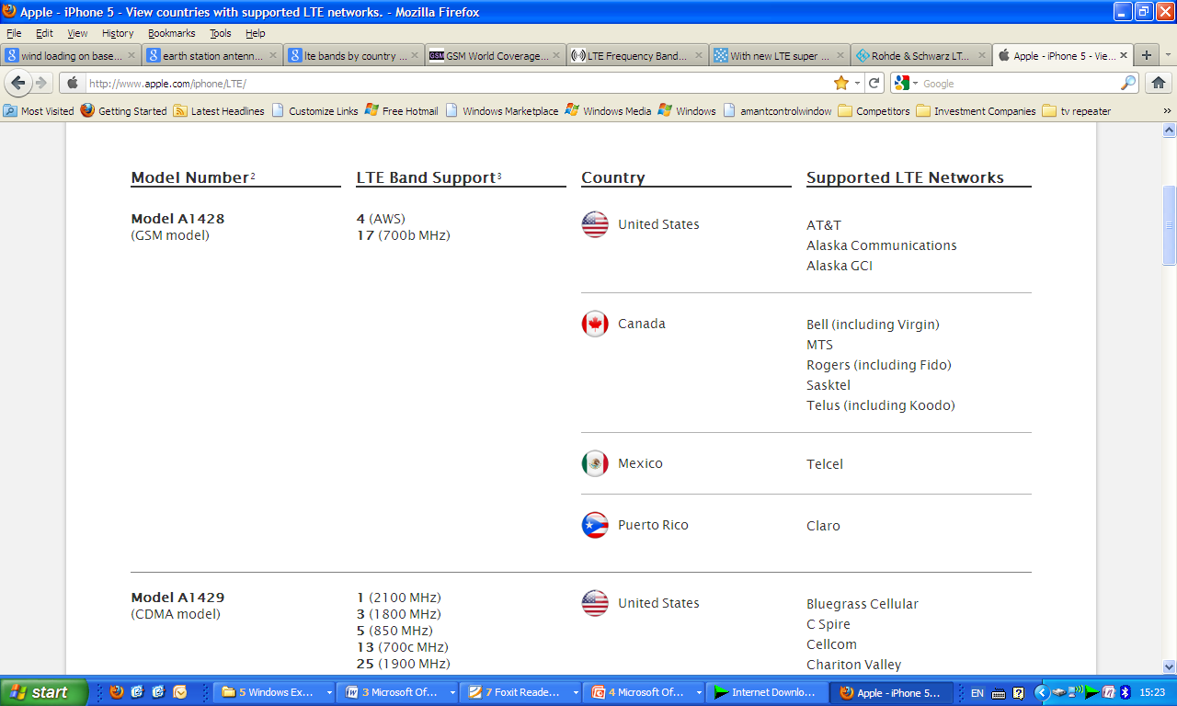
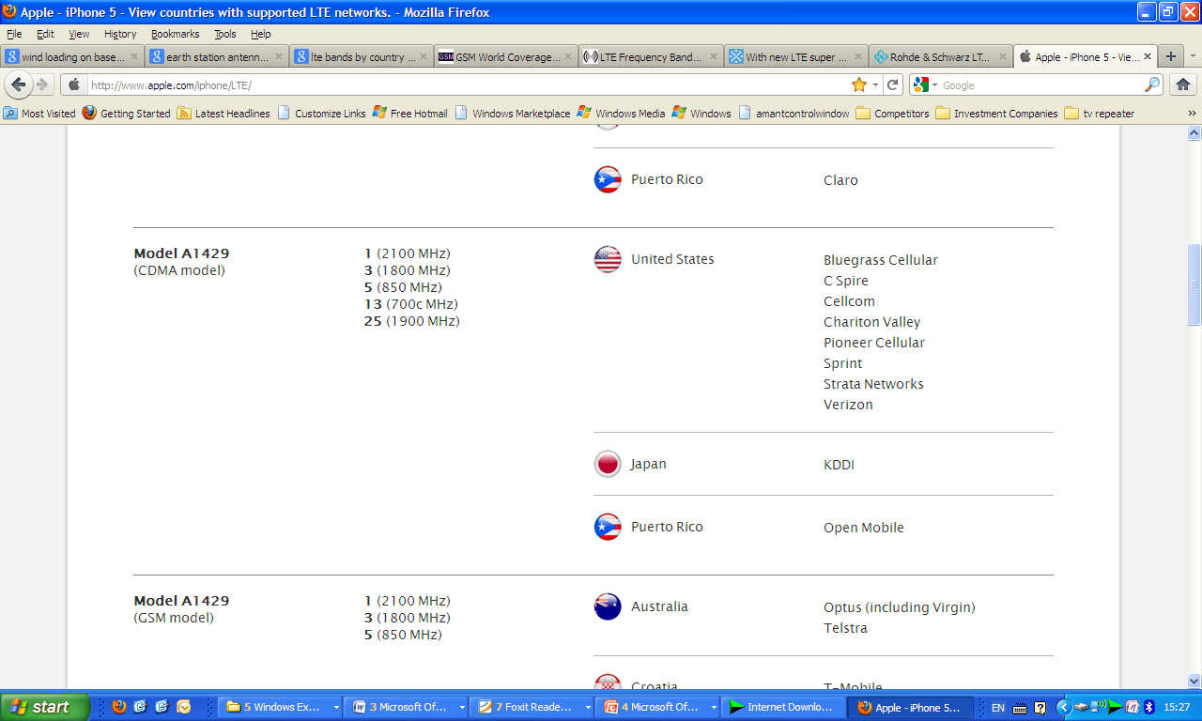
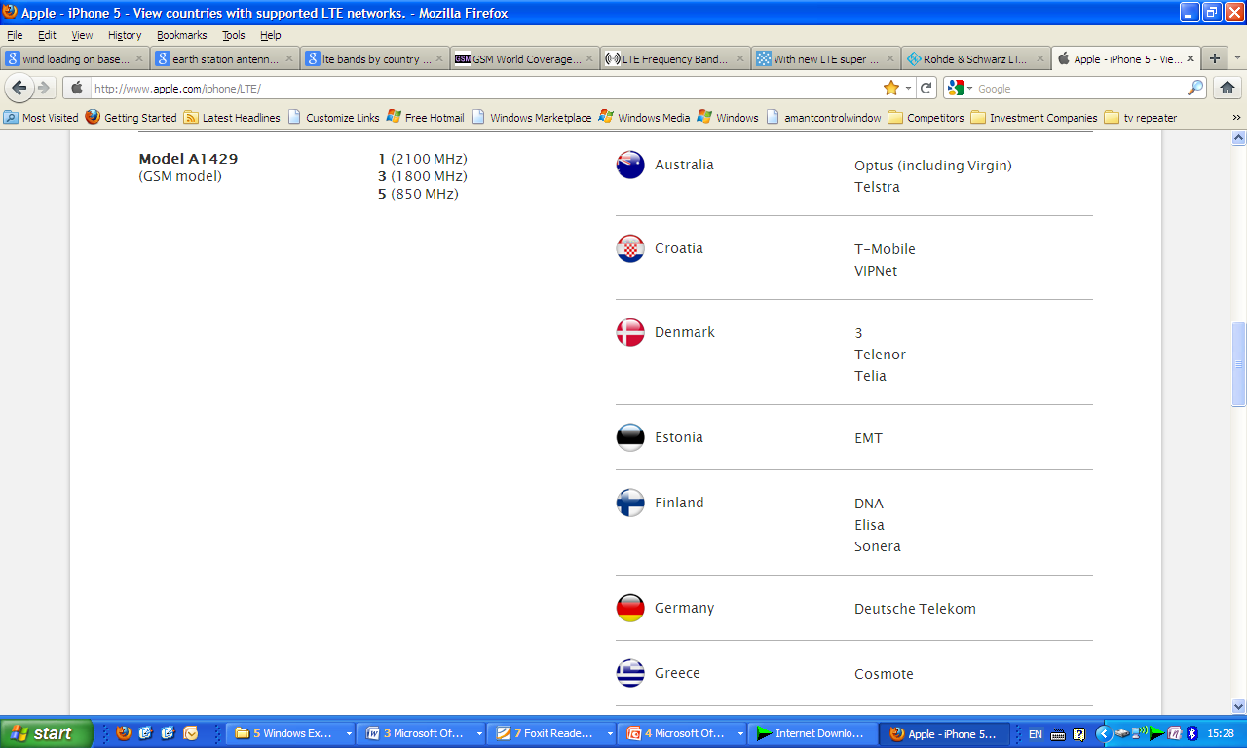
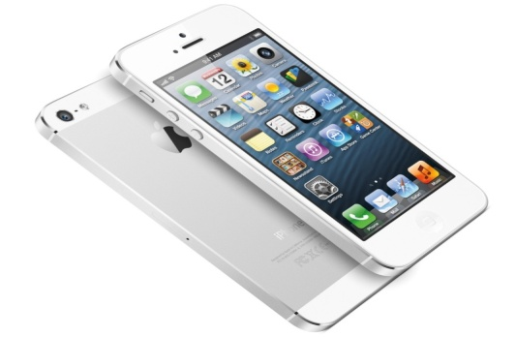
4G - Spectrum Fragmentation- iPhone-5
Different versions for different regions & different carriers

Slide 6
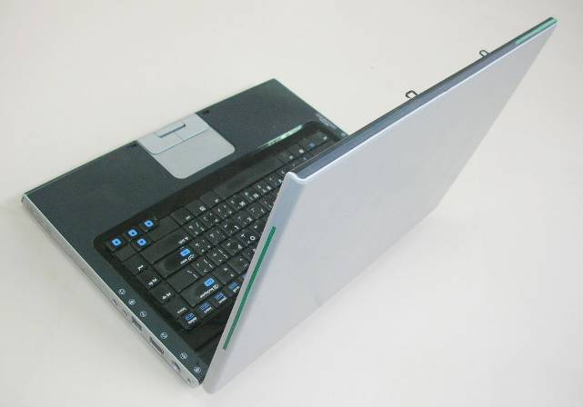
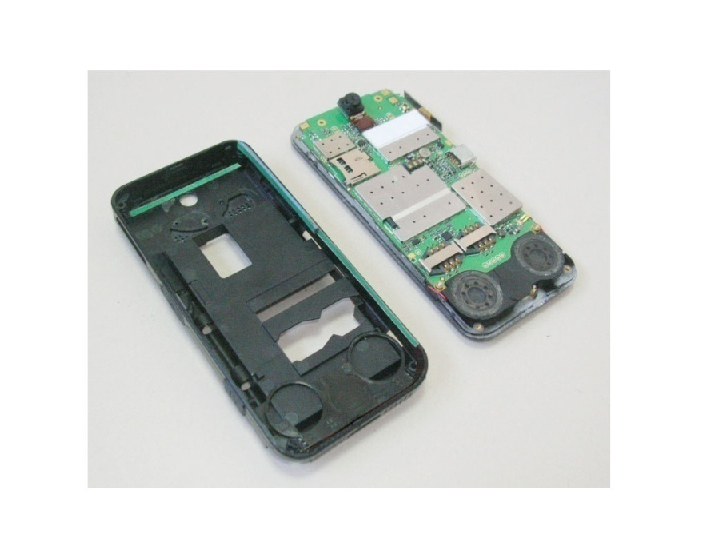
Novel LTE Wide band Antenna Technology
Two Antennas:
0.698 - 3.80 GHz
All 40 LTE bands
(4G + 3G + 2G + GPS + WI-FI + Bluetooth +--- etc.)
High-band antenna
Low-band antenna
High-band antenna
Low-band antenna

Slide 7
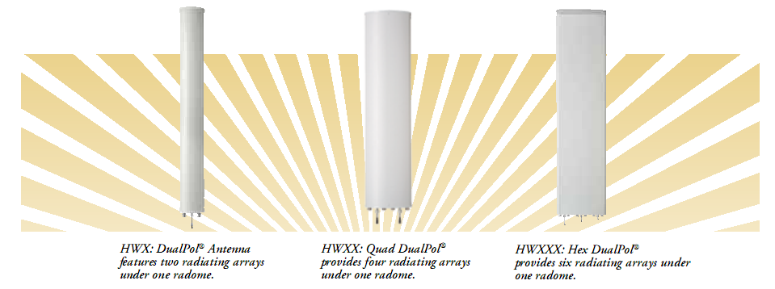
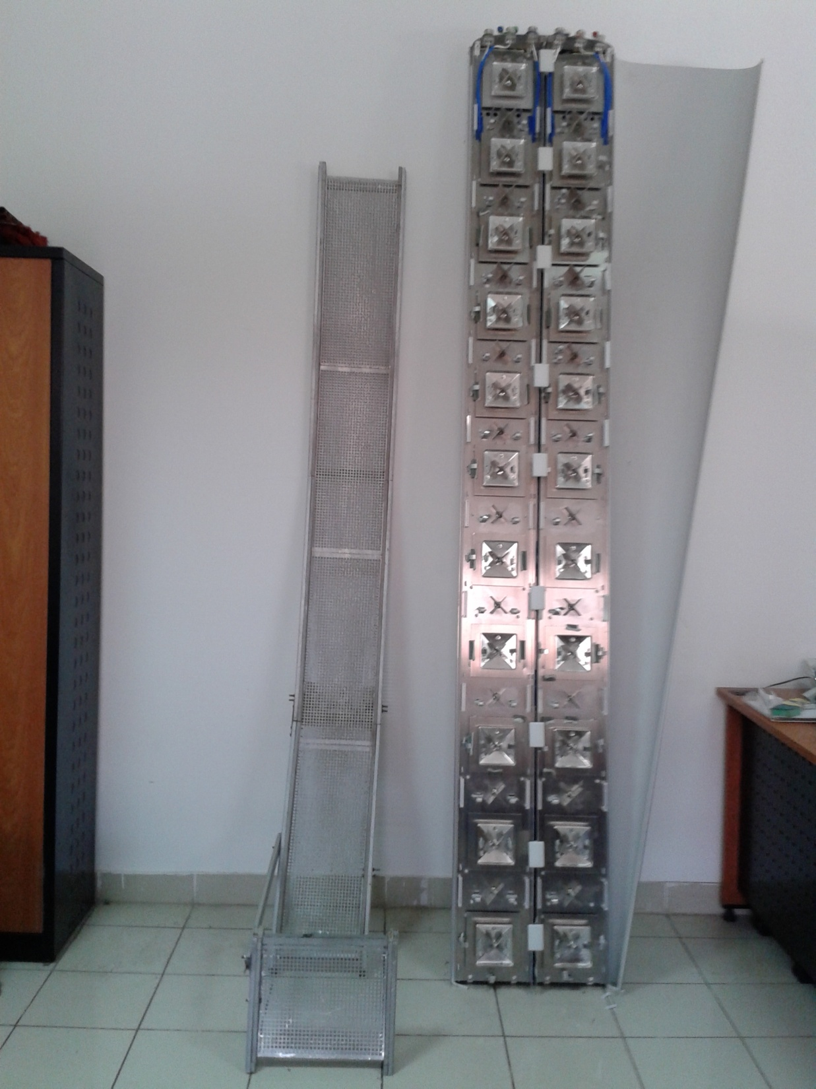
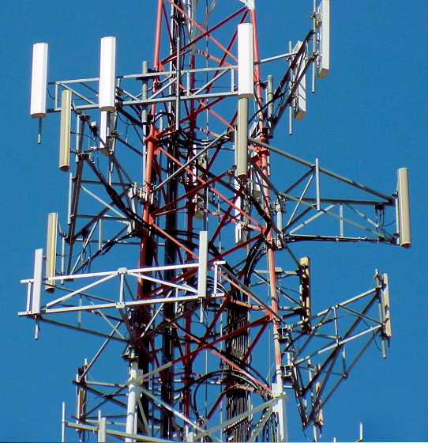
Current Base Station Antenna Problems in LTE
Narrow frequency bandwidth
Limited number of applications - No co-sitting
Cannot be upgraded - High cost
Heavy weight-Difficult to install(50 death accidents)
Complicated mounting towers - High wind loads
15 cm
30 cm
50 cm
56 Kg

Slide 8
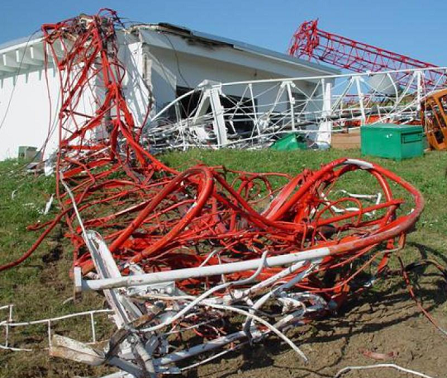
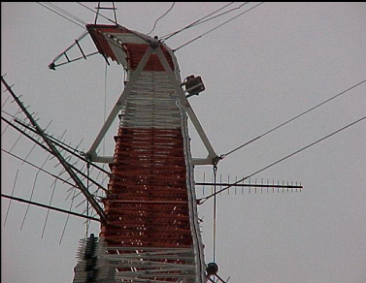
Current Cellular Towers Failure (heavy weight)
2003-2011,50 climbers were killed at cell sites in US
11 climbers died at AT&T sites.

Slide 9
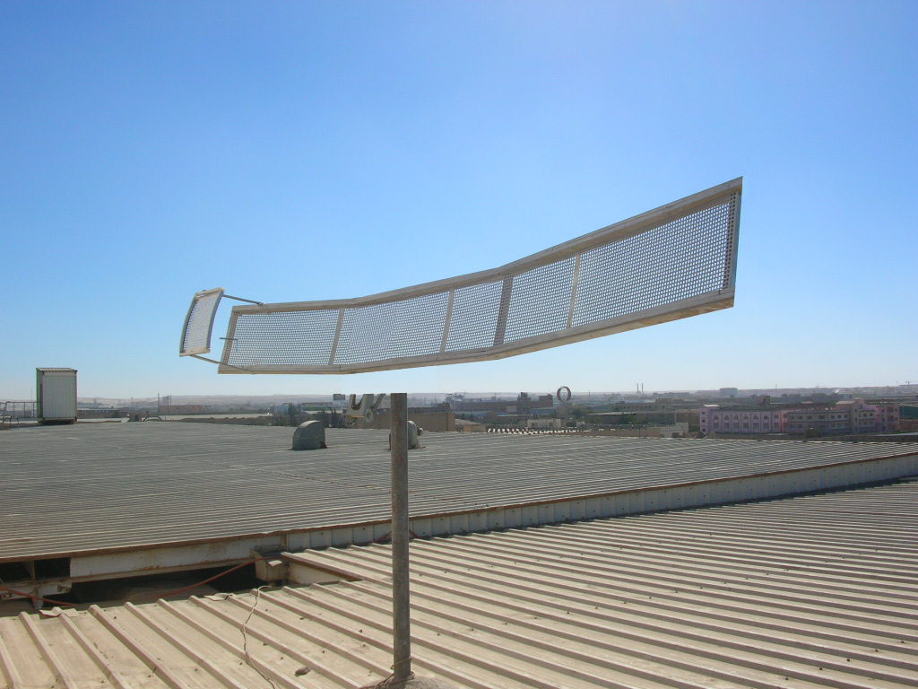
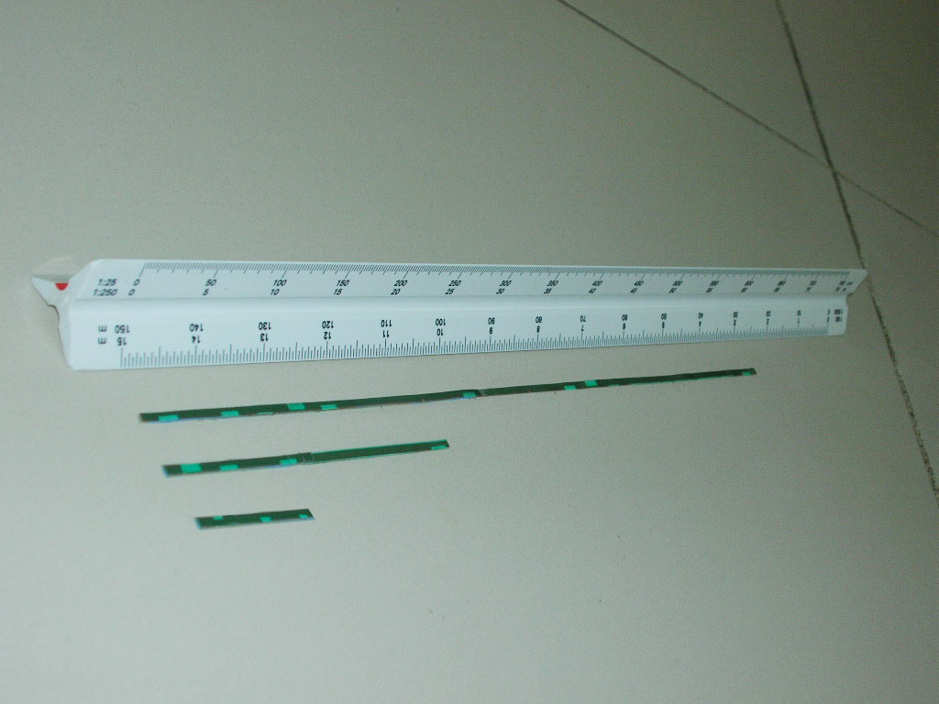
For the first time, covers any arbitrary number of frequency bands just by adding a new feed for each band
A Novel Base Station Antenna
Advantages:
Foldable / Deployable
Low cost – Easy to manufacture
Lightweight -Low wind-load
Simple towers – easy to install
No need for upgrading (2G +3G + 4G+ --- )
Any number of applications
Co-sitting
Different feeds

Slide 10
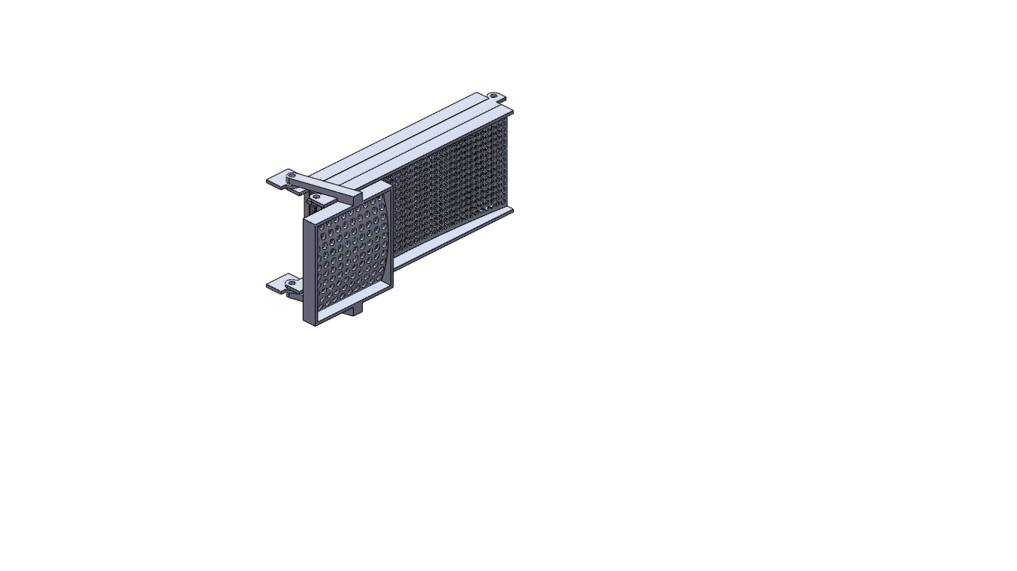
Folding Mechanism Animation

Slide 11
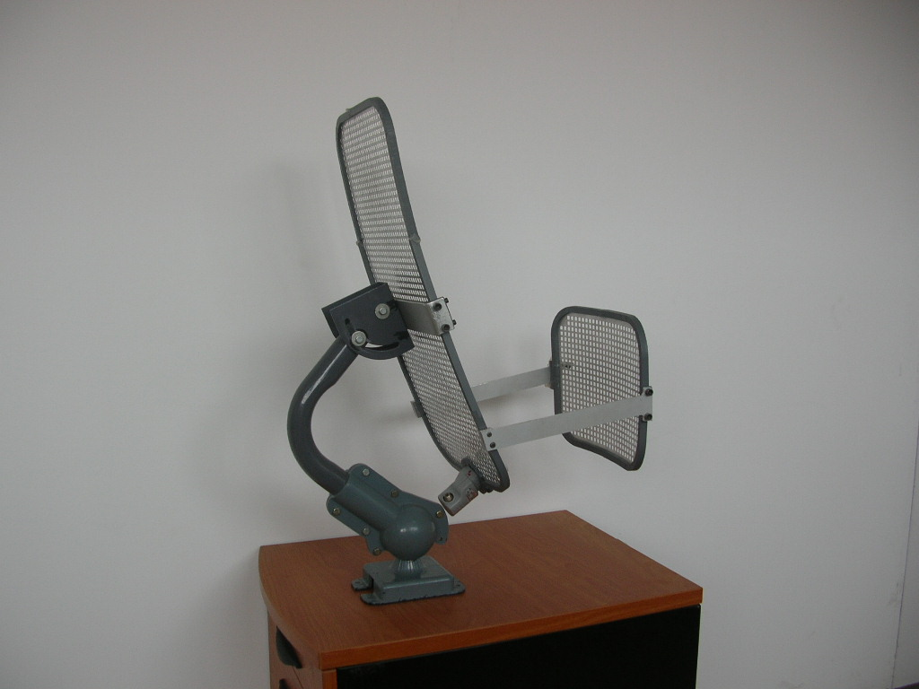
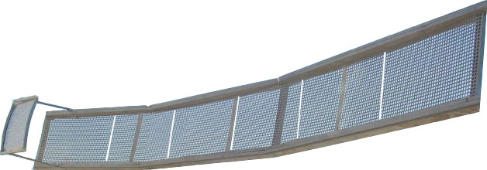
Other Applications
*Satellite TV Antennas
*LTE Backhaul Antennas *Biomedical Application Antennas
*Deployable Space Shuttle Antennas
*Deployable Satellite Antennas
*Earth Station Antennas

Slide 12
Future Benefits for the World
Each country will have only one network of base station antennas for all operators and for all (current & future) applications
Low-cost, high speed (4G) telecommunications infrastructure (especially developing countries)
Simple, low-cost, light weight mounting system, easy to install without any human risks
Enhances the efforts to develop new wireless technologies & new applications such as medical wireless applications

Slide 13
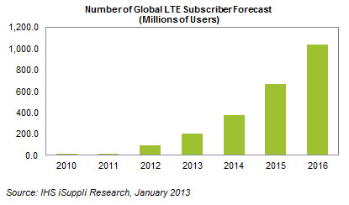
Global LTE Subscription Map
http://www.isuppli.com/Mobile-and-Wireless-Communications/News/Pages/Global-LTE-Subscribers-Set-to-More-Than-Double-in-2013-and-Exceed-100-Million.aspx

Slide 14
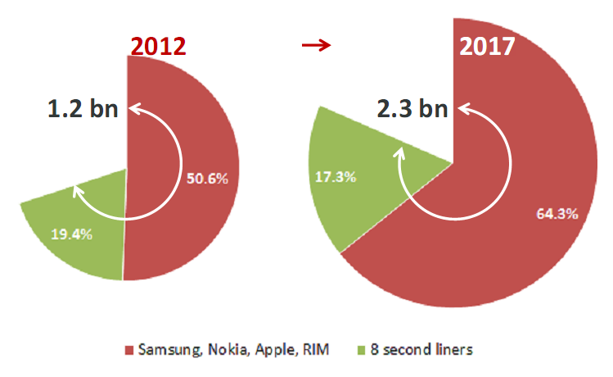
Smart phones - Market Size

Slide 15
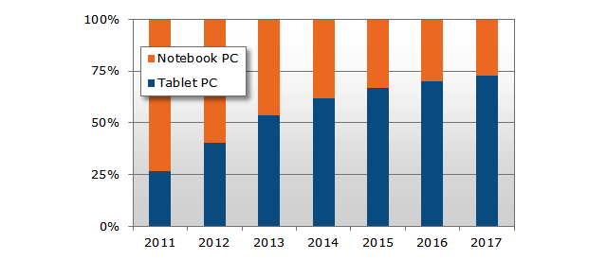
Tablets – Market Size
NPD expects 240 million tablets & 207 million laptops to ship in 2013 .
Source: http://www.displaysearch.com/cps/rde/xchg/displaysearch/hs.xsl/130107_tablet_pc_market_forecast_to_surpass_notebooks_in_2013.asp

Slide 16
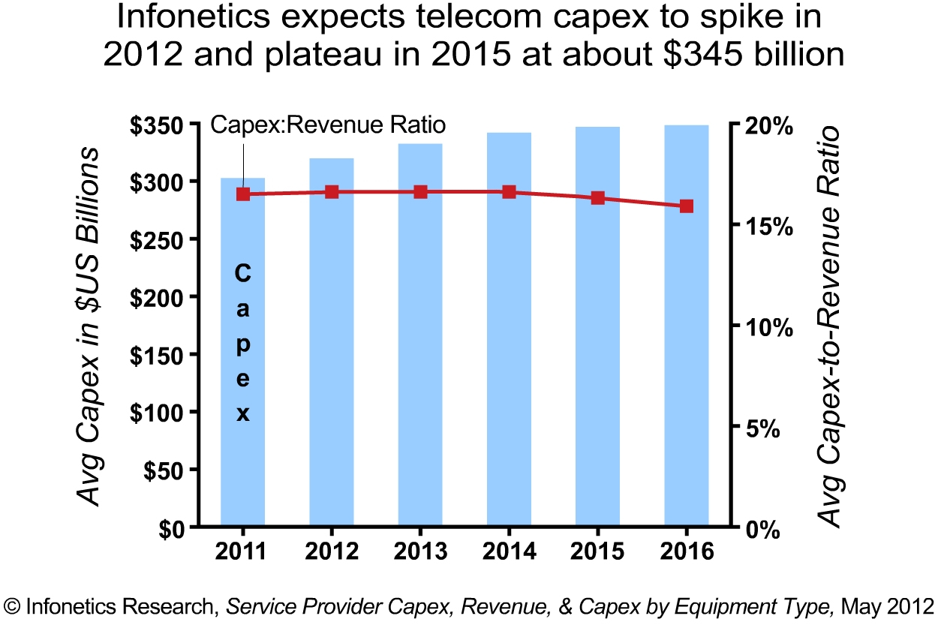
LTE Base Station - Market Size

Slide 17
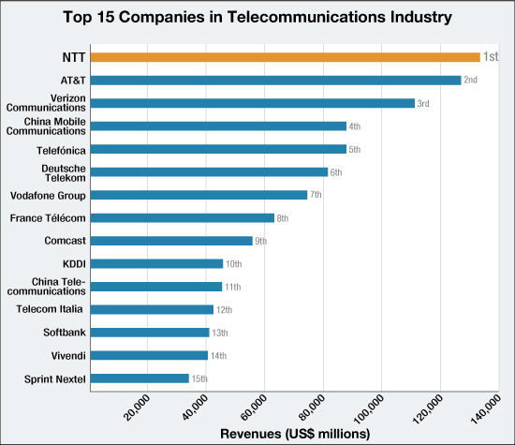
Base Station – Market Size
Source: Fortune Global 500 (July 23, 2012 issue)
http://www.au.ntt.com/en/about-us/awards-recognitions.html

