Slide 1



Slide 2
What Gap Are We Addressing?
WE TACKLE A PROBLEM IN THE $4 TRILLION
EDUCATION MARKET:
STUDENTS ARE NOT
MOTIVATED
TO EXCEL IN
THE CLASSROOM
& BEYOND

Slide 3







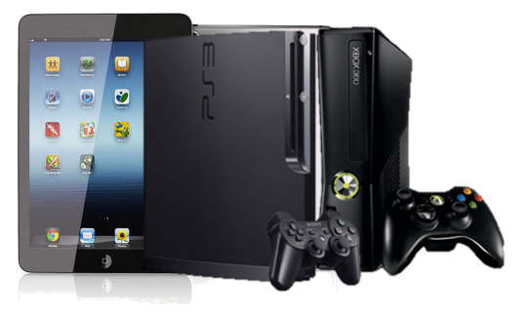

How Does it Work?
Student complete specific
tasks
Student is awarded Centsless points
Student redeems points or bid in auctions

Slide 4
1
Target Audience &
Market Size

Slide 5

Who is Our Market & Why?
Private & Public Schools
Institutions of
Higher Learning
They would be better equipped to engage their students.
Attendance, Homework & Assignments would be Gamified

Slide 6
Size of Our Market :
Anticipated Market Size :
(Urban students aged 8 – 20):
50 million (S East Asia)
130 million (S. East Asia+ East Asia)

Slide 7
2
Partners & Roll Out plans

Slide 8
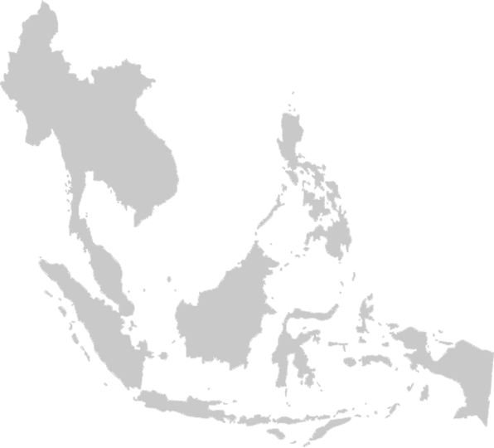

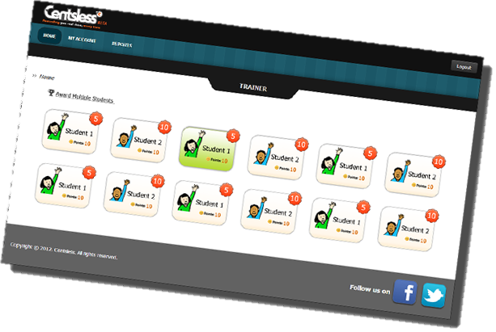



Cashville Kidz TV Series
Singapore
70 schools
Malaysia
8000 schools
Online & Offline Engagement
> 200,000 students

Slide 9
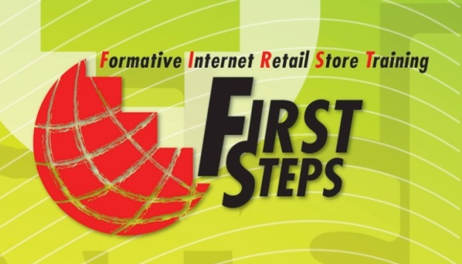

E-store management training
for schools
A program that is run by the Malaysian Technology Development Corporation (MTDC) that aims to promote student entrepreneurship.
100 schools
> 25,000 students
> 60,000 parents & friends
Notes:
This programme will reach out to about 100 schools in Malaysia

Slide 10
3
Revenue Streams, Financials and Growth

Slide 11
Revenue Streams
Centsless
Corporate Sponsorship
Subscription
(Learning Center)
Gifting
(Parents)
Loyalty Points Purchase
(Learning Center)
Notes:
We have four main revenue streams, direct purchase of points, sponsorships, Subscription, loyalty points purchase.

Slide 12
Forecast - Profit and Loss
Year
Notes:
We forsee a marked increase in profits after year 2, whiich we plan to expand to Indonesia and Thailand…

Slide 13
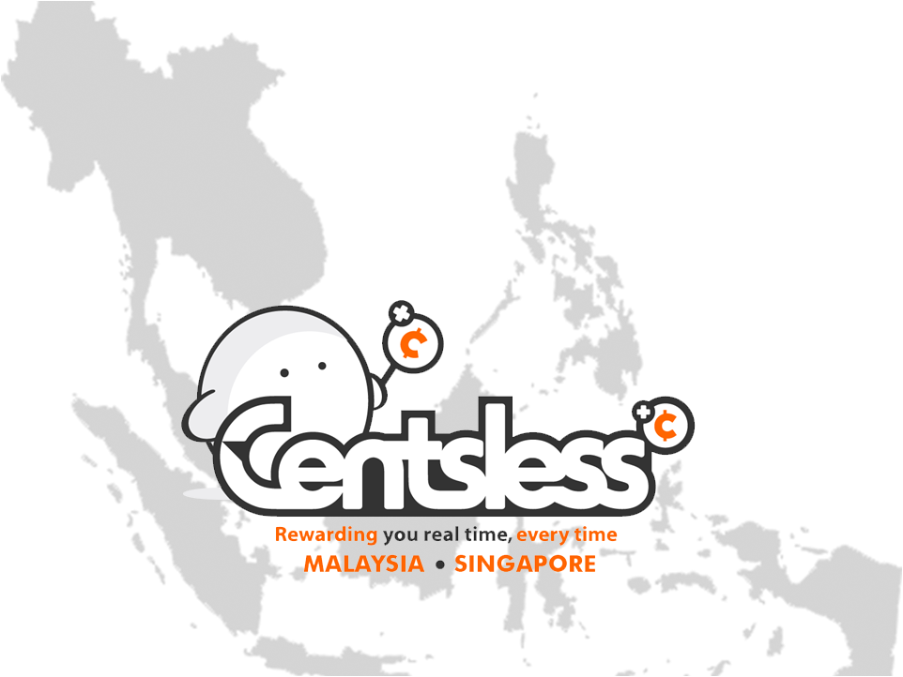



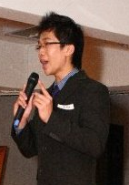

Centsless says Thank You!
Any Questions?

