Slide 1


Toni Maraviglia
Co-Founder/CEO
toni@enezaeducation.com
@tisfortoni
Notes:
Introduction:
Luo
I’ve been a teacher now
As you can see

Slide 2


Education Crisis in Kenya
9 Million Registered in Primary school
32% move to secondary school
EMIS Data 2011: Provided by the Kenyan Ministry of Education
Notes:
You don’t have to be a teacher

Slide 3
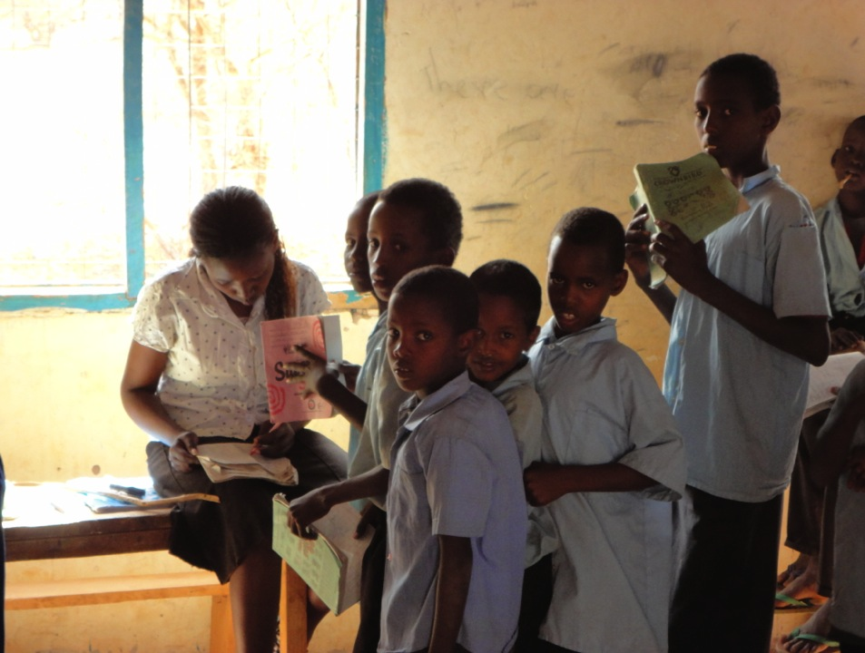
Why Kids Fail
Students receive little feedback
No access to quality resources
Notes:
From this picture you can see

Slide 4
Why Kids Fail
School
Students
Teachers
Parents
Gov’t
Little interaction amongst stakeholders
Data isn’t shared until it’s too late
Notes:
To make matters worse…
At Eneza, we aim to solve both problems by providing quality, individualized content and a way for information to be shared.

Slide 5

How the heck does it work?
Content-Aligned Quizzes and Lessons through mobile web and SMS/USSD
Why does a mammal’s red blood cell have no nucleus?
A) Never had one
B) Lost in its development
C) Not a true cell
D) Never needed one
Back < REPLY > Next
INCORRECT. A mammal’s red blood cell had a nucleus in the beginning of its development, but it was lost to make room for hemoglobin.
Back < REPLY > Next
Individualized Feedback
Notes:
How you ask?
Student products include
Everything here is also available on mobile web
Quizzes
Feedback

Slide 6

Quiz, Learn, Ask
Parents pay by SMS
(1/2¢ each) or by
Web subscription
($2-5/month)
Self-Assessment & Competition
You have received 80% on this quiz. You are ranked 5/101 at Baba Dogo and 239/1,234 in Nairobi.
Reply with Fert1 for next quiz.
Back < REPLY > Next
Mammals blood is made of red blood cells, plasma, white blood cells, and platelets. The red bloods cells do not have a nucleus because it was lost
(NEXT)
ASK Why are there so many red blood cells?
Back < REPLY > Next
Mini Lessons
Ask a Teacher Feature
Notes:
Competition
Mini lessons
Ask a Teacher
Who pays for it? Parent!

Slide 7

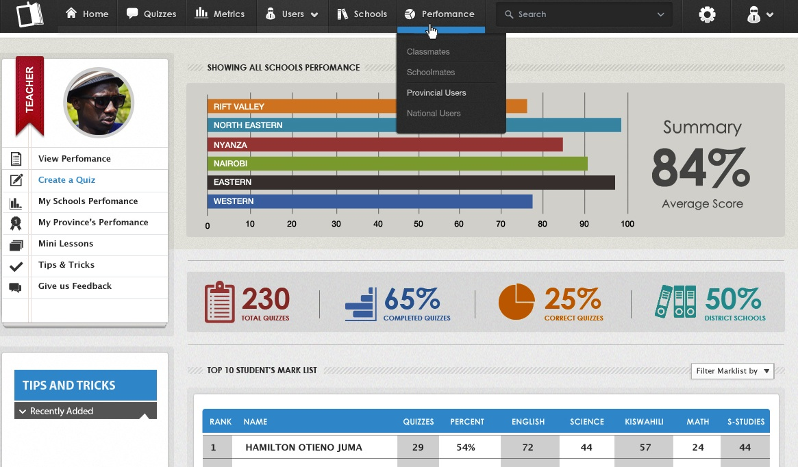
Analytics teachers always wish they had…
Content + Data
Parents = $5/month
Schools = $40/month
VIP (>2 schools) = $100+ / month
Notes:
Through mobile and web applications parents + teachers can also subscribe to data and help content.
We have VIPs who elect for further schools, and we’ve also had many asks to be a distribution channel for content

Slide 8
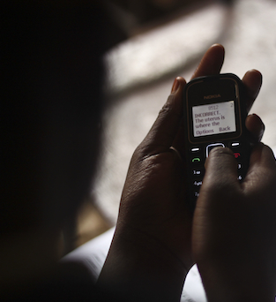
A bit of traction…
12,000 Students (paying)
Presence at over 400 schools across Kenya
20 Schools subscribed
1,000+ Head teachers in VIP account
Our students have marks 9% higher than average

Slide 9



People Behind Eneza
Educational Engine
Toni Maraviglia, CEO
Peter Sereti, Community Rel’s
Rahab Njuri, Content Mgr
25 Teacher Content Creators
Advisors
Wendy Kopp, Teach For America
Chaula Gupta, TFA
Shabnam Aggarwal, Pearson India
Joseph Karuga, KEPSHA
Lydia Muchemi, Ministry of Education, Kenya
Technical Wizards
Kago Kagichiri, CTO
Moses Mutuku, Developer
Joe Okatch, Developer
Operational Ninjas
Chris Asego, Operations Director
3 Community Relations Coords

