Slide 1


Discover everything about tomorrow.

Slide 2
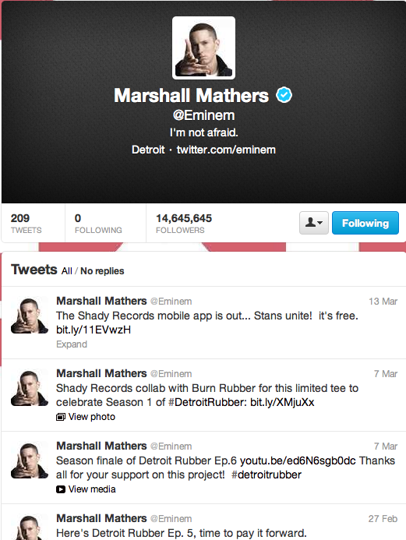
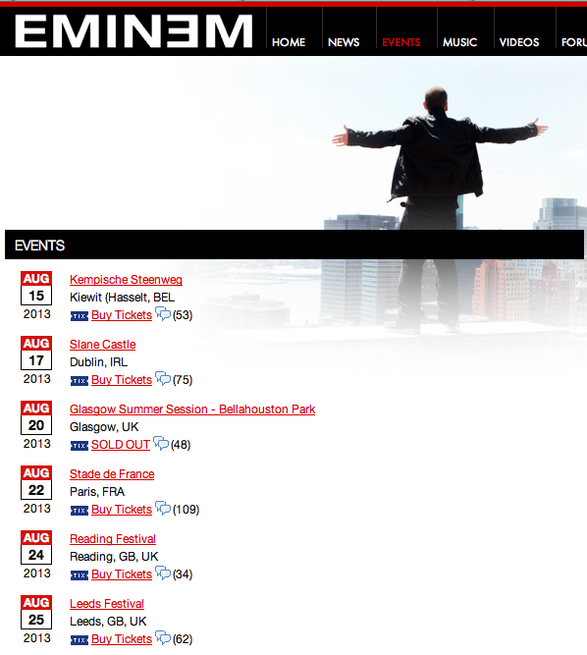
Discovering Eminem’s events
Social Media
Websites

Slide 3
The coolest way to discover events & activities.

Slide 4
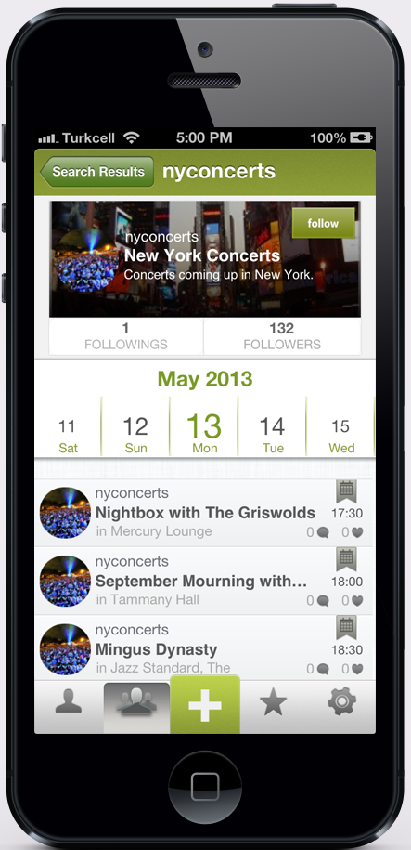
Follow your interests to discover upcoming activities of them.

Slide 5
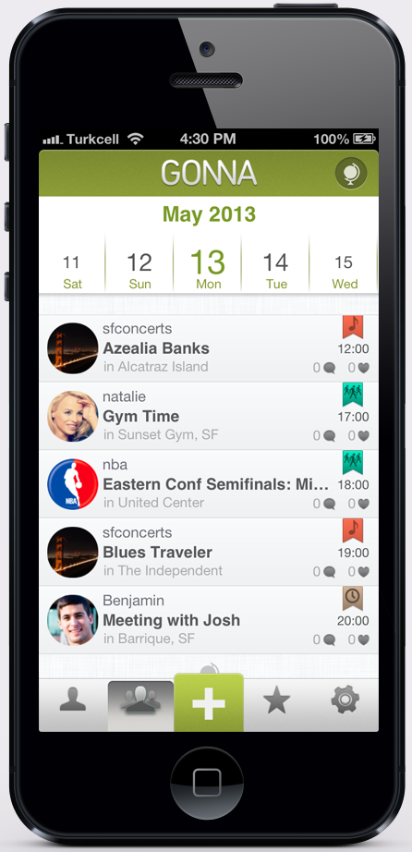
A gorgeous social calendar organized around your interests.

Slide 6
2 months
10000 downloads
60000 activities

Slide 7
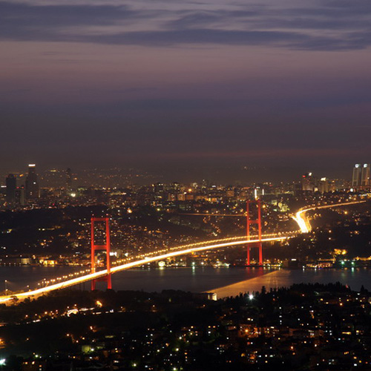

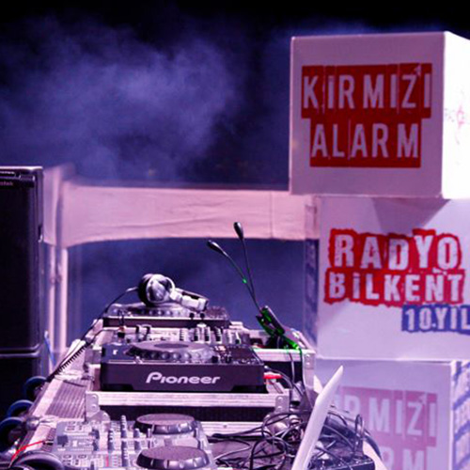
What kind of content?
istanbulkonserleri
1323 followers
Concert calendar of Istanbul
Galatasaray
750 followers
Galatasaray SK football & basketball schedule
96.6 Radyo Bilkent
260 followers
Radio Bilkent’s schedule

Slide 8

MIT EF BPC 2012

Slide 9
Discover everything about tomorrow.

