Slide 1
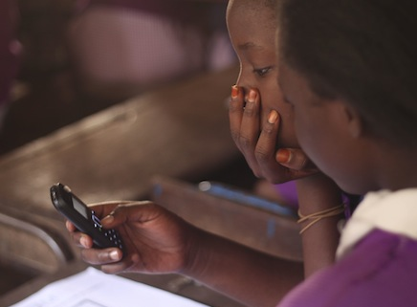

Toni Maraviglia
Co-Founder/CEO
toni@enezaeducation.com
@tisfortoni
Notes:
Oya wore uru. Good morning everyone.
My name is Toni Maraviglia, I’ve been a teacher for the past 8 years, and as you can see, I speak a bit of Luo Tribal language after living in a rural part of Kenya for a year.
I’m here to share the story of Eneza, (formerly MPrep) for an entrepreneur’s perspective. But I’ll let you in on a little secret…

Slide 2
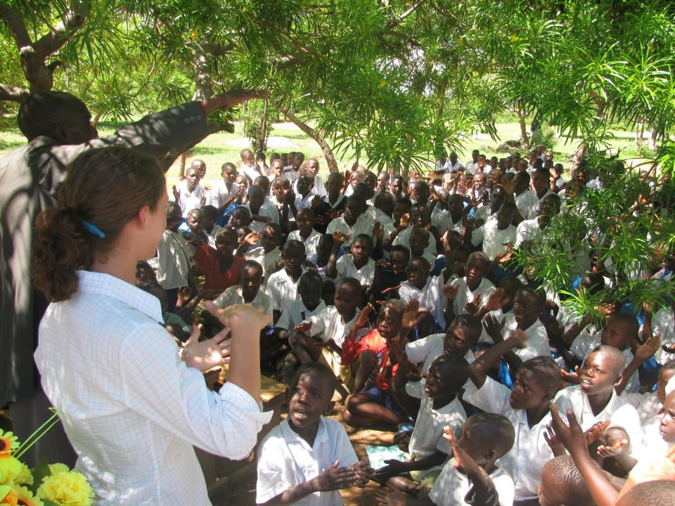
Notes:
My story begins in 2008 in the rural community of Muhuru Bay Kenya. 4 years into my teaching career, I had the amazing opportunity of starting a programme for primary school students to pass their exit exams. Only 14% of kids in the community usually passed.

Slide 3
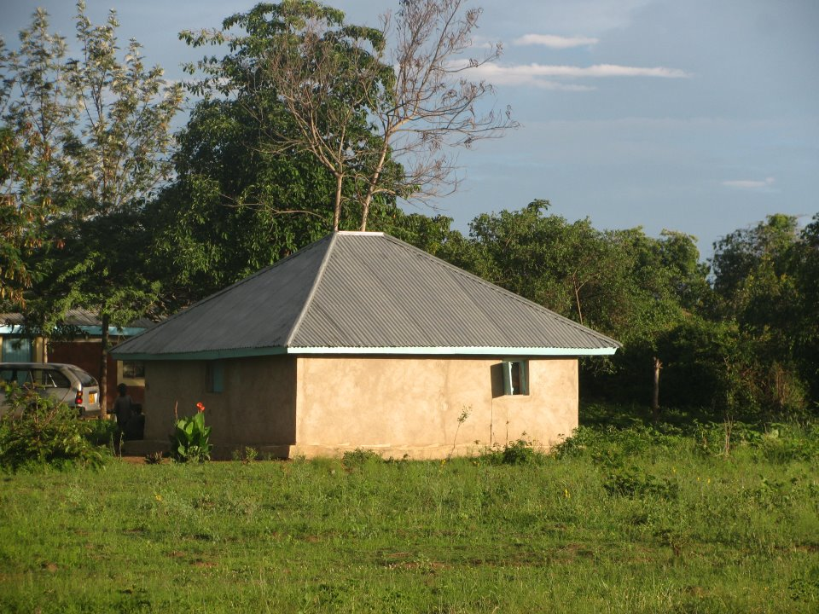
Notes:
And as anyone living in rural Africa understands, the living conditions were not exactly modern. This was my hut and home, my dala from 2008-2009, and it affected me greatly.

Slide 4
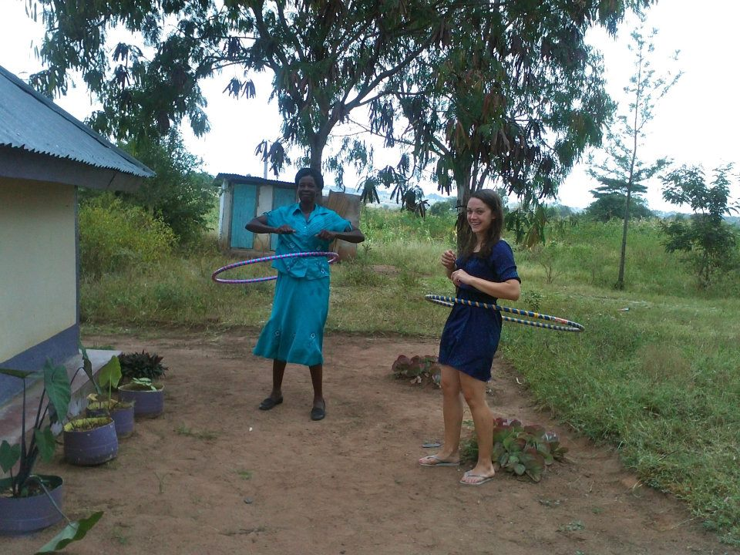
Notes:
There’s my mama right there, an expert hulahooper and amazing lady, who made excellent fish. We had no electricity, no running water, and somehow, she always managed to get this mzungu hot water for bathing in the morning.

Slide 5
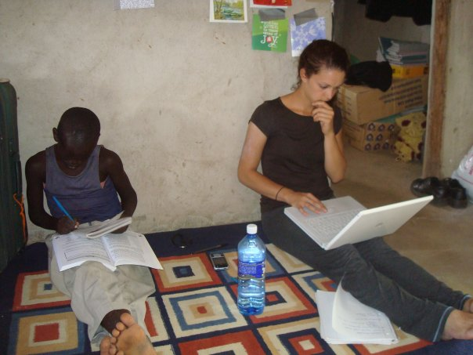
Notes:
And in the hut was the greatest influence on me, my brother Daniel, a Class 7 boy with the persistence to do well in school. But despite all my hard work in the community, and despite raising the passing rate of primary school students to 48% passing by 2010, Daniel still failed his exams.

Slide 6
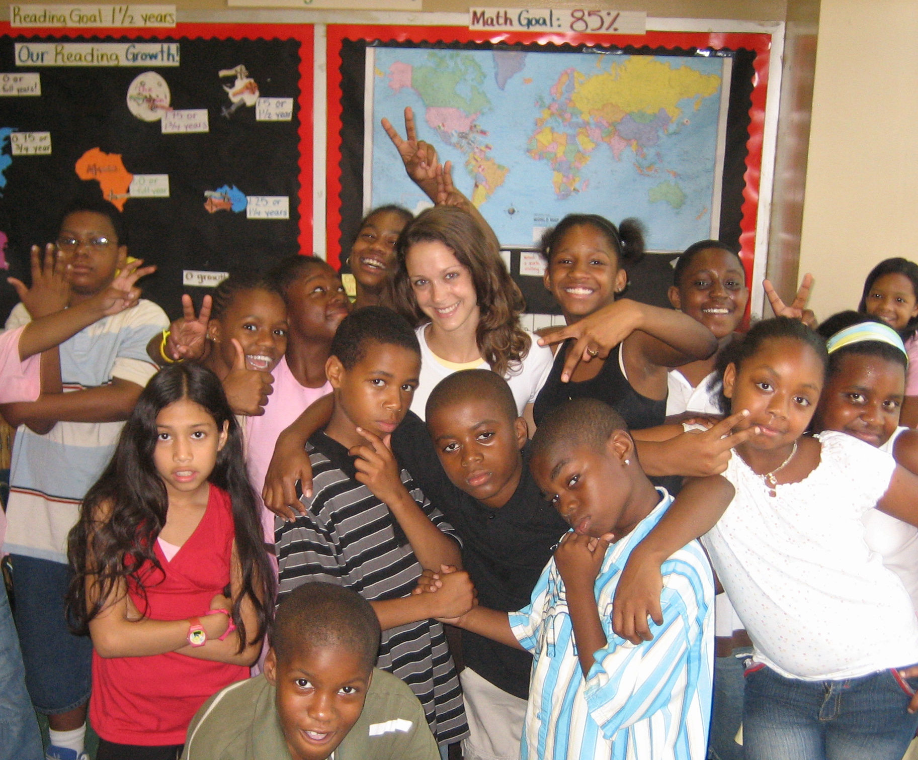
Notes:
I went back to the US in 2009 and was teaching again for a few years. By 2011, it was time for me to return to Kenya, to my second home, to mama, to Daniel, to the hut and see what was happening.

Slide 7
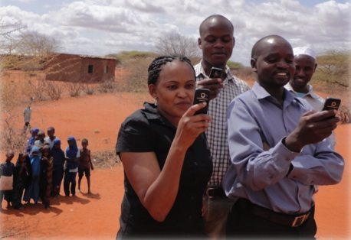
Notes:
And boy. Was Kenya a different place. Yawa! Phones! Phones everywhere. Even in the most rural of areas. And as I started pitching my educational ideas to those in Nairobi, I was soon challenged, “Why don’t you build a mobile phone app in education? You’re really passionate about it!”
First thing I thought: NO! Teachers don’t like technology. “Well, why don’t you help create something you would use?” So, I did. If there’s one thing that students loved in my classroom, it was showing what they knew on nuanced topics, and if there was one piece of data that helped me as a teacher, it was the data from formative assessments. Eneza is based on this first idea.

Slide 8

What the heck is Eneza?
Content-Aligned Quizzes and Lessons through mobile web and SMS/USSD
Why does a mammal’s red blood cell have no nucleus?
A) Never had one
B) Lost in its development
C) Not a true cell
D) Never needed one
Back < REPLY > Next
INCORRECT. A mammal’s red blood cell had a nucleus in the beginning of its development, but it was lost to make room for hemoglobin.
Back < REPLY > Next
Individualized Feedback
Notes:
Since many people ask, this is just a brief idea of what it looks like. We started by taking all of the national content, creating interactive quizzes and mini lessons through SMS, and included individualized feedback.
Teacher’s dream, let me tell you. It was like a mini teacher was sitting on the shoulder of each kid. Instead of starting all fancy, we used the simple technologies first. Texts.

Slide 9
Quiz, Learn, Ask
Self-Assessment & Competition
You have received 80% on this quiz. You are ranked 5/101 at Baba Dogo and 239/1,234 in Nairobi.
Reply with Fert1 for next quiz.
Back < REPLY > Next
Mammals blood is made of red blood cells, plasma, white blood cells, and platelets. The red bloods cells do not have a nucleus because it was lost
(NEXT)
ASK Why are there so many red blood cells?
Back < REPLY > Next
Mini Lessons
Ask a Teacher Feature
Notes:
Super simple, quiz, learn, ask. Kids can compete against one another, engage in mini lessons on topics they fail, and even, ask teachers questions based on what they’re studying.
We’ve since expanded our platform up in technology to include mobile web apps that look a little something like this…

Slide 10

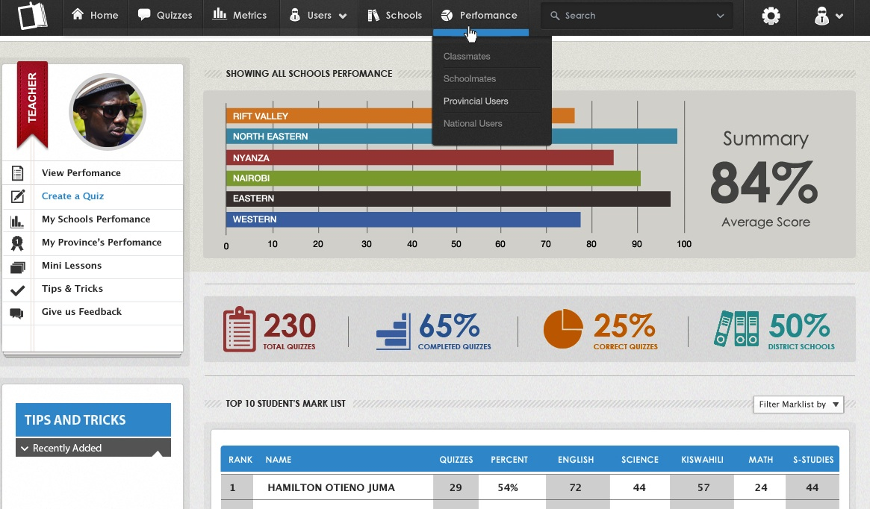
Analytics teachers always wish they had…
Notes:
For teachers, it includes analytics we wish we always had. Students can engage in additional local content via the webt. At this point, we’re now building a network to become the largest educational network in Kenya. I’m pretty excited about it. And I’m incredibly excited to share my story with you. I’ll tell you though. Being an entrepreneur in Kenya is not all that glamorous. I think many people don’t understand it.

Slide 11
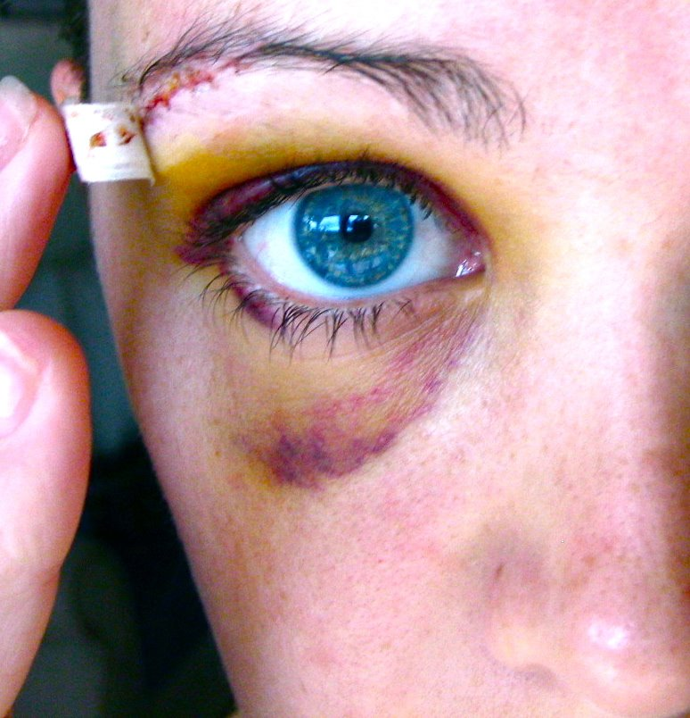
“Without struggle, there would be no progress.”
– Frederick Douglass
Notes:
About a year ago, my company was broke, I was exhausted, and I was hit by a small bus called a matutu, for those of you who know Kenya well. To make matters worse, I was then dragged across a road at gunpoint 6 days later when 2 thugs robbed me. Those were dark times for me. But, “without struggle there would be no progress.”

Slide 12
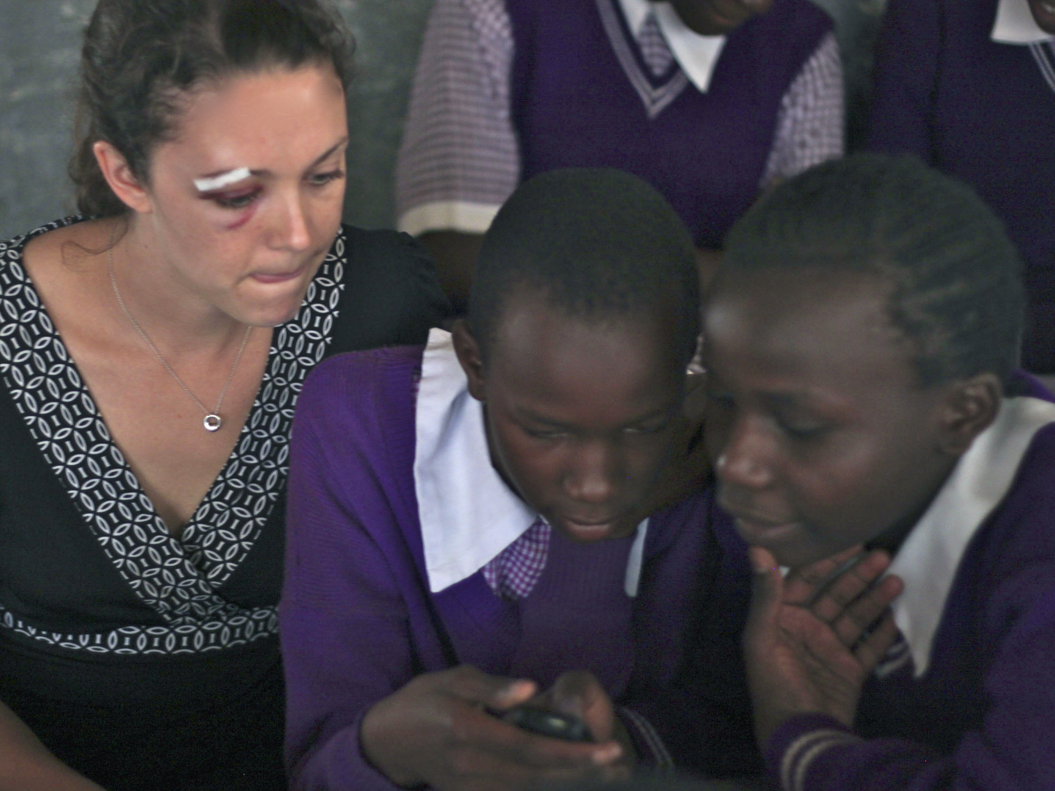
Notes:
But like any entrepreneur, I was back in the field with the kids the same day. Why do I share this with you when I could just be sharing our successes? Being an entrepreneur is not just about pitching to investors or flying to new locales or having big launched of your product. It’s about digging down deep, working until your brains, hands, and feet are about to fall off, listening to your customers and team,. You must brush your teeth in airports, wear holey socks and cover up the circles under your eyes. You must struggle, you must get back in there in the face of challenges. Why?

Slide 13
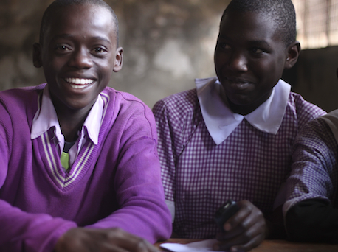
Notes:
For me, these kids are 100% worth it.

Slide 14
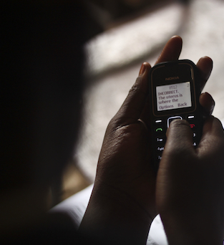
Success?
12,000 Students (paying)
Presence at over 400 schools across Kenya
20 Schools subscribed
1,000+ Head teachers registered
Our students have marks 9% higher than average
Maybe
Notes:
Sure, we’ve had some great successes over the past year and a half. 12,000 students, presence in over 400 schools, proven impact. But, this is really only a maybe for me.

Slide 15

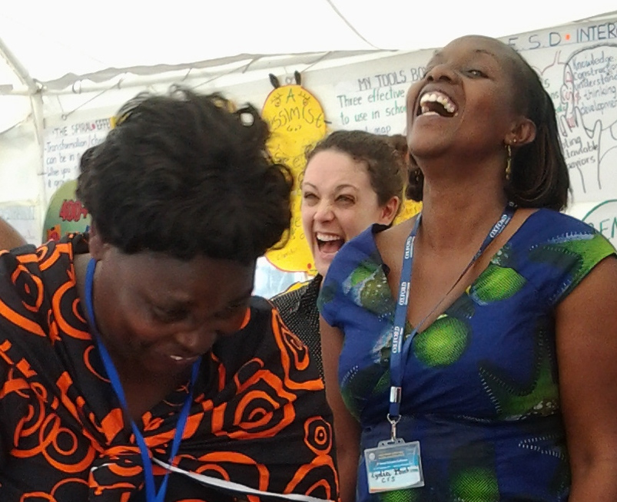
Private Partnerships
Public Partnerships
Notes:
Help from our partner, Safaricom and the Ministry of Education has really helped.

Slide 16
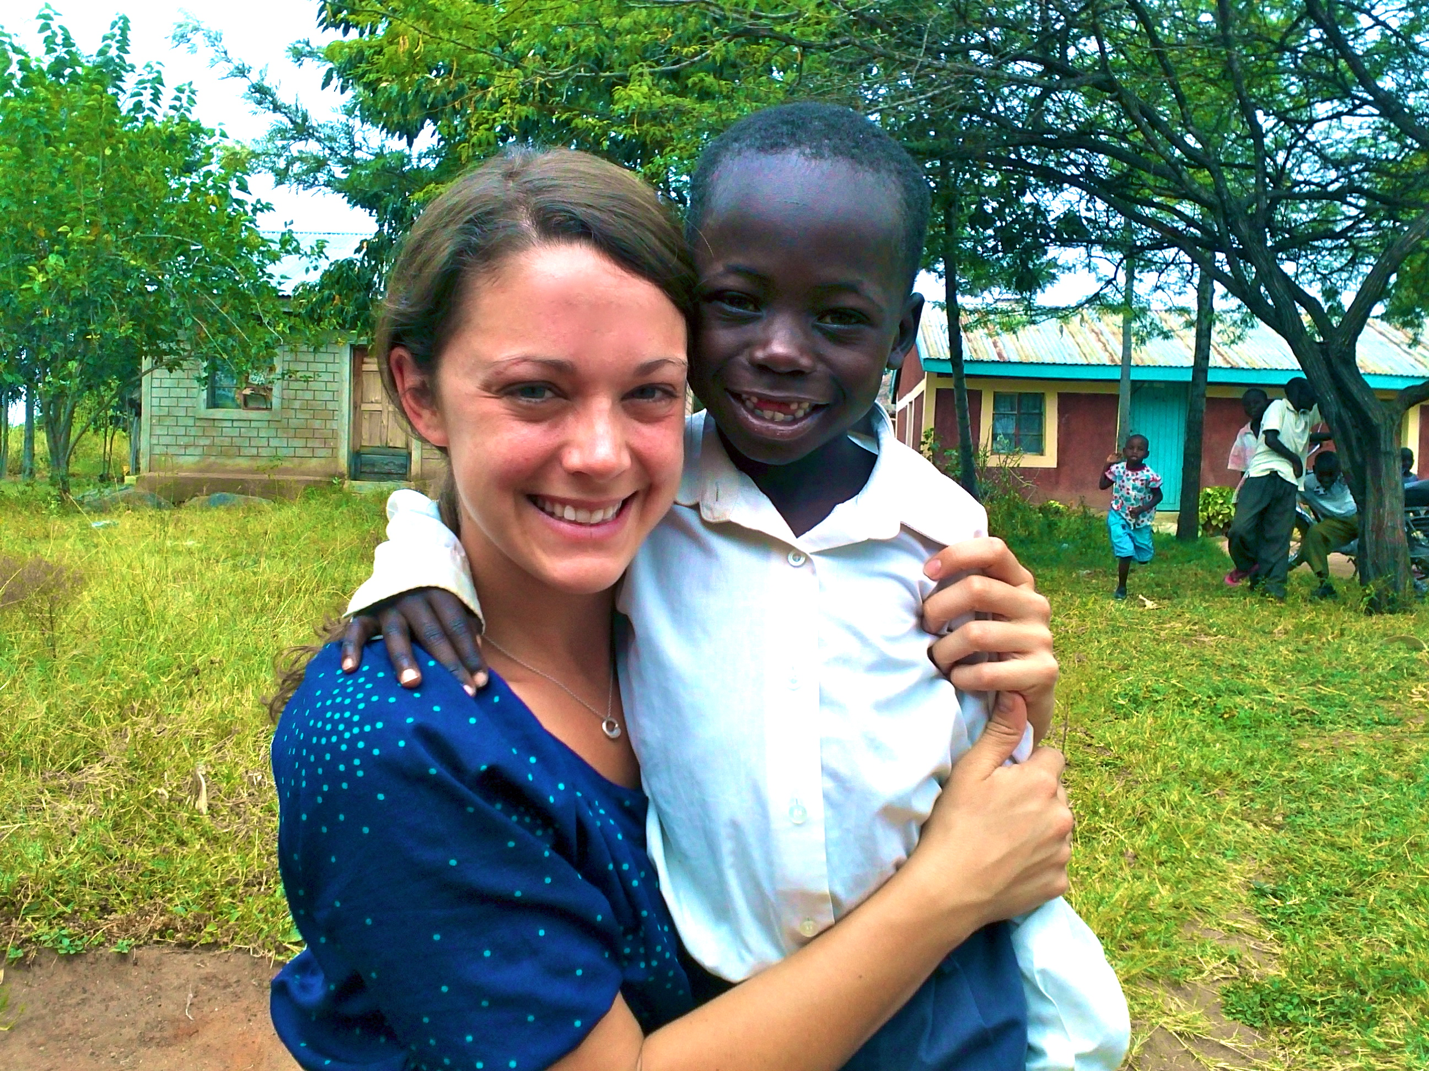
Notes:
And personally, so has the support from the support of my Luo family, especially this little guy, nicknamed “Young.” Being an entrepreneur is no longer about me or the company being successful. Of course, paying dividends to our investors will eventually help. For me, Eneza is more than that. We’re demanding that kids in the unreachable parts of the world get the basics, the educational opportunities, the critical understandings that they rightfully deserve.

Slide 17
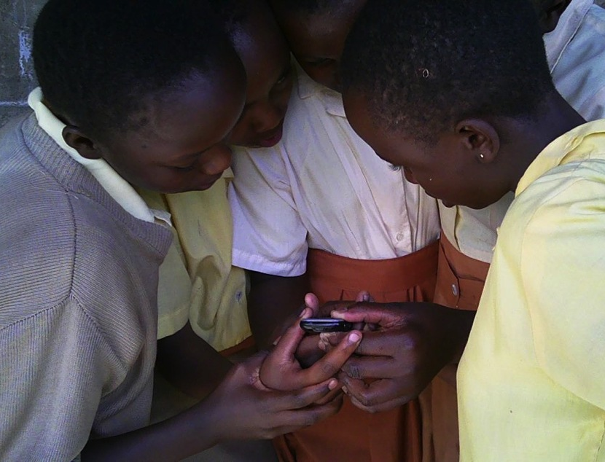
Notes:
For me, gaining a first-hand perspective, struggling until you’re ready to give up, and fighting for what you believe in is what being an entrepreneur is all about. Ero komano ahinya. Thanks for letting me share my story.

