Slide 1



Solutions for Mobile Recruitment
By:
28 May 2013
Notes:
Use only Segoe UI Light font

Slide 2

AFRICA’S LABOR FORCE
1
1.1B
2040
720M
7 years -2020
500M
Today
mPawa
Notes:
Use only Segoe UI Light font

Slide 3
Blue Collar Workers
2
35% Labor Force
Change jobs 4 times each year on average
mPawa
Notes:
Use only Segoe UI Light font

Slide 4












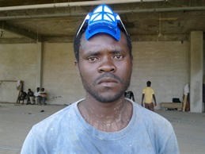













Slide 5
Inefficient Labor Market
Job Seekers | Employers
No documented track record Long queues for new jobs Reliance on word of mouth Lack a tool to market themselves | Challenge finding the right employee No central location to easily access blue collar staff Project delays & high recruitment cost
mPawa
Notes:
Use only Segoe UI Light font

Slide 6
Mobile job matching application built for blue collar recruitment in Africa leveraging web to SMS to deliver instant job notifications to job seekers while presenting employers with a centralized location for easy access to job seekers
b
mPawa
Notes:
Use only Segoe UI Light font

Slide 7



mPawa Platform
3
55 Employers
620 Placements
12,000+ Job Seekers
mPawa
Notes:
Use only Segoe UI Light font

Slide 8
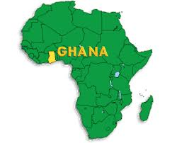
Growth & Scalability
6
Nigeria
Kenya
South Africa
Uganda
LinkedIn for Blue Collar Workers in Africa
Senegal
mPawa
Notes:
Use only Segoe UI Light font

Slide 9

Thank You
mPawa

Slide 10



Follow us:
www.mpawa.com
twitter.com/mpawa_africa
facebook.com/mpawa.africa
mPawa

Slide 11
Q&A

