Slide 1

Khaya Power
Billy Hadlow
Notes:
Add image of someone using your product etc..

Slide 2
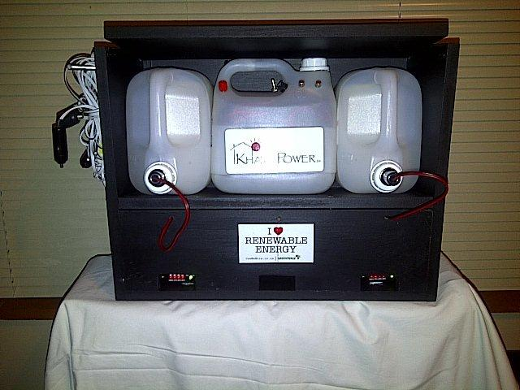
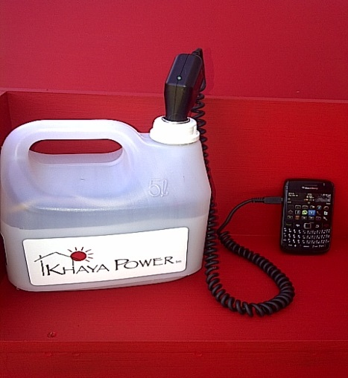
What is Khaya Power?
Innovative energy solution for rural and decentralized populations in South Africa
Provide energy access and an alternative lighting source to paraffin and candles
The product:
  A 5 liter container is revamped with a battery
  Charge via solar
  220 volt and Dc power.
Notes:
In point 1: Describe your story here i.e. seeing a girl studying under lampost – your motivations etc..

Slide 3
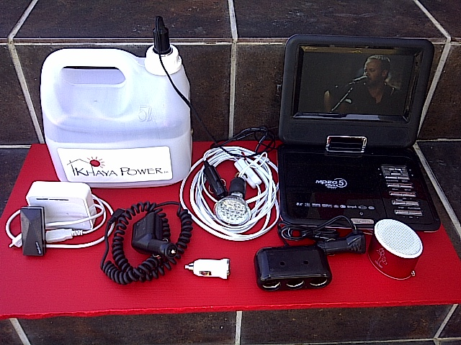
Business Model The Market
Khaya power is Rental based/Deposit paid.
Recharged units exchanged for $1
Accessories are sold at the “Agents”.
Charging stations powered by Solar Panels or 220 volts is made available at “Agents”
Customers save 2 to 4 litters of paraffin per week.
Customers save up to $3 per week on Charging cell phones.
Informal settlement's
Schools
Rural areas
Taxis and public transport
Leisure Market

Slide 4
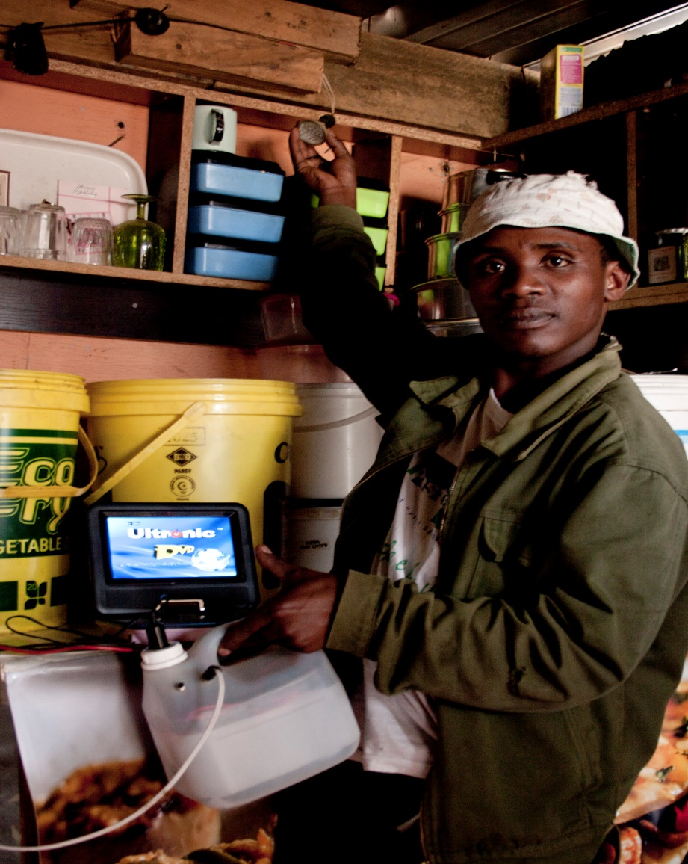
How is the business model innovative?
The power pack can run various small 12 volt dc devices i.e. LED lights, cellphones, radio, shower, rodent repellant, Wi-Fi router and more)
  Security and electronics to control the use and protection of the battery so it can only be charged at a Khaya charging station
Units are exchanged once the unit’s power is depleted.
Khaya power has a cellphone based fault reporting system on each unit for Maintenance and Repairs.

Slide 5
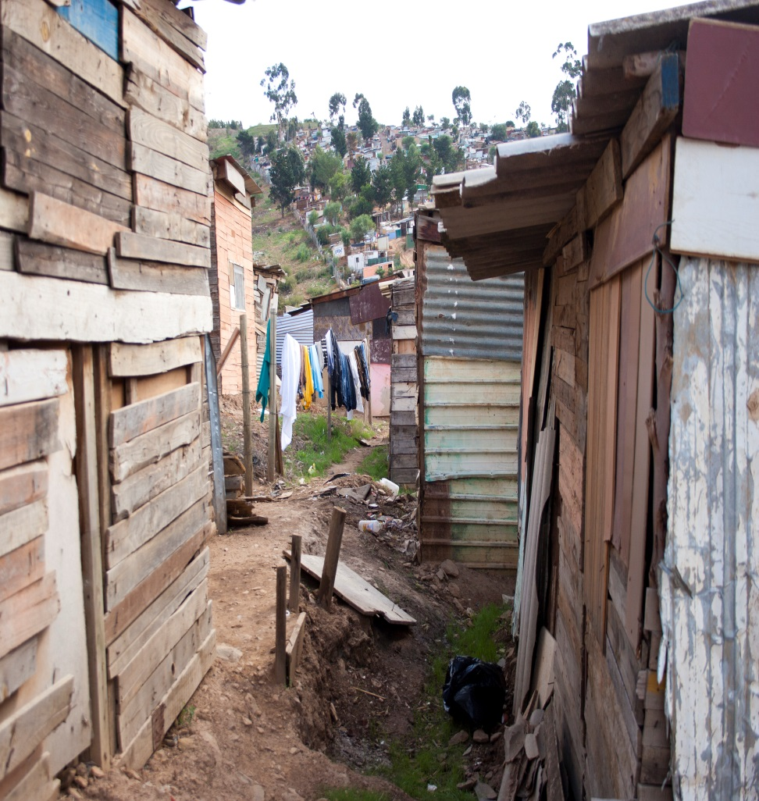
Challenges
Customers are Poor
Habits are hard to Change
Keeping the business sustainable and building a distribution network.
Funding to role out Khaya power in numbers
Keeping units robust and simple to operate

Slide 6
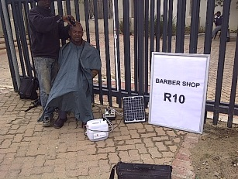
Opportunities
Job Creation – encourage micro and small enterprises in rural communities i.e. sell data through wifi router, barber shop etc..
Ability to send and sell units
Issue of maintenance and repair addressed

Slide 7
Thank You

