Slide 1

Global Forum on Innovation & Technology Entrepreneurship

Slide 2
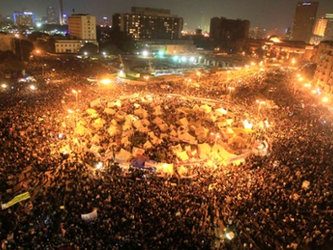

Slide 3


66% of Arabs under the age of 35
80% of online queries are in Arabic
3% of online content is Arabic
35% is the growth rate of digital ad spend

Slide 4
Content maybe King; but Local Content is KING KONG!

Slide 5

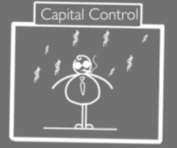

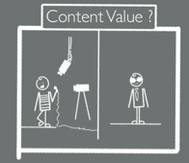

What Wakes Us Up Everyday…

Slide 6


The Magic Formula… (don’t cheat)
CROWD-SOURCED CONTENT PRODUCTION
Qabila Academy (increasing & filtering talents pool)
Qabila Short Film Festival (high-end & talent-centered production)
CREATIVITY & PASSION
Young team that breaks through the clutter
A culture of innovation that empowers (everyone does what he/she loves)
COST-EFFECTIVE GORILLA PRODUCTION PROCESS

Slide 7

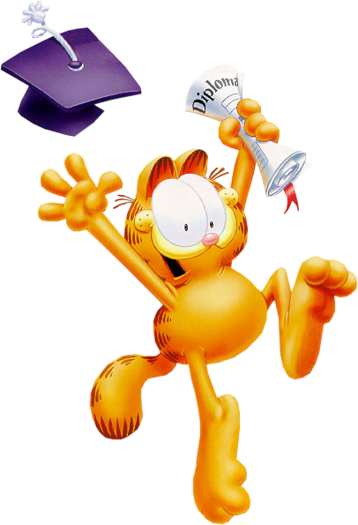


Show Me The Money!

Slide 8

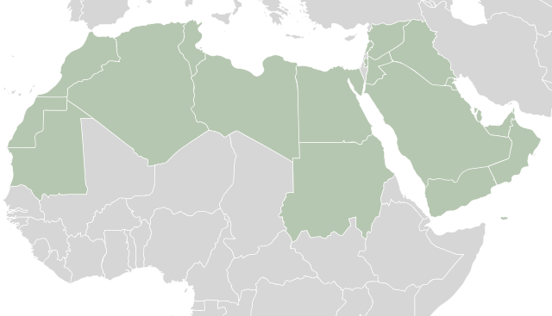

An Arab League of Our Own!

Slide 9














Yeaaaaah Baby….
99% Growth in Revenues

Slide 10


Slide 11

People Love Us!

