Slide 1


Slide 2


CROWDFUNDING INVESTMENT PLATFORM FOR HIGH-GROWTH STARTUPS IN AFRICA

Slide 3
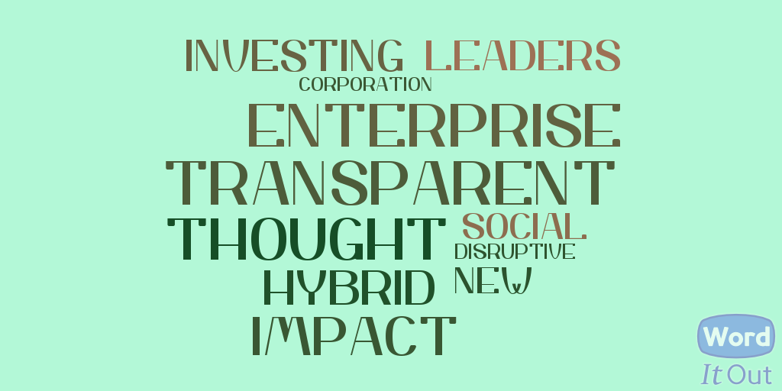

Slide 4
WHAT’S ALL THE NOISE ABOUT STARTUP FUNDING?
Startups are innovating in fields as diverse as education, agriculture, and health.
No access to credit from banks and other financial institutions. They’re bootstrapped!

Slide 5

The growth trajectory of most African startups is
flat.
Very few scale to international markets

Slide 6

CLEARLY SOMETHING’s

Slide 7



LET’s FIX IT!
+
+

Slide 8

TIME TO UNLOCK “PATIENT CAPITAL” FROM THE MIDDLE CLASS

Slide 9

TIME TO LINK THE MIDDLE CLASS TO THE STARTUP COMMUNITY AND HELP INJECT LIFE INTO THE AFRICAN STARTUP ECOSYSTEM!!!

Slide 10
Market opportunity
Africa; here and in the diaspora
Fastest-growing and youngest population. The growth of the middle class is phenomenal.
By 2020, more than half of African households are projected to have discretionary income, rising from 85 million households today to almost 130 million in 2020.

Slide 11
Market opportunity
Africa; here and in the diaspora
In Accra for example, Ibid estimates that 55% of households have a disposable income of more than $5,000 p/a.
56% of Africans own internet-capable mobile devices. About three-quarters of urban Africans have access to a bank account with an observable trend of a robust savings culture.

Slide 12
WELL, YOU KNOW STARTUPS.
THEY ALL CLAIM TO BE UNIQUE.
HOW ARE WE DIFFERENT FROM THE COMPETITION

Slide 13
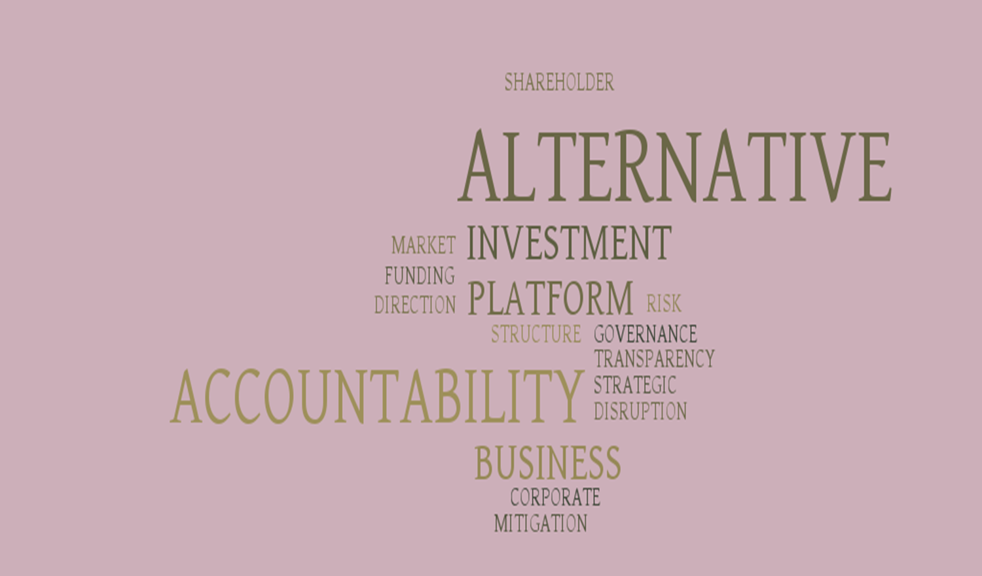


Slide 14
Unique value proposition
new type of investor; african middle class
Transparency/Strong Due Diligence
Mobile money integration
Equity ownership

Slide 15
Where’s the money - smile :-)
Matching fees
Small equity in funded startups
Transaction fees
Early stage private equity company
Conservative estimates put first year equity value in funded startups at $600,000.

Slide 16
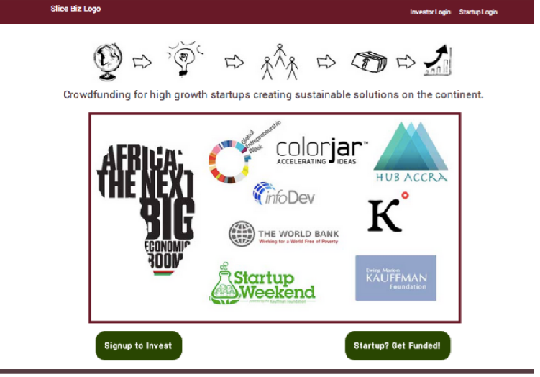

Slide 17
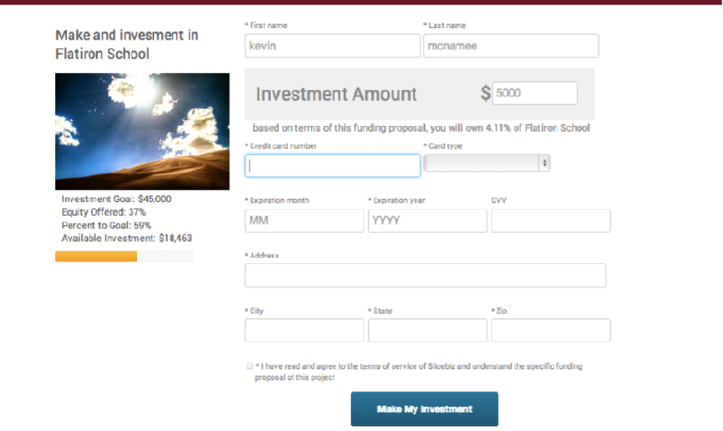

Slide 18


PARTNERS/backers

Slide 19


PARTNERS/backers

Slide 20


PARTNERS/backers

Slide 21





Traction covered BY;
WINNERS OF;

Slide 22
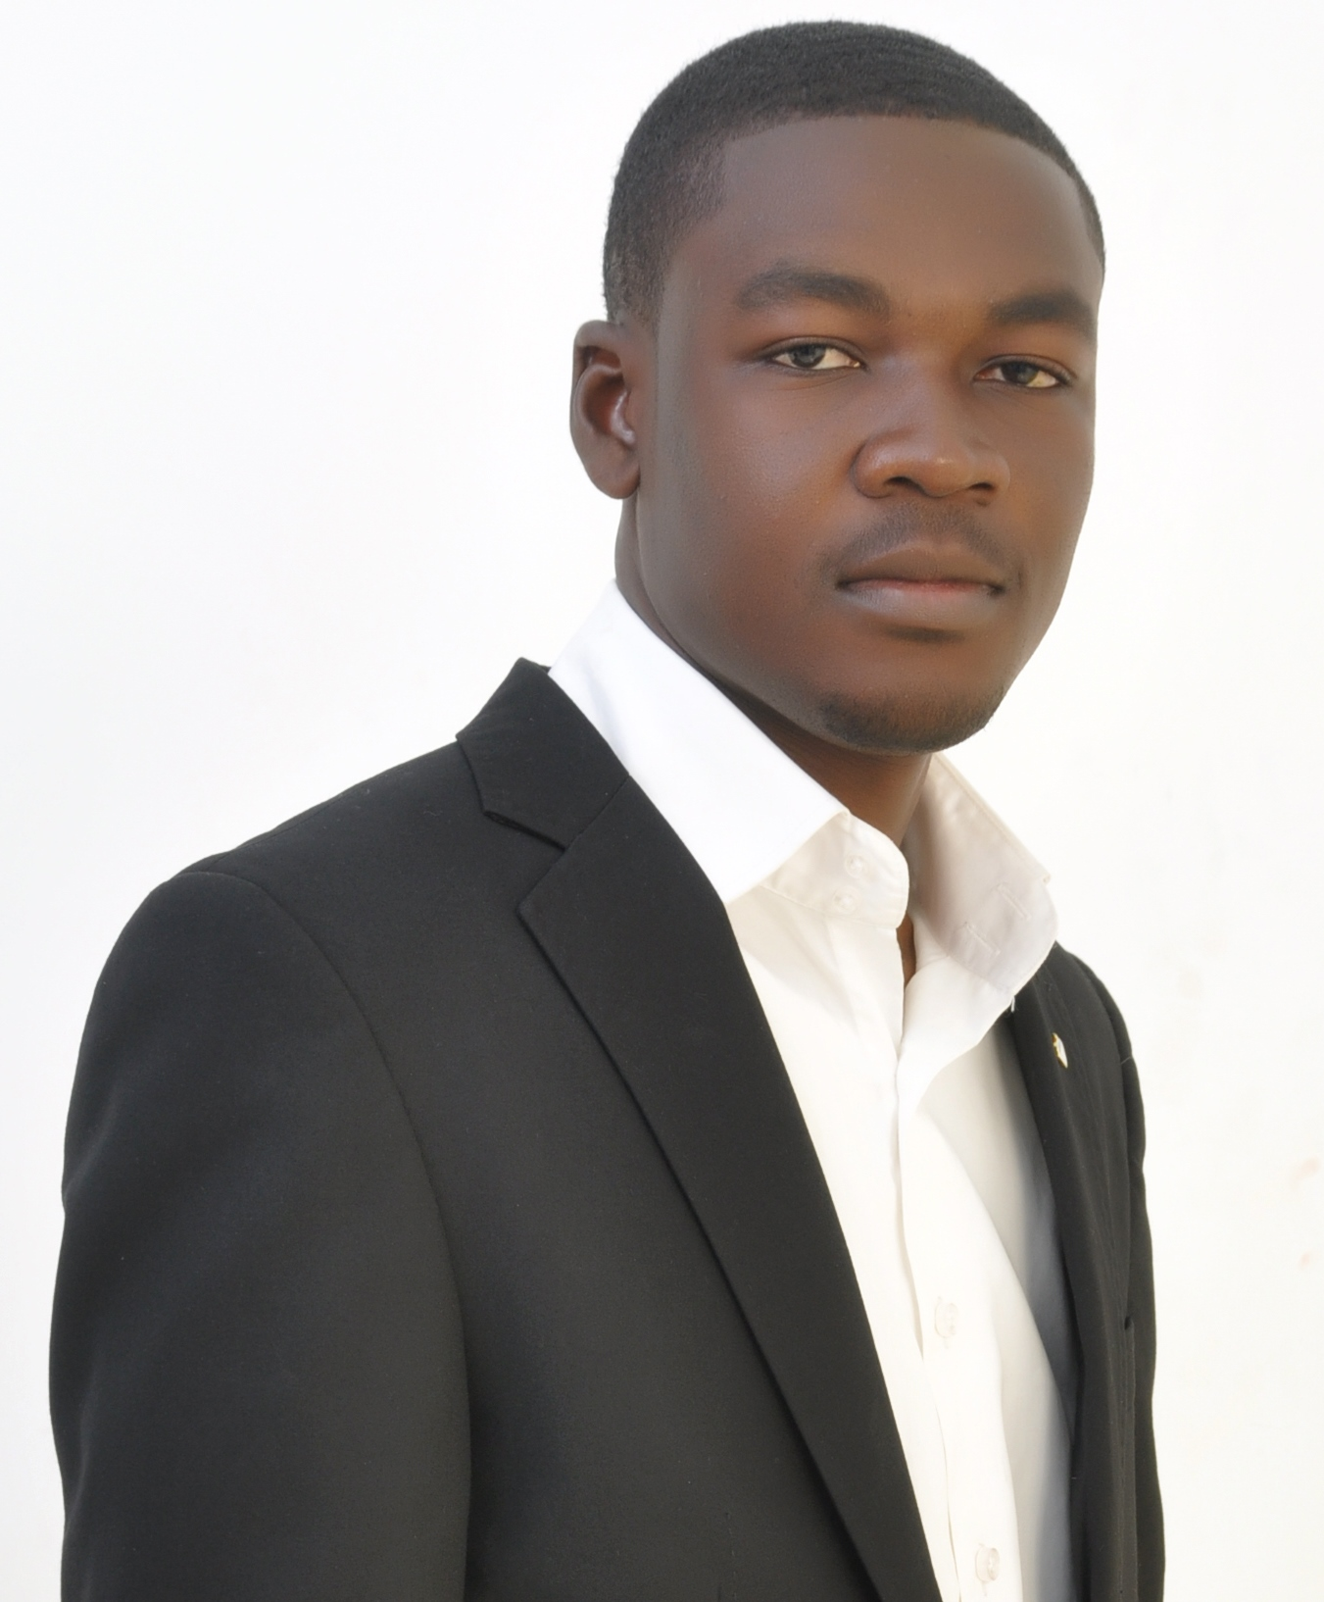
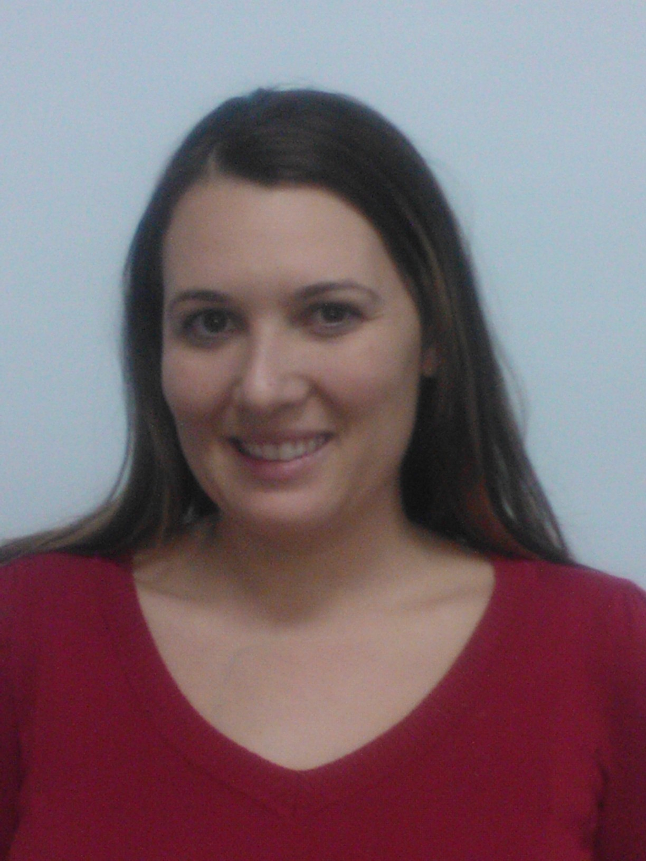

TEAM
William Edem Senyo
CEO
HEATHER COCHRAN
COO
MADELINE VELTTURO
INVESTOR RELATIONS

Slide 23
THANK YOU!

Slide 24
?

