Slide 1

..

Slide 2
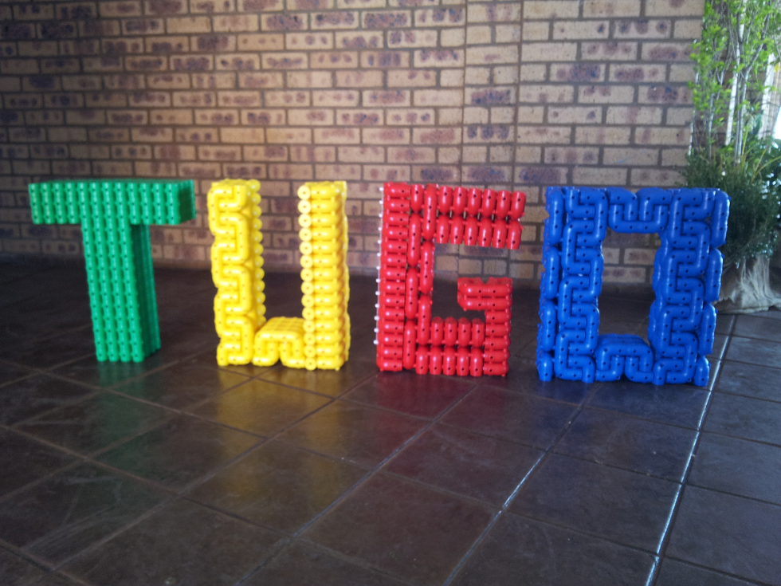

Slide 3
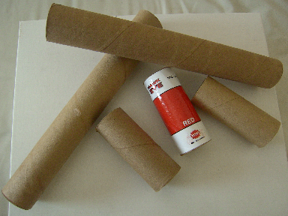
“Light Bulb Moment”
Simple Toilet roll core

Slide 4
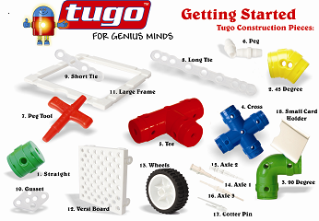
A new Construction toy
Number of different components that challenges the mind

Slide 5
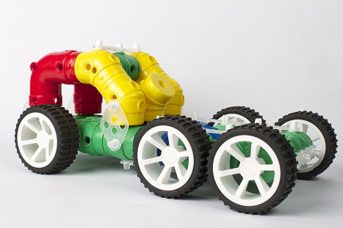
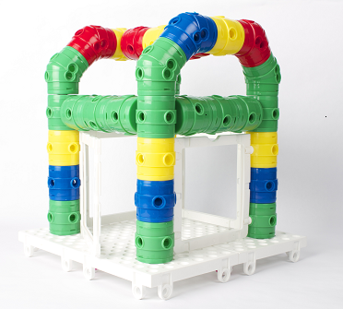
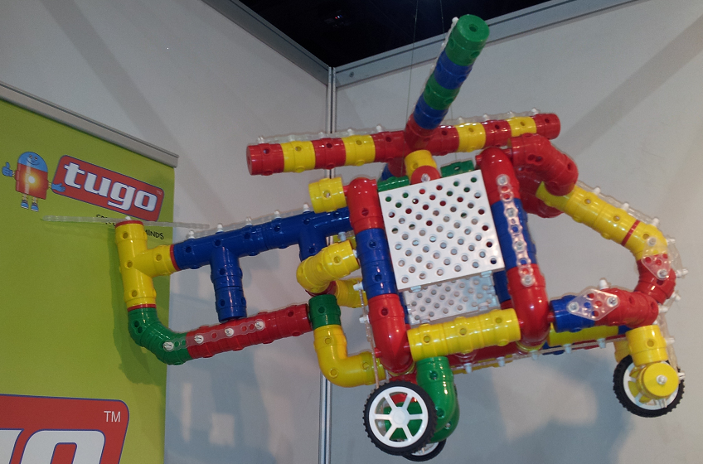
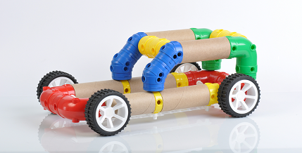
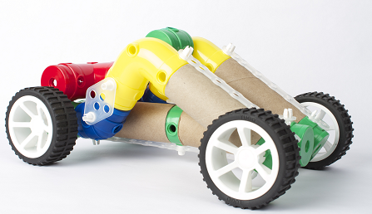
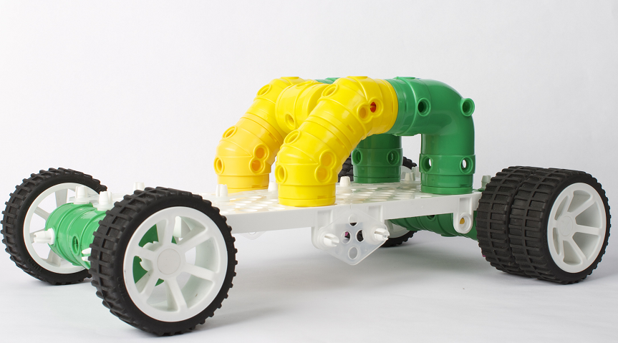
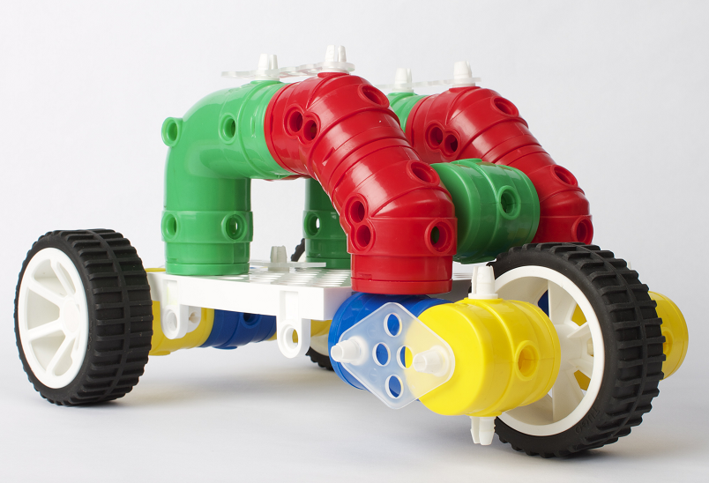
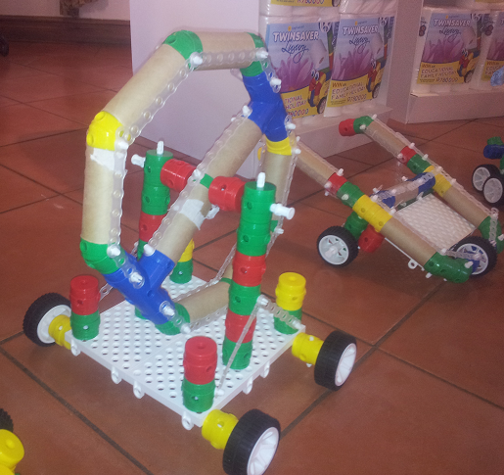
3-D Models using Engineering Principles

Slide 6
What are the benefits?
Encourages creative thinking
Problem Solving
Develops fine motor skills
Hand eye co-ordination

Slide 7
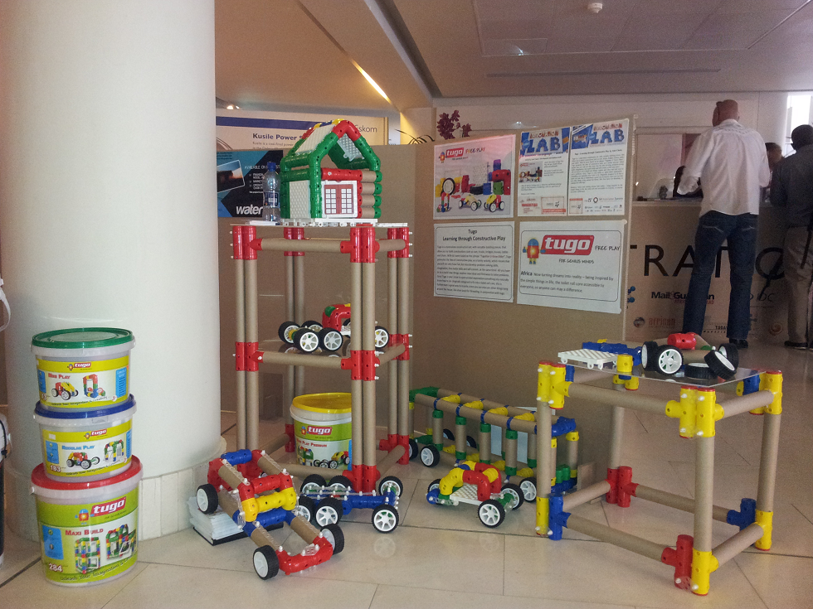
Display stands

Slide 8
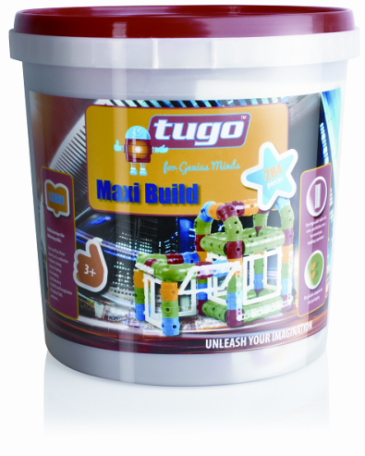
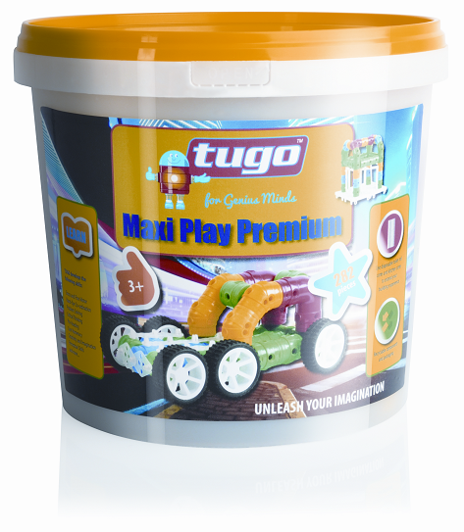
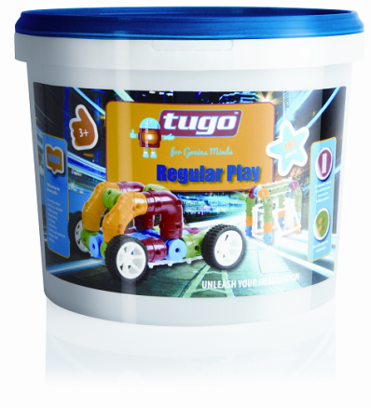
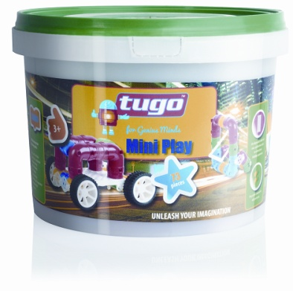
tugo range
Tugo Mini Play
Tugo Regular Play
Tugo Maxi Build
Tugo Maxi Play Premium

Slide 9
Driving force behind the development
My Son was diagnosed with ADD
Early Childhood development tools (toys)
Cost effective (Through Versatility)
Encourages recycling

Slide 10
“What is the market saying”
Very versatile
Value for money
Teachers - Strong focus on ECD and
Strong links to Maths and Science

Slide 11
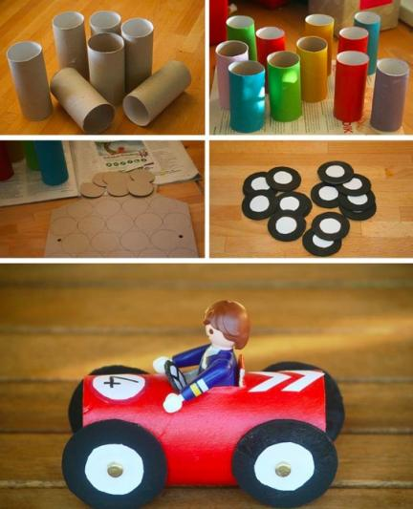
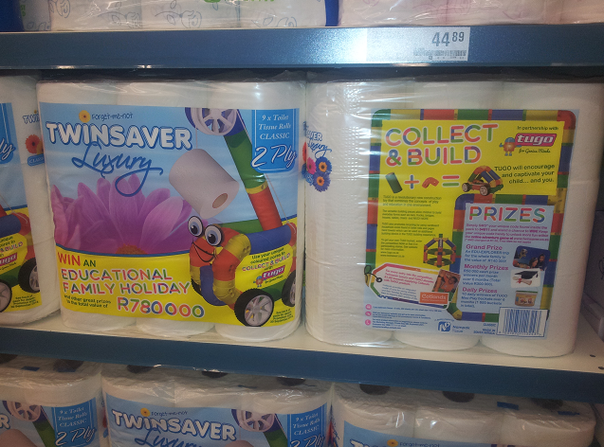
Achievements
Approved as a learning aid in the Classrooms
Vaal University of Technology is fast tracking the electronic and Robotics
Partnered with Nampak Twinsavers
Just launched tugo into one of the leading retailers in SA (Pick n Pay)

Slide 12
Support Received
IDC – Industrial Development Corporation
SEDA –Small Enterprise Development Agency
TIA –Technology Innovation Agency
Sasol Chemcity
SMTDC- Soshanguve Manufacturing Technology Demonstration Centre
Vaal University of Technology

Slide 13
Revenue stream
Educators (29000 schools)
Parents (7.4 m children ages 3-12)
Corporates – for team building
Just about anyone who wants to be creative

Slide 14
Management
Strong Management team – Corporate and Business experience.

Slide 15
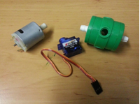
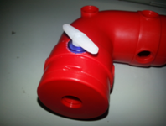
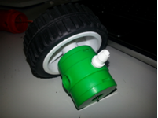
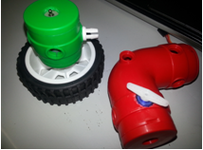
Future -Tugo Robotics – VUT (Vaal University of Technology)
VUT (Doing the development under the supervision of Prof Deon De Beer)
Tugo received a British Council Grant to assist development .
VUT is helping to apply for additional funding

Slide 16
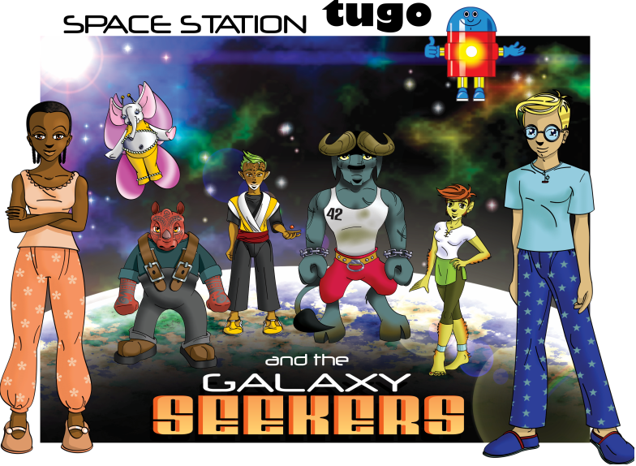
Future -Tugo Animation
Our Team
Educational Specialist (Want to help develop Educational content)
Highly talented Artist (Partners)
Clear fusion our Animation specialist (Partners)
SABC Education where we can secure 3 to 12 min free educational space which can be used to build our brand and educate children
Mobile applications with educational content (Partners)

Slide 17
Thank You
The End

