Slide 1

INCUBATION!
What’s Working...?
What’s Not...?
+ some Global Trends
Cesar Yammal, infoDev Latin America & Caribbean Region
Heinz Fiedler, infoDev Middle East and North Africa Region
Jill Sawers, infoDev Africa Region
Julian Webb, infoDev Asia Pacific Region
Stefan Schandera, infoDev Eastern and Central European Region
Steve Giddings, infoDev Africa Region
GLOBAL FORUM ON INNOVATION AND TECHNOLOGY ENTREPRENEURSHIP,
28-30 MAY 2013, EAST LONDON, SOUTH AFRICA

Slide 2

Incubator Managers
GRANT FUNDING
M&E on INPUTS
GRADUATES.. um…?

Slide 3



IT’s BROKEN !
STAKEHOLDERS
Unrealistic expectations by policymakers
PPPs recognized as useful… but
not happening
MODELS
Incubation directly run by public sector
(….other than China)
University run incubation

Slide 4

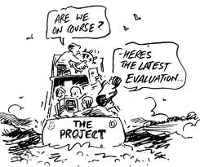
IT’s BROKEN !
PEOPLE & PROCESSES
Inadequate training and remuneration of incubator management
Lack of strong leadership
Limited deal flow (no critical mass :
< 10-15 clients)
OUTCOMES
Poor monitoring and evaluation (hides failures… stimulates incubation demand!)

Slide 5

IT’s BROKEN !
FUNDING
Underfunded incubators and the spiral of death
Financial self-sustainability sought… but no realistic plans
Overdependence on government subsidies
Government incubators have short incubation periods with limited cost recovery

Slide 6


Slide 7
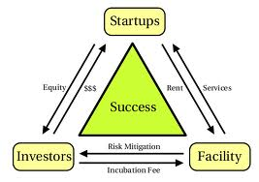

IT’S WORKING !!
MODELS
Mixed incubators - if managed well and less government control
Specialized incubators showing higher impact and sustainability – via embedding in innovation ecosystem and providing market access support
Increasing numbers of incubators in different sectors (e.g. furniture, agri, ICT)
PROCESSES
Entrepreneur led incubation – selecting and developing entrepreneurs
Adapting by learning from clients

Slide 8


IT’S WORKING !!
MONITORING and EVALUATION
Improving monitoring and evaluation of
incubator performance
Quality job data emerging from good incubators.
Collection of graduate data
GOVERNANCE
Incubators with autonomy from host or sponsoring institutions – e.g. from universities
Competency based boards rather than representative boards

Slide 9


IT’S WORKING !!
STAKEHOLDERS
Increasing policymaker awareness of what incubation can do
University based incubation moving to “developing” entrepreneurship (pre-incubation)
Increasing signs of private sector incubation and PPP attempts
Continued government interest in promoting the creation of technology based companies
FUNDING
Increasing government support to both entrepreneurs and incubators over multiple years with regular reviews and realistic performance objectives

Slide 10



INCUBATION APPROACHES
“Incubation Lite” – accelerators/
co-work spaces/hubs often run by
private organisations
More specialised incubators – well funded, targeted etc
Investor led incubation for early stage commercialisation
FUNDING
Increased use of result-based financing to support good incubators and close poor performers
Channeling of government support for entrepreneurs through seed funds
More angel investor development and alignment

Slide 11

TARGET MARKETS
Public sector pressure for youth, rural and women solutions and non-ICT incubators e.g. manufacturing, agribusiness

Slide 12

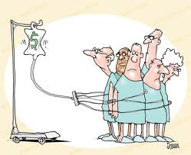
STAKEHOLDERS
Increase in private sector initiatives
More public-private sector initiatives…
but limited by know how
SUSTAINABILITY
Increased drive for cost recovery and financial self-sustainability using success sharing models
More autonomy for organisations using success sharing

Slide 13
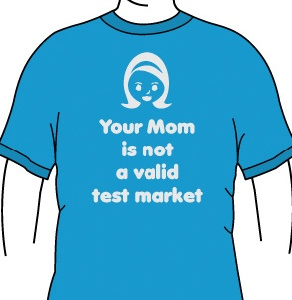

PROCESSES
Greater emphasis on rapid market validation in pre-incubation (market pull vs technology push)
And finally…
MANAGEMENT DEVELOPMENT
Greater focus on developing entrepreneurial management teams and resourcing them well

