Slide 1

Murat Aktihanoglu
General Partner
murat@eranyc.com
http://eranyc.com

Slide 2

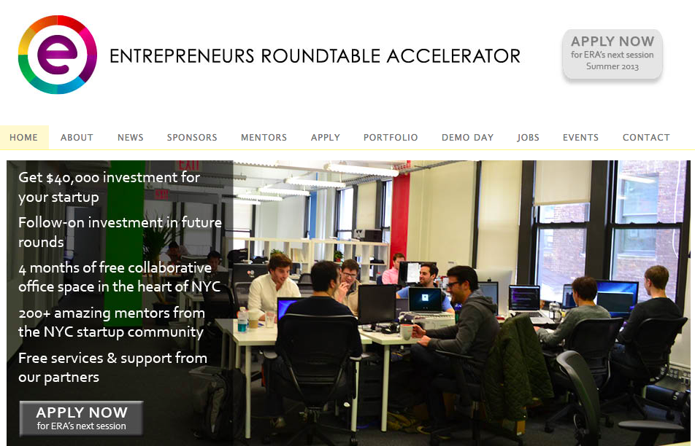

background
Computer Science + Silicon Valley
Notes:
I collect entrepreneurs. ☺

Slide 3
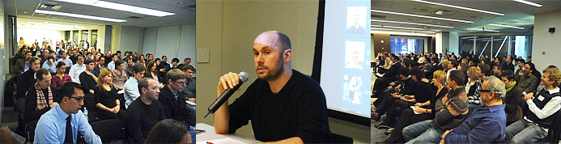
Entrepreneurs roundtable (2007 - )
Non-profit
Educational
Community Building
Monthly roundtables
Startups present to investors, network
ER Hightlights
6 year history of community development
100+ events in NYC
100+ VC and Angel Investor speakers
300+ startups pitched at ER events
2000+ startups applied to pitch at ER events
20,000+ entrepreneurs on the mailing list

Slide 4
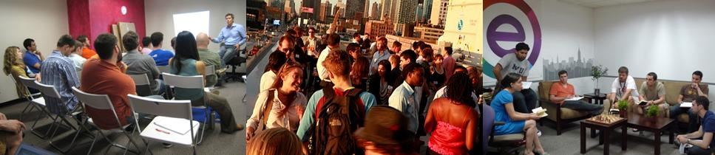
Entrepreneurs roundtable accelerator ( 2011 - )
Technology Accelerator / Investment Fund / 2 sessions a year / 10 companies per session
$40,000 initial investment
$50,000 - $200,000 follow-on investment
Four-month program with free collaborative office space
Daily access to 250+ mentors (investors, serial entrepreneurs, subject experts and industry executives)
Exclusive access to alumni network of 50 companies (as of 2013 Summer)
Free legal services, free consulting services, free hosting, 5 free flights from AA
Demo Day in New York and California and on-going support

Slide 5

Accelerators in the Startup Ecosystem
Companies need the most help at the earliest stages
Core driver of successful outcomes is the ability to guide entrepreneurs to success
ERA provides access to qualified help!
AMOUNT OF HELP
VCs
ERA
Super
Angels
Angels
Help Needed
by Startup
STAGE OF INVESTMENT

Slide 6
ERA
3 years
50 companies
90% fundraising rate
250 mentors
25+ sponsors
100+ people co-working space in Midtown, Manhattan with alumni companies co-located

Slide 7
Add value
Adding value should be goal number ONE.
GET FEEDBACK from the companies throughout the program
APPLY THE FEEDBACK
  Recycle mentors
  Bring in necessary skills/workshops/resources
  Adjust the program
RE-ASSESS after each session

Slide 8
Involve the community
Local serial entrepreneurs as mentors
Local investors
Service providers (anyone who would benefit from a strong entrepreneurial ecosystem): Lawyers, accountants, banks
Local subject experts: marketing, sales, engineers
Press
Local governments

Slide 9
Leverage each mentor optimally
Use each mentor in the best possible way
Two-way matching with the company and the mentor
Get out of the way if there is a match

Slide 10
RIGHT MENTORS AT THE right time
Not all mentors should come in at the same time
Stage the program: Customer Discovery, Product, Customer Validation, Traction/Marketing, Fundraising
Bring in serial entrepreneurs/product mentors first
Then subject experts
Then investors towards the end of the program

Slide 11
Weekly support groups
Group should self-organize to support each other
CEO Roundtables
CTO Roundtables with CTO’s and Resident Technologists
Product feedback sessions – bring in students/other entrepreneurs

Slide 12
Pivots are part of the process
Support the entrepreneurs
Entrepreneurs have the most information
Let them make the decision
Make sure the decision is INFORMED

Slide 13
Pitching is a sport – takes practice
Enable entrepreneurs to pitch throughout the program
Bring in qualified help to give feedback every week
Find the pitch before Demo Day, recycle what doesn’t work

Slide 14
First raise is important
First money raised is VERY IMPORTANT
CONFIDENCE
ADDS to the perseverance
PROVES a fundable business
ENCOURAGES to carry on

Slide 15
Fundraising is relationship-building
Transitive trust – PASS THE NETWORK ON TO THE STARTUPS
Teach BEST PRACTICES
Companies should learn to send out INVESTOR UPDATES
Cohorts encourage good practices from investors

Slide 16
Demo days work
Visibility for startups
Investment timeline compression
Event to create publicity around the ecosystem
Do Demo Days “WHERE” necessary
2 WEEKS TO A PERFECT PITCH with daily practice sessions

Slide 17
Alumni should stay connected
Synergy is TREMENDOUS
Build an internal system for information exchange and mentor matching
Build your own Knowledge Base
Organize on-going events between the alumni
Make sure the alumni know each other and USE each others’ PRODUCTS

Slide 18
Last: most important: unblock the startup
The goal of the program should be to UNBLOCK the startup
Track progress closely with MONTHLY REVIEW MEETINGS
Track feedback from mentors
Have an OPEN DOOR POLICY
Provide IMMEDIATE help when the startup is blocked: Bring in help, make necessary introductions

Slide 19




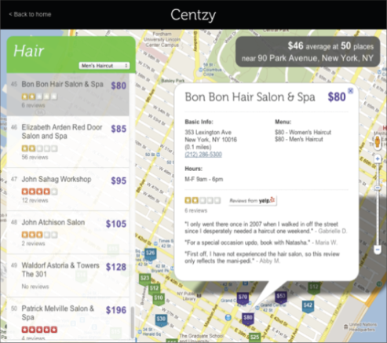
Case Study: Centzy
Systematically brings local business information, such as price and hours, online, providing a valuable big data service to a still offline industry.
Key Facts:
Founders:
Jay Shek, CEO
Jeremy Clemenson, CTO
Founded:
San Francisco, CA
ERA Investment:
$25K, Summer 2011
Follow-on Financing:
$800K, Series A Fall 2011
Follow-on Investor:
ff Silver
LightBank
Kayak for local services’ prices and hours
Collects local price and hours data to deliver niche and specific value to consumers
Collected data in NYC, SF, and Chi for salons, spas, gyms, cleaning services, etc.
Uses a paid crowdsourcing platform: people pulling offline data online.
Less than 25% of local businesses have websites and less than 10% post prices online
$350B market and there is no existing online discovery tools for local prices and hours
ERA’S IMPACT
ERA helped take a powerpoint concept to a viable funded business
Gave Centzy (west coast guys) access to the NYC startup ecosystem
“ERA is the reason we are in New York. Through ERA’s network, we were introduced to all of our interested seed investors and they helped us build an oversubscribed seed round.” – Jay Shek, CEO

Slide 20






Case Study: Bespoke Post
A curated subscription club for men, which physically mails a “box of awesome” products to targeted affluent customers monthly.
Key Facts:
Founders:
Rishi Prabhu, CEO
Steve Szaronos, Co-Founder
Founded:
New York, NY
ERA Investment:
$25K, Summer 2011
Follow-on Financing:
$800K
Affluent male focused discovery platform for contextual commerce
Acquired several key partnerships, allowing the company to create exclusive product offerings
Profitably growing customer base
Opt out revenue model, which creates high customer retention
The company started as a mobile tagging platform
Through ERA’s mentorship and guidance, the company pivoted to a more attractive, high growth business
ERA’S IMPACT
Responsible for introducing Bespoke Post to several product & media partners
Helped the company transform from a concept to a scalable business
“ERA provided us access to a great mentor network, which enabled us to secure key Fortune 500 business partnerships, and during the West Coast Demo Day we secured our first investor.” – Rishi Prabhu, CEO

Slide 21

http://eranyc.com
murat@eranyc.com

