Slide 1

Scaling Entrepreneurship Education and Ecosystem Building Models
Susan Amat, MBA, Ph.D.
5.29.13
@SusanAmat

Slide 2

Miami Case Study
Ecosystem Creation
The Launch Pad®
Venture Hive®
What’s Next

Slide 3
The Launch Pad®
University Educational Model
Slow success instead of fast failure
Individual development focus
Culture of collaboration
Curated best-practice resources
Network of collegiate entrepreneurs

Slide 4
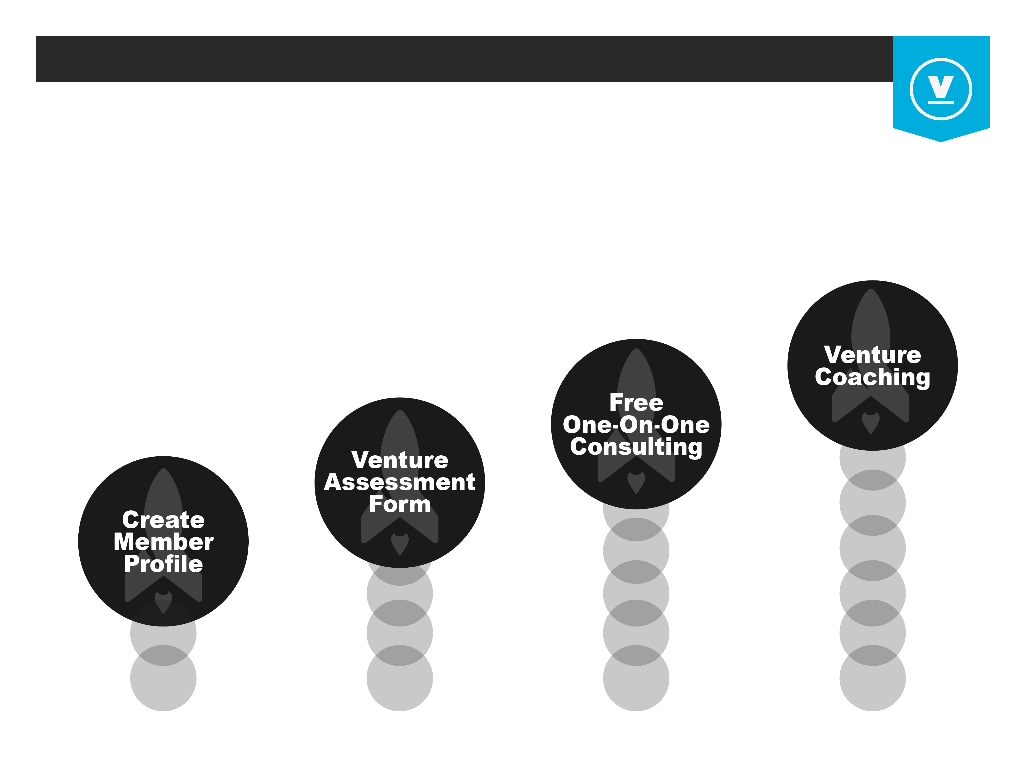
The Launch Pad®
Process and Platform

Slide 5
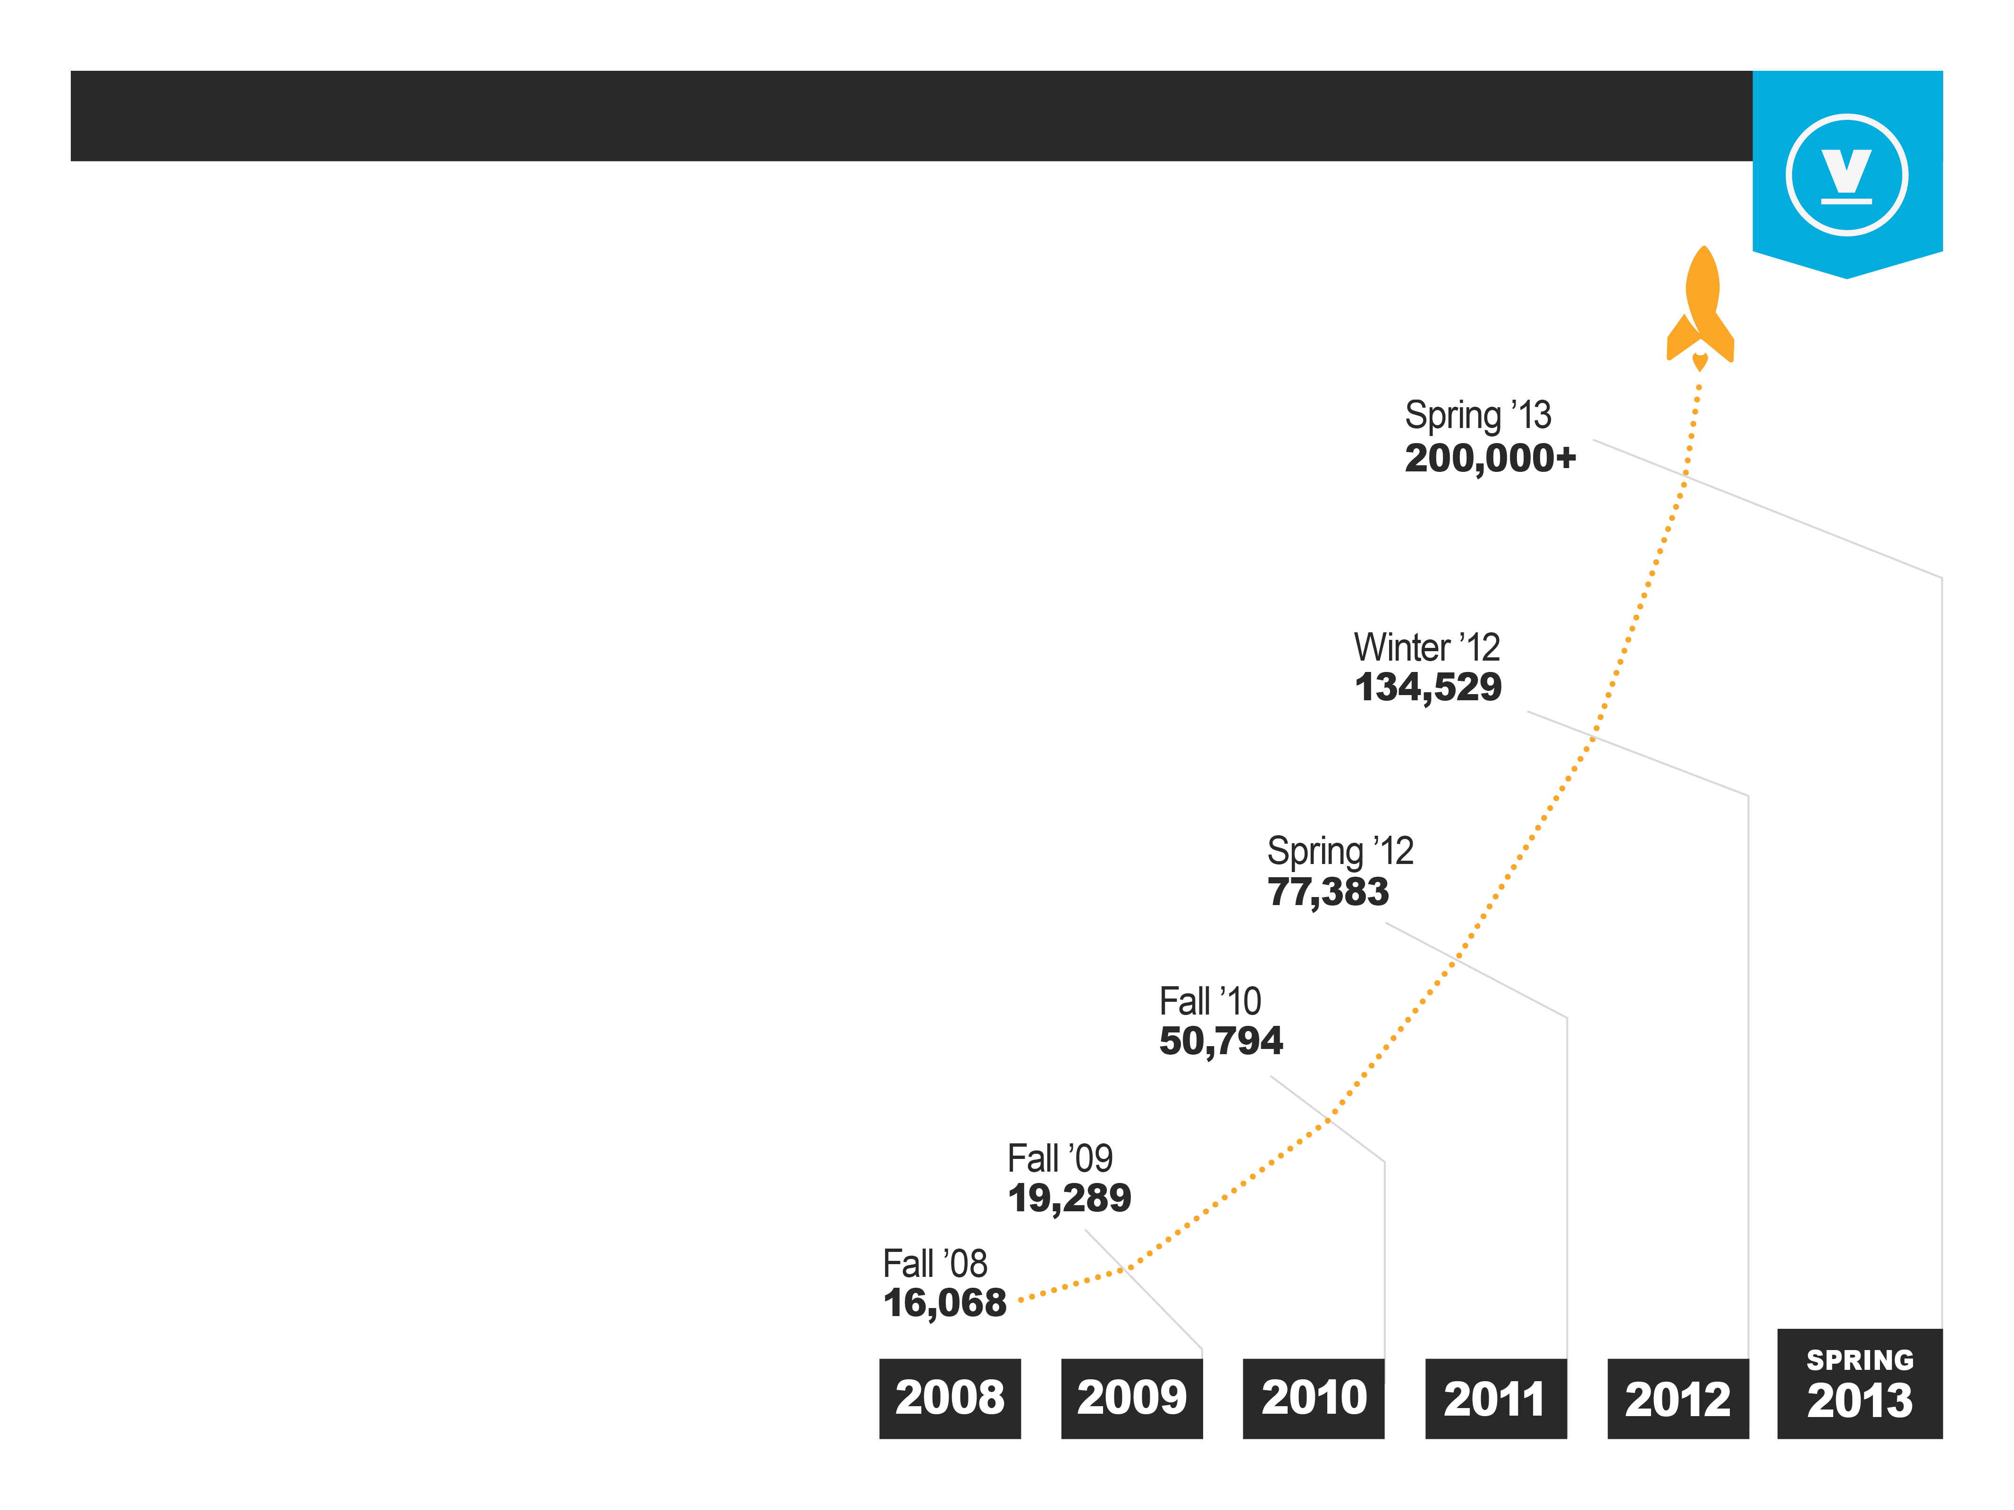
The Launch Pad®
By The Numbers
^{Total Accessible} ^{Student}
^{Population} ^{By Enrollment}
^{The Launch Pad® UM Only}
^{2,550+ Members}
^{1,600+ Ventures received}
^{free one-on-one consulting}
^{Total Network}
^{4,500 Members}
^{2,500 Ventures received}
^{free one-on-one consulting}

Slide 6
The Next Step
Community Capacity Building
No support infrastructure
Poor culture of mentorship
Private sector not engaged
No smart money
No tracking or documentation

Slide 7
Venture Hive®
Economic Development through Accelerators
Recruit startups on industry verticals
Engage private sector and government
World-class resources and support
Network of startups and communities
Collaborative tool development

Slide 8
Venture Hive®
Early Results
100+ entrepreneurs
27 startups
$3M in funding in 6 weeks, $2M+ matched
50 industry-specific mentors engaged
Startup community!

Slide 9
Platform Solutions
Economic Development through Accelerators
Turnkey solution for program management
Individual and venture level metrics
Tools for impact assessment
Curated best-practice resources

Slide 10
Next Steps
Long-term impact
High School Magnet Program
Internship tracking
K-12 culture shifting
International pilots

Slide 11
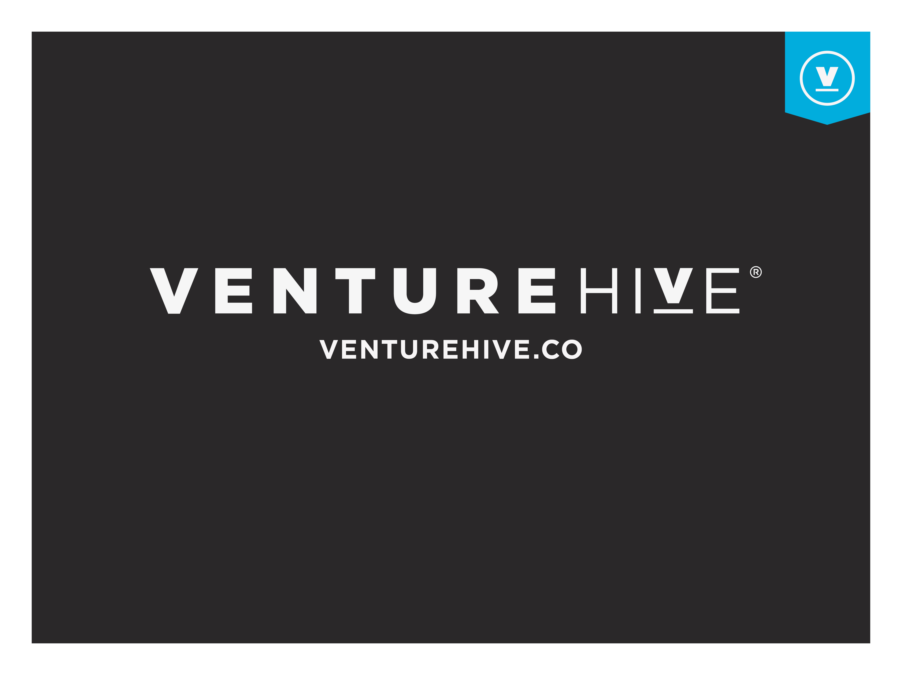
Susan Amat, MBA, Ph.D
Susan@VentureHive.co
@SusanAmat

