Slide 1

TOPICA
VIRTUAL INCUBATION
IN VIETNAM
Presented by
DANG MY CHAU
GLOBAL FORUM,
South Africa
MAY 2013

Slide 2
Introduction
Partners with 6 universities
13,000 students
1,000 have graduated
1,000 industry instructors
250 full time & 100 part-time staff
TOPICA
Online bachelors
Amazing English
Topica Accelerator: Founder Institute
1,000 students
50,000 online users
7 franchises
64 locations
2 intakes
> 150 registered
61 on seats
18 companies

Slide 3
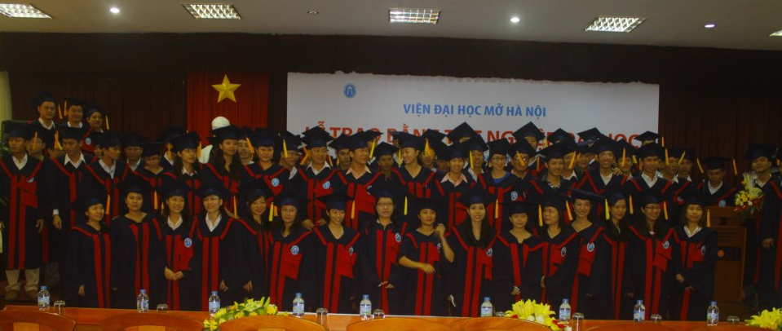
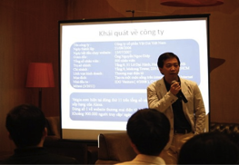

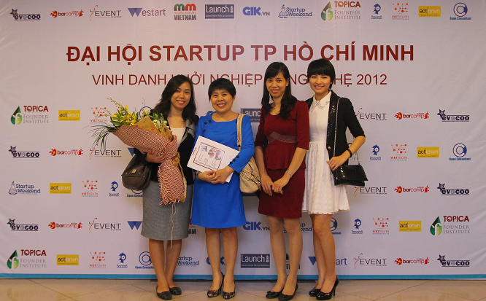

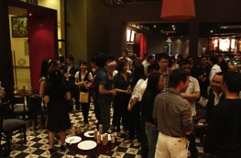

Slide 4
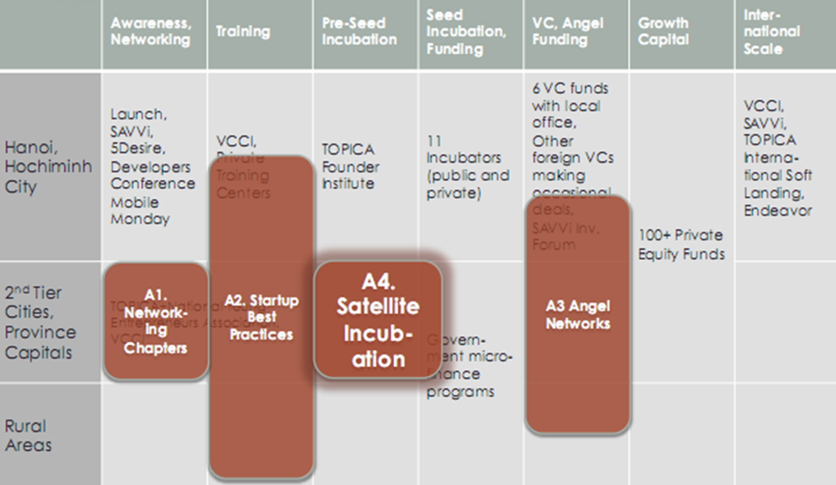
Entrepreneurship EcoSystem
Notes:
Reference: START Project Proposal 5.0 Final
4

Slide 5







Sample Portfolios
Hospital management software
Chemical for water and solid waste treatment
Online/mobile dating community
Mobile news service, contextual ads
Online/mobile manga community
PC repair on-call service
LED billboards
Value added mobile content
Elearning software
Online communities
  Implemented in 30 hospitals
  Received investment from Fintec
  Graduated with good revenues
  Won research prize from World bank
  Graduated with good revenues
  Raised venture capital
  Acquired by YAN TV in 2010
  Raised venture capital, strong revenues
  Raised venture capital
  Graduated with good revenues
  Franchised to 40+ provinces
  Graduated with good revenues
  Received angel investment
  Graduated with good revenues
  Failed
  Failed
Noi.vn
Baomoi.vn
VSMC

Slide 6


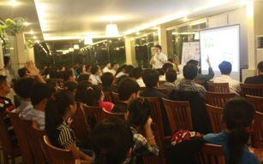
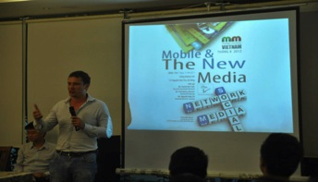
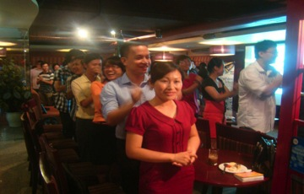
Networking & Awareness (2011-2013)
40 events: Mobile Monday, Demo Day conference, Startup Conference, etc
7,000 participants
Startup, Mobile Communities: Launch (>7000 members), Mobile Monday (3,500 members), Savvi, 5Desire

Slide 7

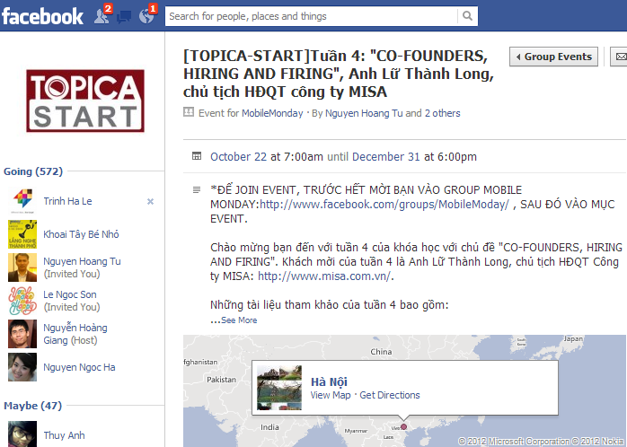
Startup Best Practices
Online Start-up Course: with Top Tech CEO on Facebook
6 topics in 6 weeks
Live discussion with Top CEO every Friday
Tutors & Learning materials (videos & slides) from Topica Founder Institute
After 3-week launch
572 registered
432 posts
843 video views
1297 slide downloads

Slide 8
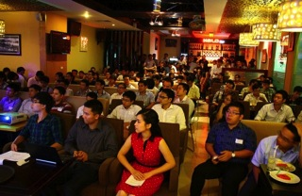

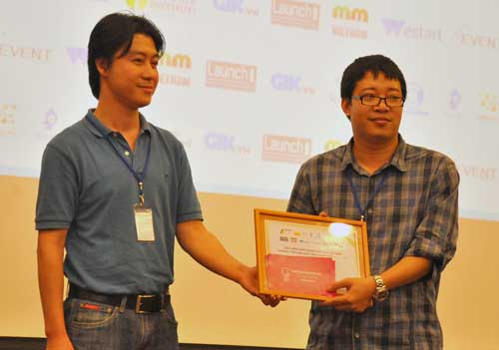
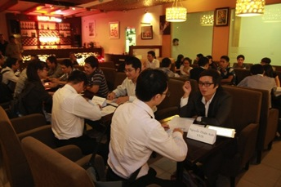
Angle Network Angel Investor Promotion Events
Ideation Bootcamp
120 start-ups and managers
Pitch Bootcamp
140 start-ups and managers
5 pitches: mobile app, social game, education
Co-Founder Dating
100 start-ups and managers
Speed Dating: 11 Founders & 40 Potentials Co-Founders
Tech Startup Competition 2012
23 startups nominated from Hanoi & HCMC

Slide 9

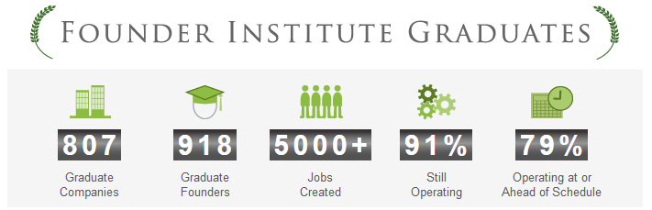





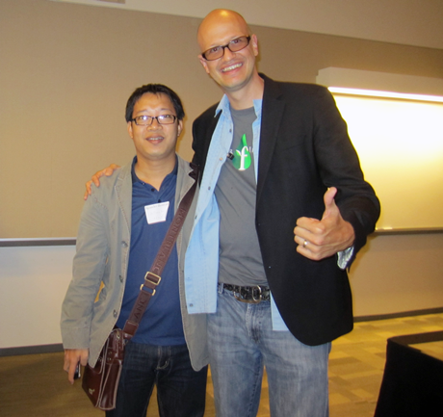
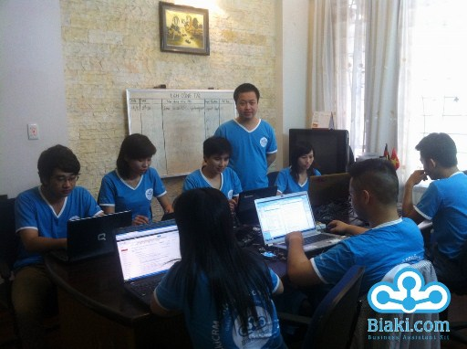
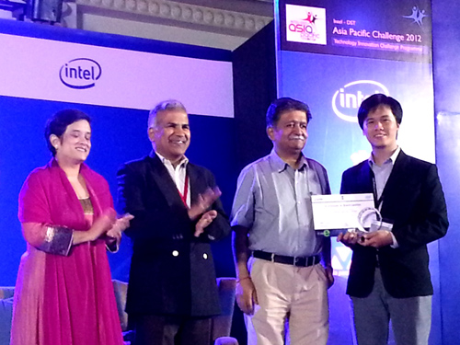
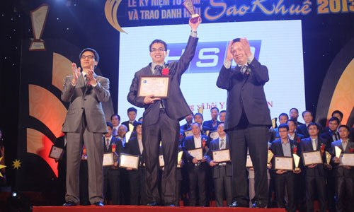
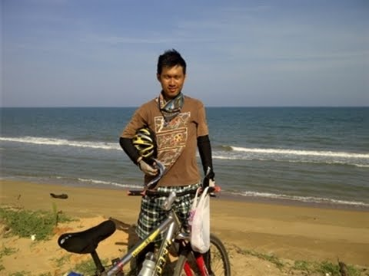
Pre-seed Incubation: TOPICA Founder Institute
Founded in 2009 by Adeo Ressi
The Founder Institute is an early-stage startup accelerator and global launch network
4 months Pre-incubation
VIETNAM: 2 intakes in 2011 & 2012
> 150 registered
61 on seats
20 graduates founders
18 graduates companies

Slide 10
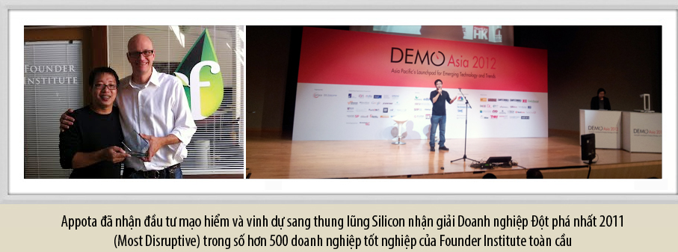
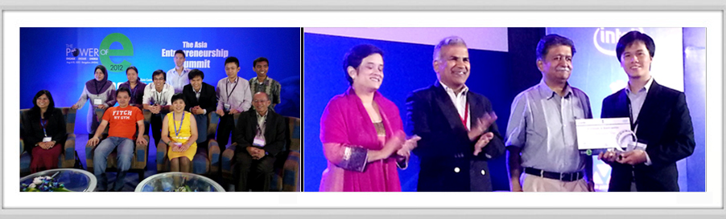
TOPICA Sent Entrepreneurs to
International Competitions in 2012
FI global competitions and Demo Asia, Intel DST Challenge

Slide 11
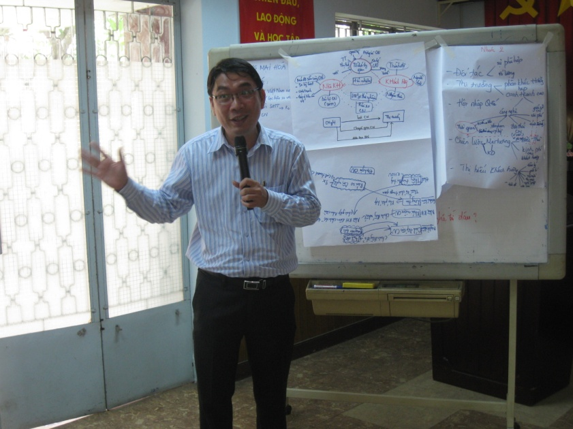
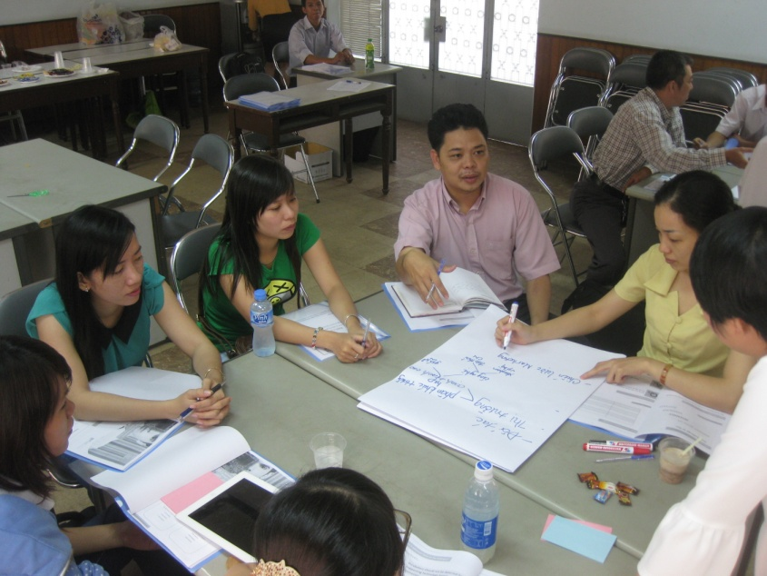
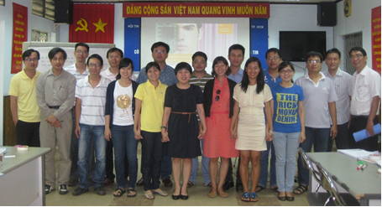
Incubation Manager Training Program
3 Training locations
Ha Noi
Da Nang
Ho Chi Minh City
43 Delivered Training
modules (Module 1-11)
400 Participants

Slide 12

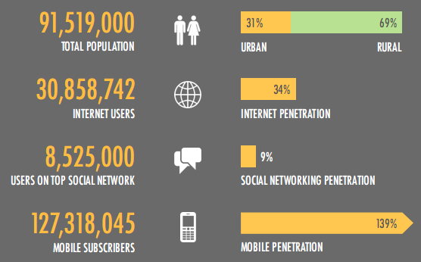

Why Virtual Incubation?
Notes:
139% mobile subscribers but only 45% real users
Internet is so fast and cheap: 2 usd/3G subscriber, wi-fi 10-20 usd at wide band
Young people tend to have more than 1 phone

Slide 13
Why Virtual Incubation?
Leverage resources
  Incubated 10 onsite (8 strong revenue, 3 raised venture capital, 1 exists), 64 online incubatees (55 self-sustainable)
  5 year-old high growth venture-funded startup dominates market with 13,000 students; 1,000 industry instructors and 250 staff
  E-learning environment infrastructures
  Delivered online entrepreneur courses for 10,000 students at 30+ universities
Network capabilities
  Corporate closely with Saigon High-tech Park M’lab, PSG-STEP, Asian Pacific Incubation Network, Founder Institute and 30+ Partner universities
  Solid relationship with main entrepreneurship communities: Vietnam Young Entrepreneurs Association, Dotcom Clubs, Launch, 5Desire, Mobile Monday
Notes:
From 2004, CRC-TOPICA received seed fund from Infodev-WB to setup incubation activities
On site incubation to 10 startup companies, 8 graduated successfully, 3 raised venture capital and 1 exits to Media Group in VN

Slide 14
Challenges ?
Not have entrepreneurship ecosystem in suburban and rural markets yet
Inflation, economic recession, unemployment
Investment funds withdraw
Funds tend to focus on exist than new investment
Sustainable events/ activities
Which incubation model?

Slide 15
Lessons learned
Issues | Suggestions
Networking, awareness sustainability | Social activities need to have more than 1 parties Select strong, popular chapter leaders Rotation leader roles Involve with university student clubs Sponsor need ???
Best practices on line courses | Live discussions every Friday Who teach whom? - >Choose successful startup with 50+ staff
FI Model | Suitable with VN market on the first hand Age 30+ Can pay for tuition fee
Incubation Manger Training | Corporate with local authorities, department of technology and sciences Commitment with the program

Slide 16




Thank you!
Contact: chaudm@topica.edu.vn
+84-973 966 950
TOPICA EDUCATION GROUP
HO CHI MINH CITY, VIETNAM

