Slide 1

Our Approach to Business Incubation
Presented by Karen Owens, Chief of Staff
For
infoDev Global Forum

Slide 2


Founded by Ashish J. Thakkar at age 15
Mara Group is a pan-African conglomerate of companies
Mara Foundation instituted in 2009
Notes:
Mara Group is a young and dynamic company synonymous with professionalism, integrity, innovation and entrepreneurial flair. We take pride in our energetic and long-term approach to relationships with employees, partners and clients.
What has today become the impressive Mara Group started small, with an IT shop created by the founder and managing director, Ashish J. Thakkar, 16 years ago.
Today Mara Group is a multi-sector business involved in information and communication technology, real estate and hospitality, manufacturing and services on three continents.
The group structure reflects our desire to establish a solid and diversified platform for expansion while ensuring integrated and efficient operations.
Our well established network of operations in Africa, the Middle East, Europe and Asia provides us with a decided competitive edge.
Our business principles are teamwork, putting clients first, integrity and corporate responsibility, which are applied to everything we do to ensure that we realize our vision of becoming the most exciting African brand.
Mara has registered presence in 24 countries and in process of registering presence in an additional 7 countries

Slide 3

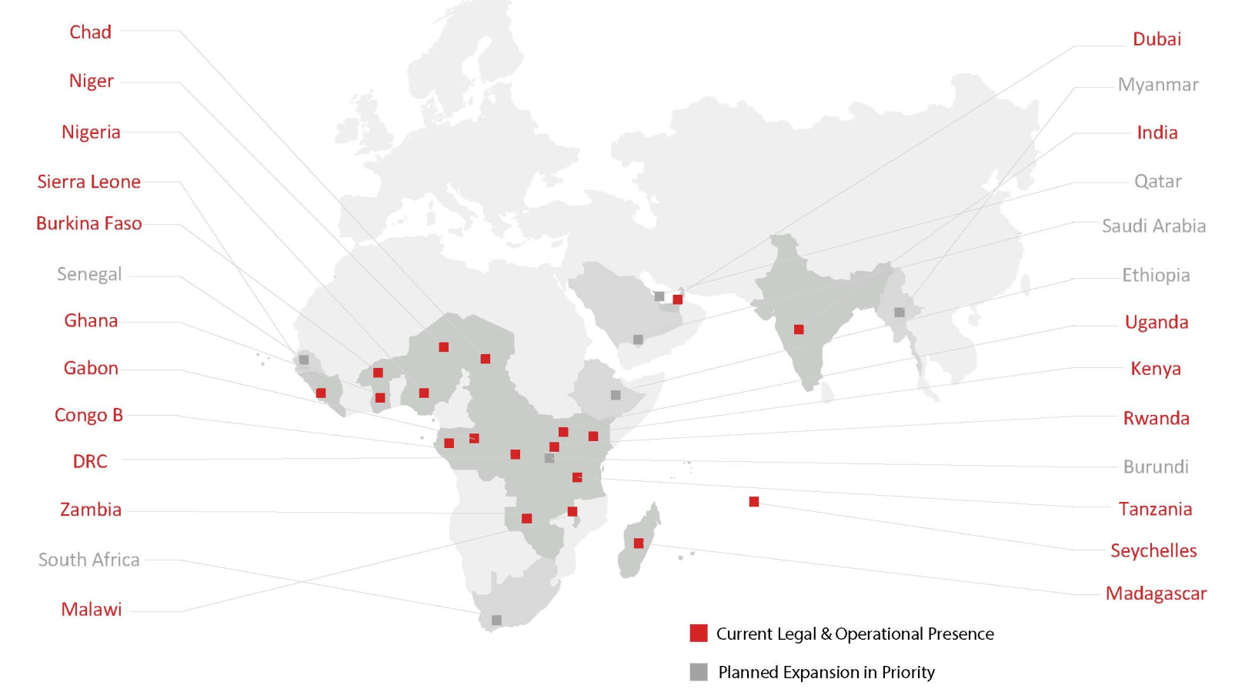
Our Footprint
Mara has registered presence in 19 countries and in process of registering presence in an additional 7 countries. Also Mara has received interest to launch Mara Online in; Argentina, Netherlands, Jamaica & Singapore

Slide 4
Mara Foundation is the Mara Group’s social enterprise that focuses on emerging African entrepreneurs. We work to create sustainable economic and business development opportunities for young business owners via our Mara Launchpad incubation centres and Mara Launch Fund. Our mission is to provide comprehensive support services including mentorship, funding, incubation centre workspace and business training to African entrepreneurs. We believe that these support services will transform entrepreneurs’ business ideas into profitable and thriving business entities that will employ other Africans and contribute to the local and national economies.

Slide 5

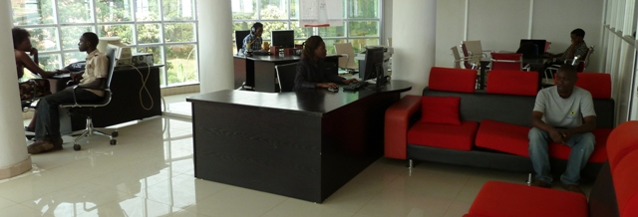
Kampala, Uganda (capacity is 80 entrepreneurs)
Dar es Salaam, Tanzania (capacity is 100 entrepreneurs)
Coming Soon: (South Africa – July 2013, partnerships with iHubs in Kenya – June 2013 and expansion in 8 other countries in 2013)

Slide 6

Mara Online is an online and mobile eco-system focused on African youth allowing users to communicate, interact and collaborate with each other via social portals, while building communities that are centered around common interests and information needs. Mara Online is a convergence of web and mobile technology that creates user-driven experiences spanning from educational tools for entrepreneurs to highly interactive mobile applications that provide connectivity to people across the globe.

Slide 7
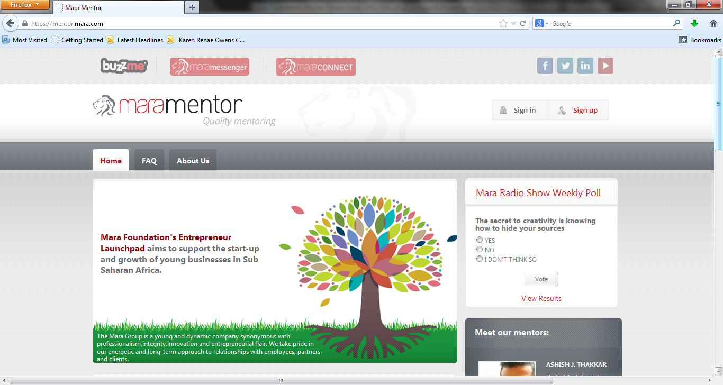
Mara Mentor Online

Slide 8
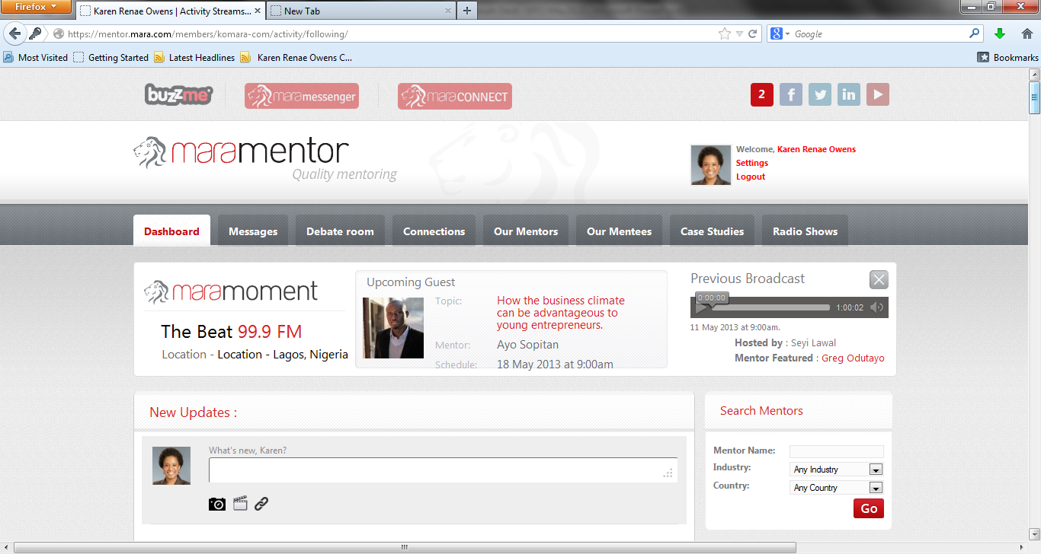
Mara Mentor Online
Mara Online (https://mentor.mara.com/) is an unprecedented African online resource and web portal for entrepreneurs to connect virtually with mentors. Mara Online is poised to become the first and largest online community and the premiere choice for entrepreneur resources, mentorship, guidance and advice for business owners not only in Africa but worldwide.

Slide 9
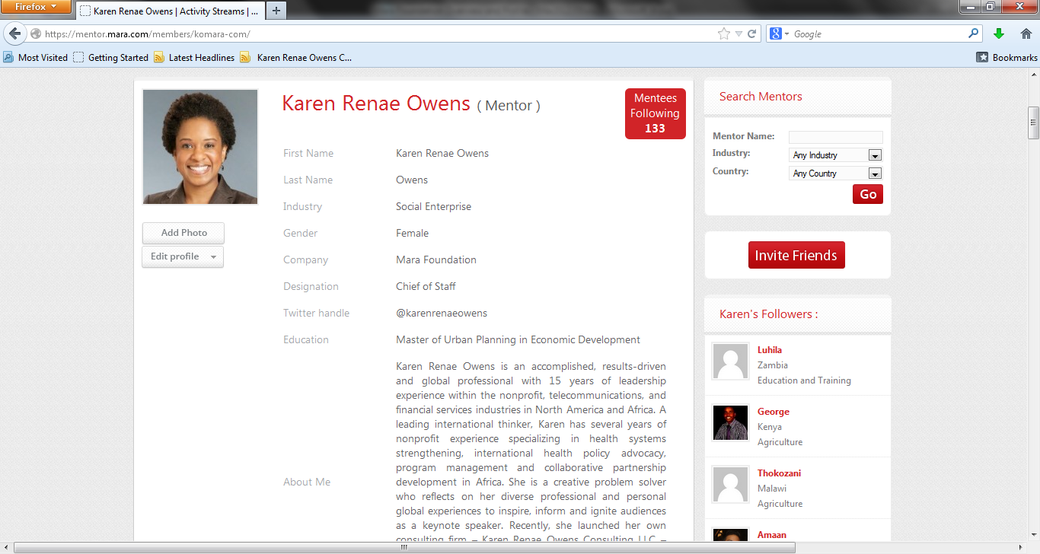
Mara Mentor Online

Slide 10
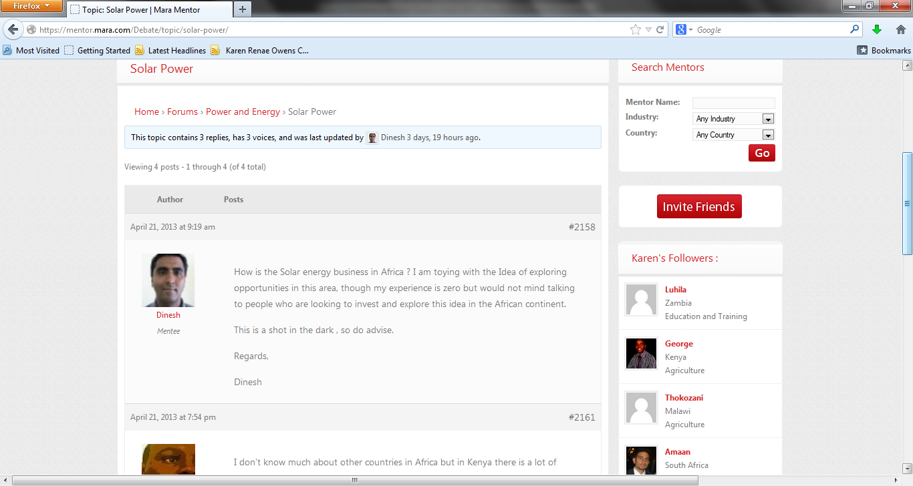
Mara Mentor Online

Slide 11
Mara Mentor
Highlights
    45,000 YTD registrations for Mara Mentor Online
    Debate room chats
    Emerging opportunities to partner with high profile mentors to create an int’l dialogue
    Network for Teaching Entrepreneurship
    World Economic Forum Young Global Leaders
Challenges
    Children/minors on the website (int’l regulations & monitoring)
    Meaningful content & exchanges to help aid entrepreneurs
    Recruiting mentors and mentees ongoing

Slide 12
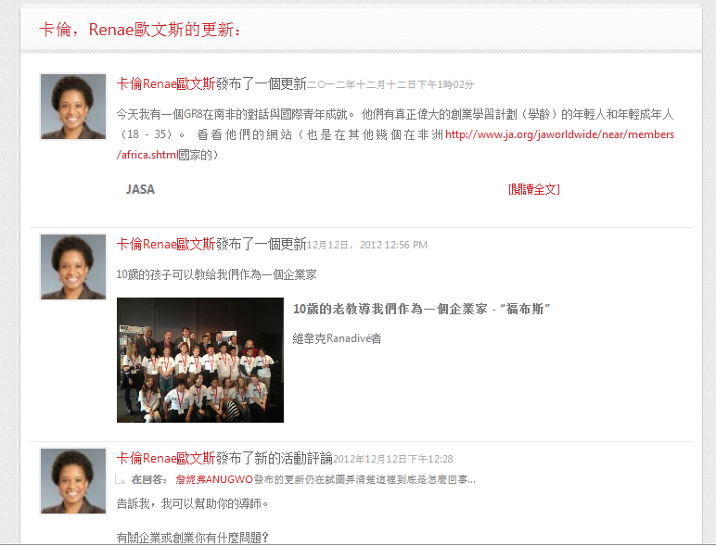
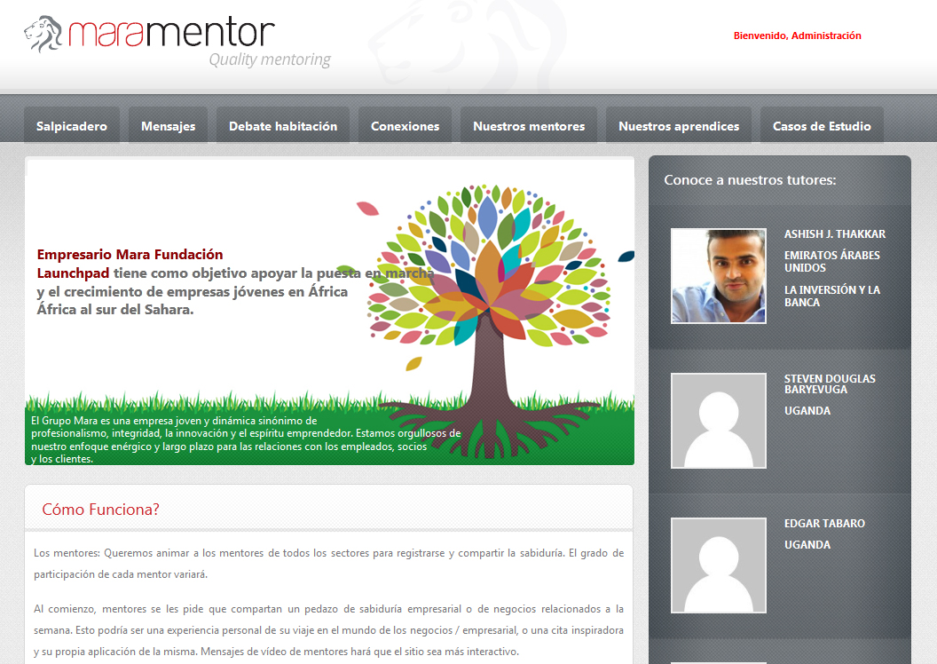
Mara Mentor
    Future
      Mara Mentor in Asia and South America

Slide 13
Mara Mentor
Why do we believe this is innovative?
  Mobile technology proliferation in Africa and the rest of the developing world
  More entrepreneurs sharing ideas & collaborating across borders
  Mara Mentor is part of the Mara Online integrative offerings (e.g., Mara Messenger & Mara Connect)
  Platform for other mobile apps to be developed and to host other technologies to help entrepreneurs connect around the world
  Online learning and entrepreneur-based courses
  Leveraging learnings from the offline program to help entrepreneurs learn more about their craft

Slide 14
Mara Mentor
Questions?

