Slide 1
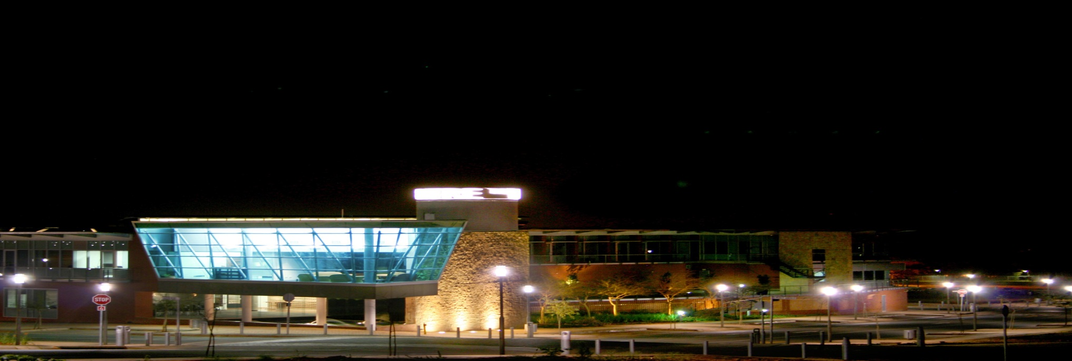

Inclusive Green Growth through Innovation
Dr Charity Mbileni
Senior Manager: Green Economy and CIC
Global Forum – Innovation for Green Growth
East London, South Africa
30th May 2013

Slide 2
Contents
Positioning Gauteng within South Africa
Climate Innovation Centre
CTP/TIH Community Outreach Workshop
Findings and Recommendations
Case Study: Ecovest Holdings (Pty) Ltd
Concluding Remarks

Slide 3
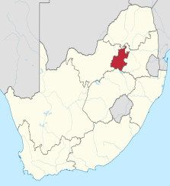
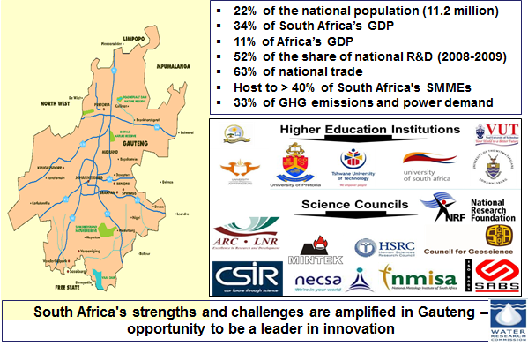
Inclusive Green Growth
Positioning Gauteng within South Africa
Gauteng Province Key Indicators

Slide 4
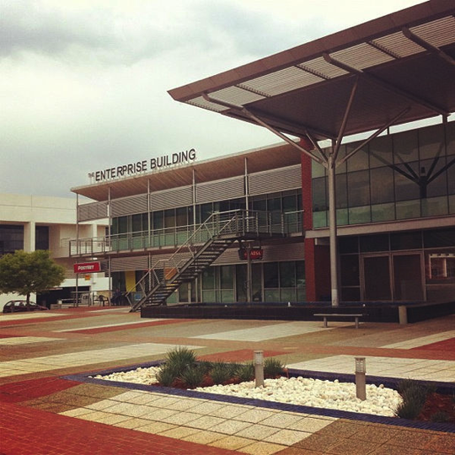

Inclusive Green Growth
The Innovation Hub
Striving to be the focal agency responsible for catalysing innovative solutions to the social and economic challenges of Gauteng
GP Dept. Economic Development & Gauteng Growth & Development Agency subsidiary
  located in Knowledge Axis in Tshwane, Pretoria
Science & Technology Park (IASP)
  Catalyst for socio economic development
  competitiveness of associated businesses & knowledge-based institutions
Support growth across Sectors e.g. ICT, Green Economy, Biosciences, Industrials
  Skills Development and Entrepreneurship
  Value Addition to existing businesses
  Catalyse R&D Commercialisation
  Attractive spaces - emerging knowledge workers
  Enhance synergy within innovation eco-system
Notes:
The Innovation Hub, a community of successful, innovative companies. Established in 2001, The Innovation Hub (TIH) is a science and technology park whose main aim is to increase the wealth of its community, by promoting the culture of innovation and the competitiveness of its associated businesses and knowledge-based institutions.
For over 10 years, The Innovation Hub has supported the growth of innovative companies across sectors such as ICT, Biosciences, Green Technologies and Industrials.
The value proposition is based upon a pre-defined precinct (physical location), a physical community of innovators and value of being a resident company at The Innovation Hub brand. The physical environment is conducive for collaboration amongst participants, leading to increased innovation levels through proximity association, shared goals and facilitation through physical events eventually contributing to making the residents more competitive than their counterparts situated outside The Innovation Hub precinct.
Our environment provides value-adding business services to support the growth of technology-rich business enterprises over the long-term to increase the wealth of the local knowledge intensive community, promote a culture of innovation, and stimulate the competitiveness of companies and knowledge-based institutions.

Slide 5
Inclusive Green Growth
Climate Innovation Centre (CIC)
Gauteng Department of Economic Development through Gauteng Growth and Development Agency
Programme funder
InfoDev’s Climate Technology Programme (CTP)
Aim: to accelerate climate innovation in developing countries
The Innovation Hub Knowledge intensive business cluster in SA
Climate Innovation Center
An innovative model to accelerate locally owned, locally developed solutions to climate change
Grants
Contracts for services
Proof of Concept
Mentorship
Pre-investment Advisory
Policy Support, Market Info
Regional Partners
Testing & office facilities
Beneficiaries: Technologists, Entrepreneurs, Start-up firms, SMEs, Industry

Slide 6
Inclusive Green Growth
Socio-economic challenges and Role of CIC
Majority of South Africa’s citizenry
are most vulnerable to climate change
least likely to benefit from green economy in terms of high-skills jobs or industrialization
CIC role is to
seek opportunities for participation from and to impact, historically disadvantaged communities incl. youth, rural and urban poor, and women
support technologies and businesses that serve the needs of disadvantaged groups
ensure inclusive growth in policy advocacy activities and financial inclusion and empowerment of the social economy
subjected to ecological issues that are a matter of livelihood and survival

Slide 7
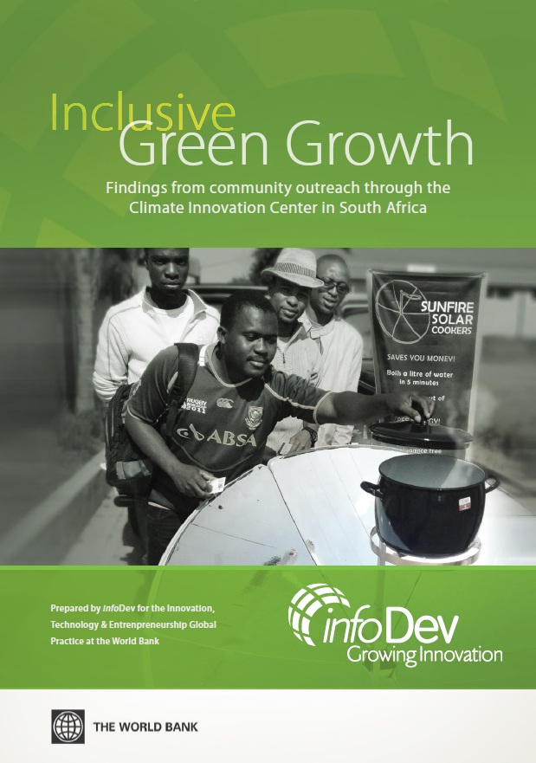
Inclusive Green Growth
CTP/TIH Community Outreach Workshops
4 local communities
  Alexandra, Ivory Park, Soweto and Melani Village
400 Individuals engaged
Audience
  students, researchers, educators, entrepreneurs and community residents
Exhibitors
  EcoVest, EnerGCare, Sunfire Systems and Green Gel
Presence
  Universities, FETS, Eskom, CSIR, Chamber of commerce and local/provincial government

Slide 8
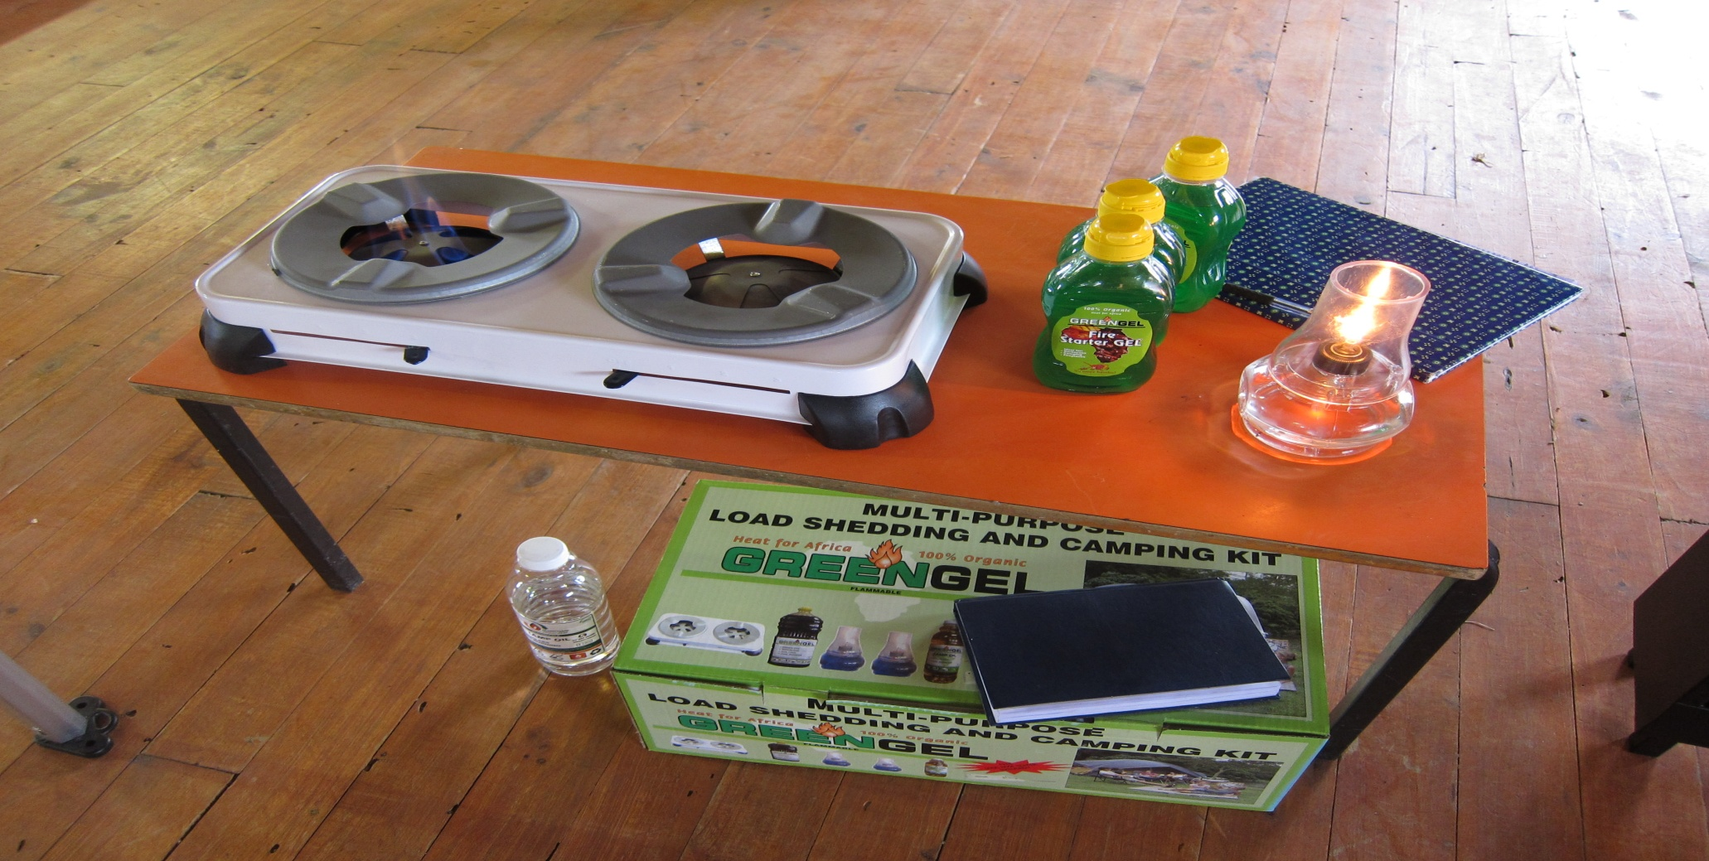
Inclusive Green Growth
Exhibitors: GreenGel

Slide 9
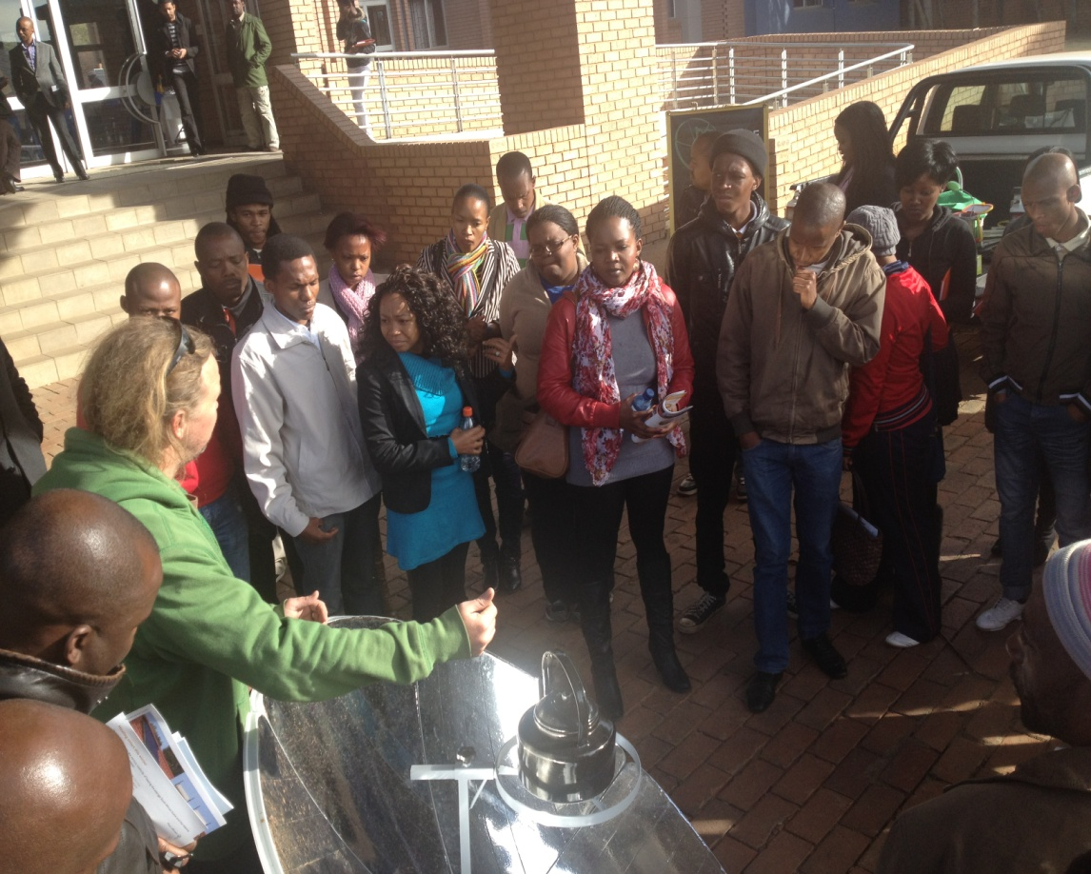
Inclusive Green Growth
Community Outreach Objectives
Promote awareness of climate
technologies that serve the bottom of the
economic pyramid and other marginalized
groups
Promote awareness of the CIC and
support SMEs to generate inclusive
green growth
Facilitate interaction and info exchange
among current and existing players in the
climate innovation ecosystem.
Gather information on stakeholder needs to further refine CIC activities towards inclusive
growth and serving the marginalized
Notes:
1) Promote awareness of climate technologies that serve the bottom of the economic pyramid and other marginalized groups
In addition to a multimedia presentation on inclusive green innovations, several South African exhibitors who are actively developing and marketing affordable clean energy solutions presented their products to the attendees for their information and evaluation. For more information on the exhibitors and their products, please refer to Section 5.5.
2) Promote awareness of the CIC and how it will support small and medium enterprises to generate inclusive green growth
Participants were introduced to infoDev‟s Climate Technology Program and The Innovation Hub. A brief overview was also provided about the Gauteng CIC and its planned suite of services.
3) Facilitate interaction and exchange among current and existing players in the climate innovation ecosystem.
Each workshop culminated in an open forum where the following issues were discussed:
• What are the community‟s most pressing needs / areas where climate technology would be of greatest impact?
• What are the barriers or issues hindering adoption of climate technology solutions in the community?
• How can the CIC better serve the needs of South Africa‟s communities and encourage local climate innovation?
4) Gather information on stakeholder needs to further refine CIC activities towards inclusive growth and serving the marginalized
Participants shared their entrepreneurial experiences and ideas, which provided more detail in the gaps in the innovation system within this demographic. This allows for a deeper review of the CIC‟s planned activities, most notably the inclusivity grants, technical assistance, and business advisory.

Slide 10
Inclusive Green Growth
CTP Findings and Recommendations
From the community consultations there is a scope for inclusive innovations in South Africa. Climate innovation can unlock local economic development and social mobility, given the challenges and needs existing in most communities.
Strategies to maximize inclusive green growth and climate technology innovation:
  Improve the quality, timeliness and flow of information on climate-friendly solutions to end-users at the base of the pyramid.
  Match end-user financing to the stream of benefits, thereby reducing upfront costs of switching or adoption.
  Extend community-level presence of institutional apparatus through partnerships with established actors in the social economy.
  Offer assistance and incentives that motivate firms to innovate towards inclusion.
Notes:
6.0 Findings and Recommendations
6.1 Inclusivity Strategies
An exhaustive survey of green BoP innovations conducted for a World Bank study(Green Growth, Technology and Innovation. The World Bank, 2012. )
indicates that very few BoP (and related low-tech) green innovations have been sufficiently scaled-up to date. However, it is evident from the community consultations that there is scope for inclusive innovations in South Africa. Climate innovation can unlock local economic development and social mobility, given the challenges and needs existing in most communities.
The community workshops and inclusive growth research yielded valuable and actionable insights which further informed the design of the Gauteng CIC. As it moves towards implementation, infoDev recommends that the center employ five strategies to maximize inclusive green growth and climate technology innovation. These strategies will directly inform the operations of the Gauteng CIC, but are also more widely applicable beyond the South Africa context. They are designed to localize and accelerate inclusion, facilitate access to climate technologies accessible, and spur green job creation at the base of the pyramid.
6.1.1 Improve the quality, timeliness and flow of information on climate-friendly solutions to end-users at the base of the pyramid.
Information asymmetry is a major barrier to purchase; sellers have disproportionately more knowledge than end-users, and are relatively less effective at conveying this knowledge in a timely and locally relevant manner. For a low-income household, purchase decisions are inherently more risky and complex. Prospective end-users need active guidance in understanding and evaluating options before they are driven to purchase.
There is therefore a need to improve the quantity of information that the poor can access about affordable clean technology alternatives. Workshop participants admitted that they were aware of some products, such as the solar lamp and cleaner cookstoves, but some technologies that were presented were completely new to them. However, following the workshops, several community members were interested to become customers and/or salespeople.
The implication for companies with an inclusive business model is that they should prioritize low-cost grassroots communications channels and direct marketing over than mass media outlets. Euromonitor estimates that mobile technology has a 95% penetration rate in South Africa, compared to only 10% for internet. Television and radio use are inconsistent across base of the pyramid markets, and are prohibitively expensive for start-up businesses except in the case of free public relations features or public service announcements. Word of mouth thus becomes a major marketing channel for reaching low-income South African households.
Moreover, the quality of available information should be made more digestible for its intended audience. Websites and marketing materials are predominantly in English; however, majority of workshop participants were only comfortable in their local dialect, particularly in the Eastern Cape location. The tone of messaging should also be respectful of the consumers rather than condescending or imposing. In both rural and urban areas, the use of personable and relatable local community representatives serves to build trust and engender consumer confidence, while streamlining marketing and distribution costs for the seller.
Finally, there is a need to tailor end-user messaging to focus on co-benefits (e.g. energy access, cost savings, health, safety, increased income/productivity). Many participants knew of climate friendly technologies such as solar lamps and cleaner cookstoves, but remained unconvinced or uninformed about the benefits. During the dialogues and demonstrations, they were more compelled by results that they described as tangible and personal, in contrast with macro-level impacts such as GHG emissions.
6.1.2 Match end-user financing to the stream of benefits, thereby reducing upfront costs of switching or adoption.
Price sensitivity is extremely high at the base of the economic pyramid. The scarcity of disposable income means that end-users are more likely to forego products and services, economize on usage of existing solutions, or employ makeshift substitutes. They are more careful and critical not only about the purchase price, but also follow-on ownership costs such as fuel, upkeep, and repair. This is exacerbated by the fact that the direct benefits of adopting the technology are often spread out over time.
CIC financing is targeted towards innovators and entrepreneurs; however, the center can connect end users to microfinance or crowdfunding institutions that can help to similarly spread out the cost of acquiring climate technology products. This mitigates the difficulty of having to save up for a lumpy upfront investment, since the timing and size of payments can be matched more closely to the resulting savings. Another option is to promote sharing of technologies that are too expensive for household or individual use. A cookstove, water filter or solar cooker can be shared by two or more homes in communities where residences are built in close proximity.
In certain cases, this approach can be further expanded to community-wide social enterprise projects. EcoVest SA is exploring this through modularization of their solar powered appliance system: whereas a complete solar light kit costs ZAR 500, the company has made the light bulb available for ZAR 65. A local business is established where batteries are charged and rented out, effectively sharing the cost of the solar panel and batteries. For houses that can afford to buy the entire kit, the company‟s other products (televisions, water heater, refrigerator) can be added on to the system with or without buying additional solar panels. Another example is the biomass gasifier which was installed in Melani‟s village bakery to increase economic output, decrease waste and create local jobs. Because it generates value for the entire community, residents share responsibility for its operation and maintenance.
6.1.3 Extend community-level presence of institutional apparatus through partnerships with established actors in the social economy.
To a certain extent, the interventions required to fully mainstream inclusive green growth may lie beyond the scope of the CIC‟s capabilities. This constitutes a valuable opportunity to leverage institutional linkages with the public sector, academe, industry and civil society. Non-governmental organizations, cooperatives, and other community-based organizations can all become key proponents in the design and implementation of effective and sustainable green economy approaches and interventions. Institutional partners will also be valuable in building a human capital base of knowledge, skills and entrepreneurial appetite that will sustain the climate innovation system. The CIC should collaborate with these entities and leverage their expertise to deliver effective, holistic, and sustainable green economy interventions.
Another recommendation is to establish satellite offices in urban and rural poor communities outside of the CIC‟s central location in Pretoria. These offices can deliver CIC expertise and assistance on a micro scale. This also includes financial support; the CIC‟s inclusivity grants may be smaller in size in order to serve a greater number of entrepreneurs and maximize job creation. To illustrate, Robert Mtshali requires only ZAR 15,000 for his water-saving car wash business, far less than the ZAR 100,000 peg for inclusivity grants and the CIC‟s average cost per job. Each satellite office could be responsible for parceling out a ZAR 100,000 inclusivity grant to support multiple ideas like Robert‟s. To this end, it will be important to leverage the expertise of the microfinance and rural banking industries in order to minimize related transaction and monitoring costs.
6.1.4 Offer assistance and incentives that motivate firms to innovate towards inclusion.
The market potential at the base of the pyramid is often overshadowed by the logistical complexity and cost structure implications of serving poor constituencies. To facilitate the mainstreaming of an inclusive mindset, the CIC must actively inform and channel existing innovative capacity towards serving the disadvantaged.
The primary way to achieve this is through the center‟s financial services. In addition to the inclusivity grants, criteria for social benefit can be weighted into the screening for proof-of-concept funding and seed investments, such that larger SMEs are encouraged to consider incorporating social development into their business plans and related milestones.
The center can also provide entrepreneurs with product development assistance and specific insight into community needs. For instance, many types of improved cookstoves are rejected by people in communities where coal is unavailable or expensive. Product functionality and design which is appropriate for a rural community may not be relevant to an urban one, and vice versa.
However, innovation in technologies and products is not enough. Processes and business models also need to be tailored to the target market. For example, many companies that operate in low-income markets struggle with financing, billing and payment. Because income streams are limited and sporadic, sometimes unpredictable, large upfront costs and even monthly payments can be a significant challenge. Companies may also struggle to develop efficient collection systems, whether in urban or rural settings.

Slide 11
Inclusive Green Growth
Further Services to Promote Inclusion
Demand generation – promoting awareness of climate technology solutions that are designed for the base of the pyramid and marginalized groups;
Supply Management – helping SMEs develop distribution networks, pricing strategies and other executional considerations for base of the pyramid markets;
Information management – aggregating, analyzing and disseminating knowledge to counteract existing market fragmentation; and
Relationship management – advocating on behalf of inclusivity with provincial/national government entities, international organizations, etc.

Slide 12

Inclusive Green Growth
Case Study: Ecovest Holdings (Pty) Ltd
Developing various solar-powered and re-chargeable household appliances
Incubated in CIC with technical and business mentorship and training
Funding for a launch pilot to be held n Alexandra township, in Johannesburg
The launch of the pilot is scheduled for June 2013
Distribution model uses local ‘Spaza’ shops in Alexandra
Spaza's will form co-operatives to ensure collaboration between shop owners
Local youths will be trained and capacitated to work as technicians who are readily available for installation, sales, demonstrations, repair and maintenance of the products

Slide 13
Inclusive Green Growth
Concluding Remarks
CIC has been fully established in South Africa
  To promote inclusive green growth and climate innovation solutions
  To facilitate access to climate technologies and
  To spur the creation of sustainable green job
Entrepreneurs with technological climate innovation solutions are supported and funded by the CIC
Incorporation of the findings of the Inclusivity Study
  Focusing on demand generation (awareness raising), Information and Relationship management
Partnerships and collaborations are crucial for sustainability of the CIC

Slide 14

Thank You!
The Innovation Hub
Innovation Catalyst for a Smart Province:
Gauteng, Republic of South Africa
www.theinnovationhub.com

