Slide 1

5th Global Forum on Innovation and Technology Entrepreneurship

Slide 2















What is the CIC?
World Bank-infoDev initiative, funded by UK Aid and DANIDA
CIC provides incubation, capacity building services and financing to Kenyan SMEs developing climate mitigation and adaptation solutions
First in a series of CICs that infoDev is launching globally
GVEP International, PwC, Strathmore University and KIRDI are the lead partners in a consortium contracted by infoDev to establish and operate the CIC
Supporting consortium partners are UNIDO, Adelphi, KIPPRA, LTS International, Netwas, Technoserve and Oxford Energy Associates

Slide 3


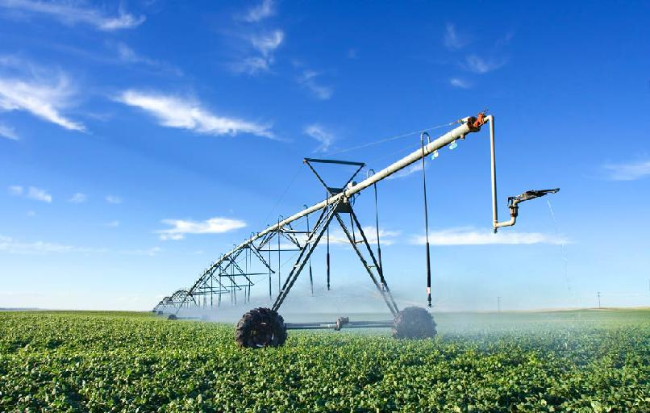
Sectors
Water and sanitation
Renewable energy
Agribusiness

Slide 4
How does the CIC foster Innovation?
Target participant: Entrepreneurs with innovative ideas/business models
Key collaborators: Government, Research & Academia, Private Sector
1
Provide mentoring and specialised training programmes
Access to toolkits, templates and pre-packaged support
Advisory services
2
Financing
Provide Proof of Concept grants ( for prototyping and testing technologies, piloting business models)
Facilitate access to other sources of financing
3
Provide access to facilities that house incubatees and support technology design, adaptation, prototyping, etc.
Access to facilities
4
Work with GoK to develop Kenyan clean tech policies
Coordinate technology transfer and collaborative R&D
Enabling ecosystem
5
Gather, package and disseminate information on technologies, financing and local markets
Access to information

Slide 5
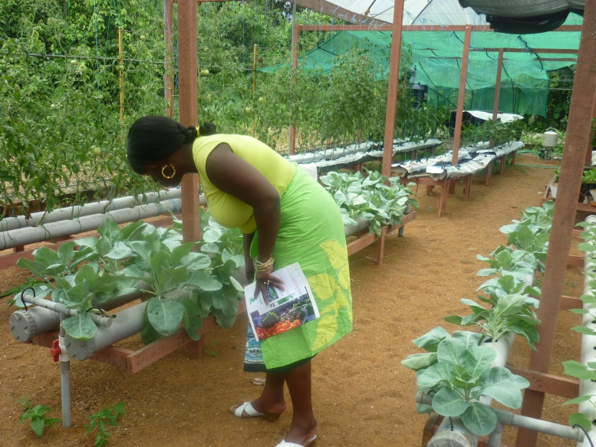
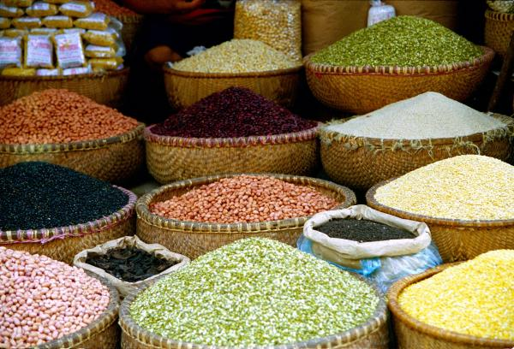
What are the Expected outcomes?
CIC will deliver a mix of social economic and environmental benefits including:
  Green Enterprises launched
  Green jobs created
  Reduction of CO2 emissions
  Greater climate resiliency
  Access to renewable off-grid energy and clean safe water
  Strengthened technology transfer and local innovation capacity
Combined suite of financing and services make the CIC the “go to” institution for emerging climate solutions in Kenya

Slide 6
What is the current outreach?
Thematic Sector | Applied | Admitted | Applied for POC Grant | Awarded POC Grant | Value of Awarded POC Grant (USD)
Renewable Energy | 82 | 19 | 6 | 3 | 87,500.00
Water and Sanitation | 16 | 3 | 0 | 0 | 0
Agribusiness | 21 | 4 | 0 | 0 | 0
Total | 119 | 26 | 6 | 3 | 87,500.00

Slide 7

Any difficult journey requires innovation

Slide 8
Case: Renewable Energy Entrepreneur
Takamoto (Pay-AS-You-GO Biogas)
Company overview
Challenges and support being provided
Location: Nairobi
Innovation: Metered Biogas, built and operate model targeting household users. Provides solution to high up-front costs associated with traditional biogas systems in Kenya.
Climate impact: Mitigation
Business/Technical challenges:
Prototyping the Smart Meter
Technical design of the pre-fab system
Understand key business drivers and response of the potential market
Understanding the potential carbon certification opportunities and process
Support being provided by CIC:
Refining technical design and testing
Market testing (pricing, usage, appeal)
Verify assumptions on the value chain
Legal advice on standards
Technology patenting
Access to sources of early-stage financing
Status
Contract signed
Prototype designed and tested
Piloting 50 units underway
Expected rollout: 370 units in 12 months

Slide 9
Jabari Pig Project
Company overview
Challenges and support being provided
Location: Kiambu County
Innovation: climate resilient agribusiness through farmer-led pork value chain integrated with water harvesting, organic fertilizer and biogas-linked to proposed power generation by COBITEC Ltd
Climate impact: Adaptation
Business/technical challenges:
Aggregating smallholder pig production
Understanding the business drivers
Benchmarking value chain competitiveness
Attaining best practices among smallholders
Access to start-up financing
Support being provided by CIC:
Proof of concept to pilot the business model
Feasibility study and modeling
Farmer aggregation and training
Market development
Access to sources of early-stage financing
Status
Working agreement signed
Workplan prepared
Kick off activities (farmer mobilization, business registration, market studies)
Industry linkages-inputs, financing etc.
Processing plant commissioning: Dec’ 2013

Slide 10
The Key Lessons Learnt
Service Delivery
Clients needs
Client focus is the key to success
Clients need easy, quick processes
Service delivery must keep pace with innovation: review, re-think, redesign
They are specific and dynamic, often one-off
Not possible to have in-house capacity that can address all the clients needs
Need to develop strategic partnership to meet client needs
Not all clients can make use of the centralized incubation space BUT still have to be served
Networking events are high impact just like training if not more.
Building Visibility
It is not what we say RATHER what clients say
KEY is to be inspirational accelerators

Slide 11

Thank You

