Slide 1
Climate Opportunities and infoDev’s Climate Technology Program
Global Forum
East London, South Africa
28-20 May 2013

Slide 2
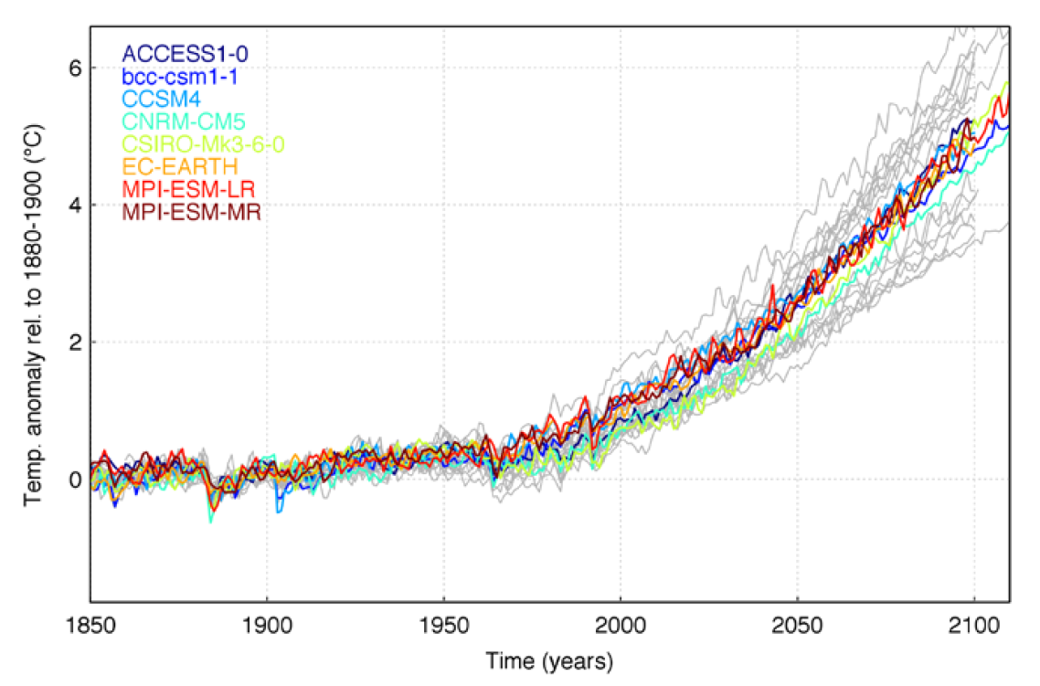
Climate change is reversing development gains
2

Slide 3
Global response to climate change and huge energy investments creates great opportunities
A global clean technology revolution will require up to $46 trillion in investments by 2050
550 million people worldwide have mobile phones but no reliable way to charge
BoP spend $37 billion annually on poor-quality energy solutions
Approximately 60% of new energy provision required for universal energy access is likely to come from off-grid and mini-grid solutions
Adaptation to climate change will massively effect huge segments of the economy
The BoP water market in Africa (252.4 million people) is measured at $2.5 billion
Only 25% of health centres and primary schools in Keya have access to reliable electricity.
3

Slide 4
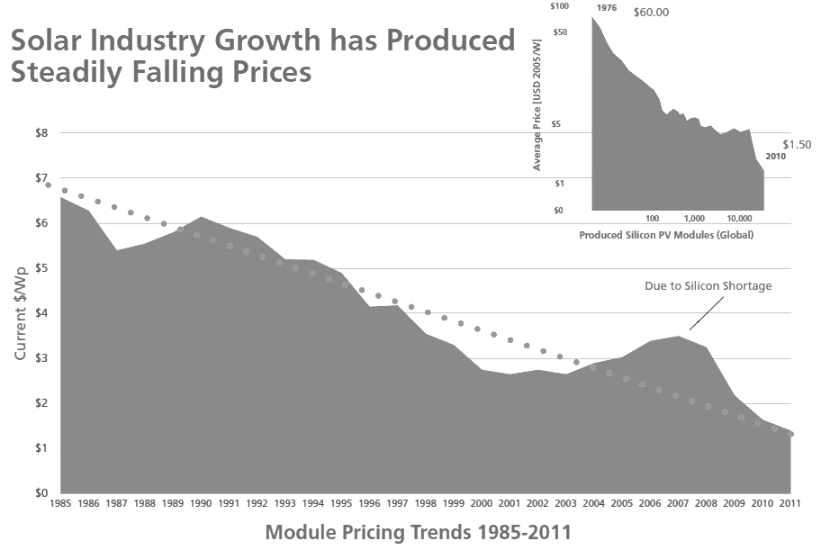
Emerging technologies provide a pathway for green growth
Solar modules, among other technologies, have experienced rapid declines in cost and increased efficiency
4
Notes:
IPCC and Navigant data

Slide 5
Barriers and gaps to innovaton
Some basic research in MICs; results from developed countries can be shared at this level
Existing Programs: Carbon finance, CIF/CTF, GEF, IFI lending
----------------------------
Some limited private sector
Low-income IFI programs
Key gap for innovation of appropriate climate technologies
Developing
Local and some multinational private sector
Niche sustainable investors
Commercial debt and public equity markets
---------------------------Multinational technology manufacturers
MICs
Stage of Country Development
Government and academic basic R&D
Government and other innovation programs (eg, US SBIR)
Valley of Death
VC and other early stage private finance
-----------------------------------
Private technology innovators
Industrialized
Conceptualization
Early-growth
Scale-up
Full deployment
Stage of Technology Development
Government =
Private sector =
Multilaterals, IFIs =
Gaps in capacity =
5

Slide 6
Challenges to developing country innovators
Lack of innovative financing options
Private capital missing
Lack of understanding of climate technologies
Unaware of technology advances
Lack of understanding of consumer needs, markets
Lack of policy engagement, incl taxes, IPR and standards
Limited capacity for facilitating early-stage innovation
Consumer base unwilling or unable to pay green premium

Slide 7
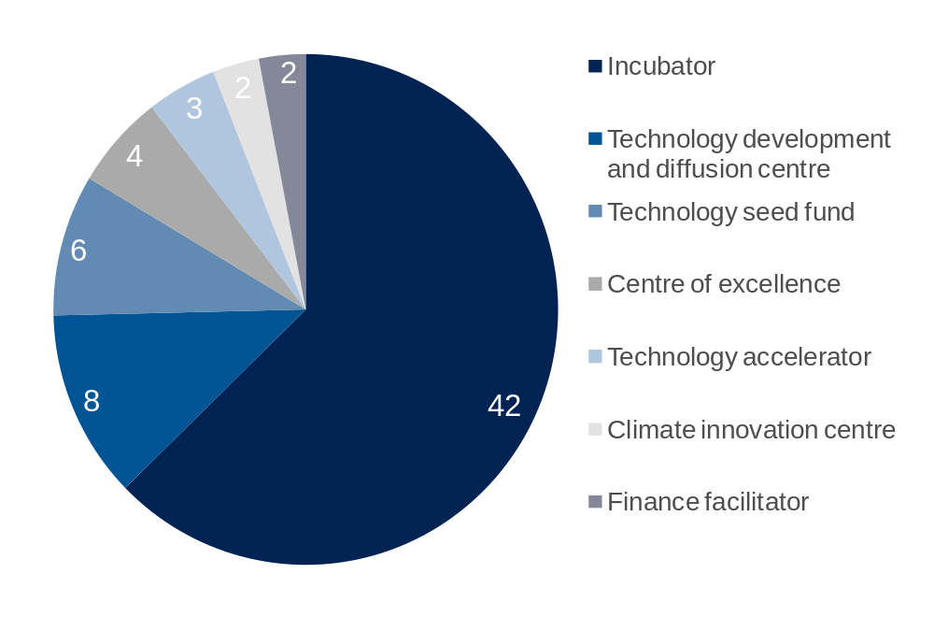
CTP design formed by global analysis
Global review of over 500 organizations and institutions supporting innovation (67 relevant to climate change)

Slide 8
At the country level CICs build private sector innovation capacity through a holistic service offering
Venture Financing
  Proof-of-concept grants up to USD 50k
  Seed Capital Investments from USD 50k-1m
  Investment facilitation and syndication
Business Advisory/ Training
  Business training, mentoring, access to professional services
  Technical training and skills development
  Education, seminars and events
Climate Innovation Centers
Government Advisory
  Research on sector policy trends and best practice
  Engagement with government on SME policy issues
  Policy dialogues, roundtables and events
Market Intelligence
  Access to databases on technologies, standards ad suppliers
  Information on markets, competitors and potential partners
  Research, reports and analytics on sector trends
Technical & Office Facilities
  Office space and services for entrepreneurs and start-ups
  Access to technical facilities to test and demonstrate products
8

Slide 9

CICs are being established in 8 countries around the world
The Morocco CIC will boost the capabilities of local entrepreneurs and SMEs to participate CTF Ourzazate and other solar ambitions
Ethiopia CIC services including a diaspora angel network, association support, and women-led innovation program will support Ethiopia’s Climate Resilient Green Economy Strategy (CRGE)
The Vietnam CIC will support up to 60 energy efficiency and sustainable agribusiness companies, complementing the government’s new Green Growth Strategy
In the Caribbean, the CTP is establishing a regional CIC network which will focus on sectors including tourism, agriculture, distributed renewable energy and technologies for adaptation.
The India CIC will address a number of domestic barriers to innovation such as skills constraints, fragmentation of institutions, unavailability of early-stage finance and an uncertain policy environment.
The South Africa CIC, highlighted in the 2011 Green Economy Accord, will promote inclusion of historically disadvantaged populations as climate technology consumers, producers and entrepreneurs.
Kenya’s CIC, the first in the Climate Technology Program’s global network, has already attracted attention from international organizations, regional bodies, governments, investors, and multi-national corporations.
9

Slide 10

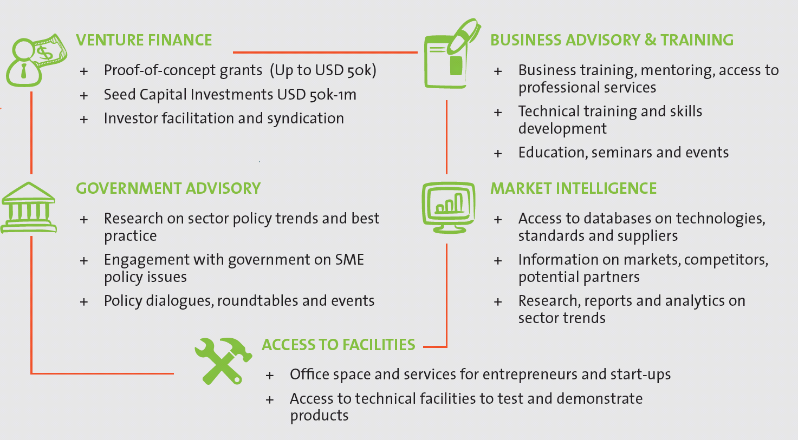
The CTP will leverage national CICs at the local level with Global activities that create a global community of cleantech innovators
GLOBAL
LOCAL
CIC Design
Morocco
Vietnam
IGNITE Fund
Investing in Green Innovation and
Technology Enterprise Fund
Caribbean
India
Ethiopia
Kenya
South Africa
Climate TRACK
Climate Technology Research, Analysis,
Communication and Knowledge
MarketCONNECT
Impact Xchange
10

Slide 11

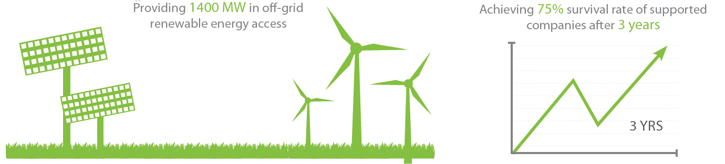



The CTP will deliver green growth impacts through investing in upstream activities
Helping companies achieve a higher success rate than business as usual
Delivering financing and support to hundreds of companies
Leveraging funding multiple times through crowding in private investment
Deploying new technologies that address local climate and energy challenges
Providing clean energy to thousands of households
Mitigating millions of tons of CO2
Allowing people around the world, including women and girls, to be less vulnerable to the effects of climate change
Creating quality jobs that lead to higher incomes and prosperity
Providing clean water across multiple communities
11

Slide 12

THANK YOU
Jonathan Coony, Program Coordinator,
Climate Technology Program jcoony@worldbank.org
12

Slide 13
Question for YOU
Question #1:
Which climate technology has the most promise in your country?
Solar (all types)
Biomass and biogas
Wind
Micro-hydro
Water supply
13

Slide 14
Question for YOU
Question #2:
What is the primary obstacle for climate technology innovators in developing countries?
Lack of appropriate financing
Access to information (on technologies and markets)
Need for international linkages
Need for business advisory services
Policy environment
14

Slide 15
Question for YOU
Question #3:
How much funding/financing could you usefully absorb??
Up to $20k
$20k - $100k
$100k - $300k
$300k - $1 mm
Greater than $1 mm
15

Slide 16
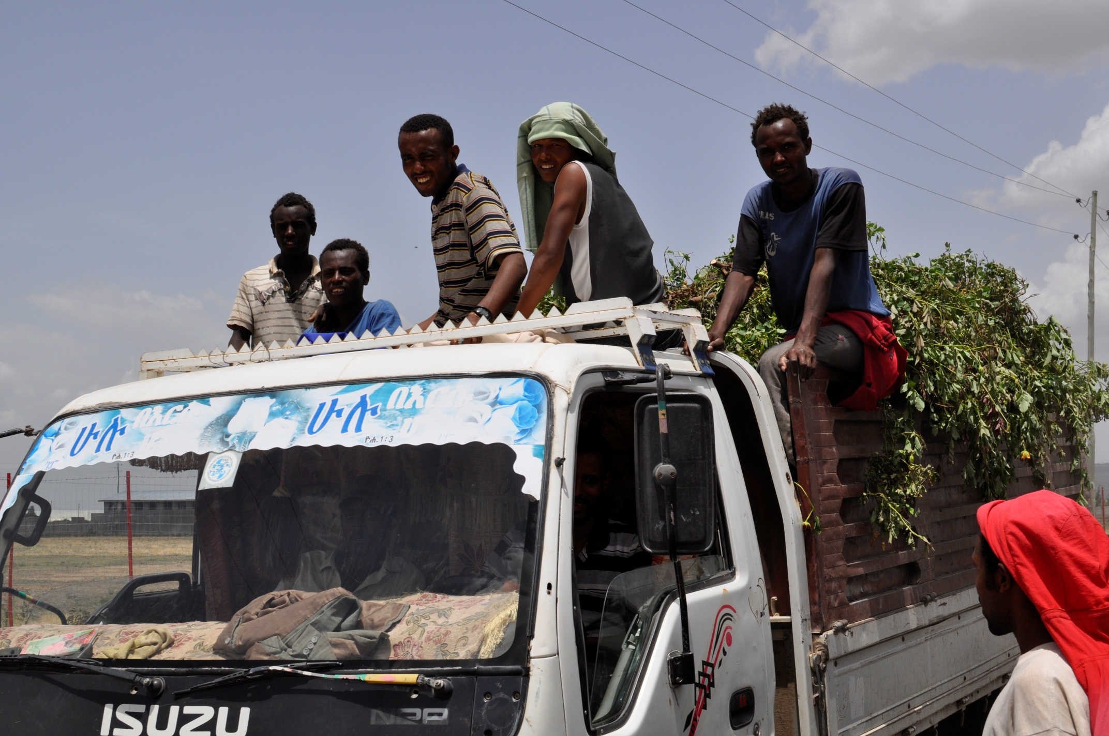
This produces an opportunity for developing country innovators
“Soil and More” based in Zeway is using Controlled Microbiological Composting (CMC) to sell cut flower compost back to farms
16

Slide 17
The Climate Innovation Trust Fund (CITF) is the first WB TF focused on Climate Innovation
WBG Contributions (Development Grant Facility)
Climate Innovation Trust Fund
Other Trust Fund Contributions
1
Steering Committee (SC)
Norway
UKAid
DANIDA
AusAID
Other Donors
Strategic oversight
Guidance and advice
Coordination
2
infoDev’s Program Management and Implementation Team (PMIT)
Results
Lessons
Convenership
Climate Technology Program
Global Level
Local Level
CIC Launch
IGNITE Fund
Climate TRACK
Kenya CIC
India CIC
Vietnam CIC
Coordination
Market CONNECT
Impact Xchange
Ethiopia CIC
Other country CICs
Technical oversight
Fiduciary mgmt
M&E
Coordination
3
Reporting
Research
Knowledge
Information
Partnerships
Private firms
Fund managers
Research institutes
Universities
Government/parastatal agencies
Incubators
Non-governmental organizations
17

Slide 18
Global CTP 5 year USD 60M program budget
18

Slide 19
CTP's current contributions of USD 35M for country CICs
19
Notes:
CICs launching in multiple other markets in 2012.

Slide 20

The CTP leverages multiple programs and financing sources including CTF, SREP and REACT
The Morocco CIC is being designed to support local content innovation and manufacture of solar components for CTF projects
CIC
Other sources of local funding include:
Governments
Private Sector
Donors/ foundations
WBG Projects
Other trust funds
In Ethiopia, the CIC’s Seed Capital Facility will provide complementary financing to energy SMEs in partnership with IFC’s SREP credit line
CIC
CIC
The Kenya CIC collaborating with Africa Enterprise Challenge Fund’s REACT to professionalize companies and boost their investability
20

Slide 21

The Kenya CIC launched in September 2012 in partnership with the Denmark and the UK
Partners: Strathmore University Nairobi, PricewaterhouseCoopers, GVEP International and Kenya Industrial Research and Development Institute (KIRDI)
Target impacts: Support 70 Kenyan cleantech ventures, generate 4,600 jobs, mitigate 1.5m tons of CO₂, provide cleaner energy access to 264,000 households, create $160m of long-term economic output
21

Slide 22
At the global level, the CTP is launching 5 new business lines
1
CIC Launch
Business Plan Development
Implementation and Launch
2
IGNITE Fund
Investing in Green Innovation and
Technology Enterprise Fund
Innovation Prizes
Investment Platform
Seed Investment Facility
Investor Syndication
3
Climate TRACK
Climate Technology Research, Analysis,
Communication and Knowledge
Analytical Products
Climate Technology Policy Toolkits
Collaborative Research
4
MarketCONNECT
Web-enabled Services
Networking and Events
Regional Innovation Networks
5
Impact Xchange
Innovation Monitoring System
Results Benchmarking
Exchanges & Training
22

Slide 23

The Center is making rapid progress to build its portfolio
Contracts signed with SMEs 17
35 Applications received post launch
  Renewable Energy (22)
  Agri-business (5)
  Renewable Energy and Agri-business (4)
  Water & Sanitation (4)
23

Slide 24
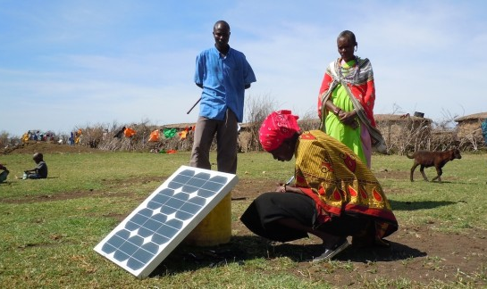
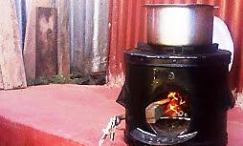
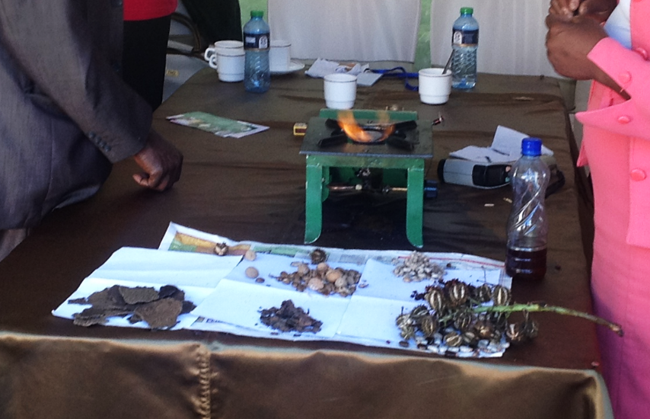
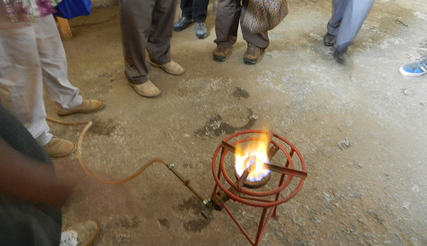
A selection of innovative companies the Kenya CIC is supporting
Sunny People: Solar phone charging service
Fawandu: Multipurpose clean cookstoves
Biossal: Making bio diesel to replace kerosene
Keekonyokie: Producing biogas from livestock farming waste
24
Notes:
Contract signed with 5 SMEs
24 additional applications received post launch
Renewable Energy (16)
Agri-business (4)
Renewable Energy and Agri-business (2)
Water & Sanitation (2)
10 being contracted

