Slide 1


Slide 2
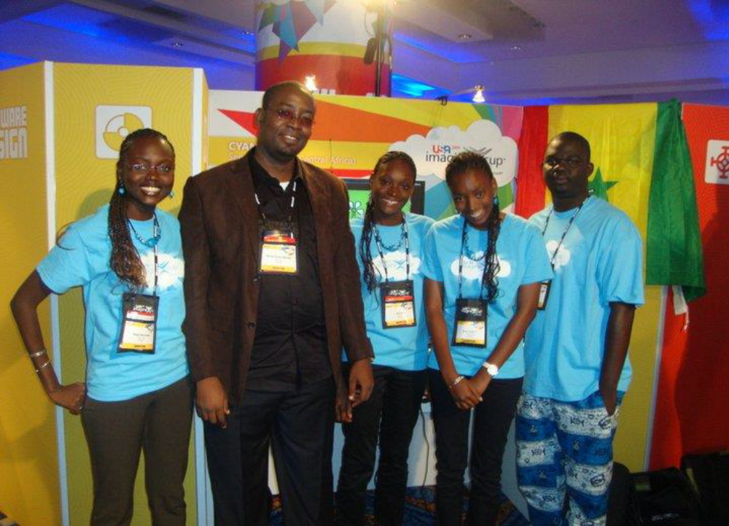
Imagine Cup 2011, New York – Software Design

Slide 3
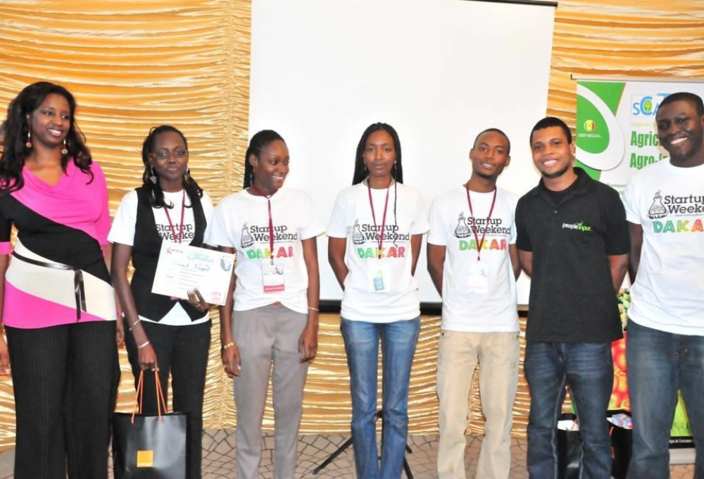
1st Startup Week-end in West Africa – Dakar - 2012

Slide 4
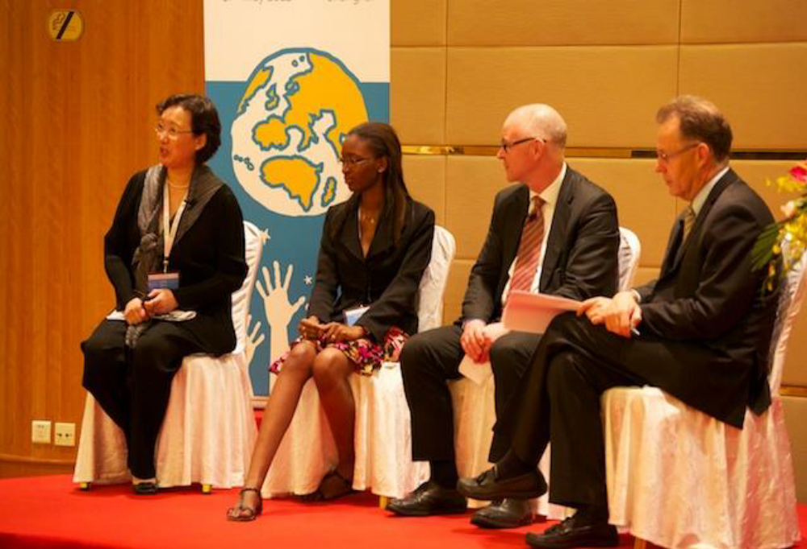
3rd International Congress on Technical & Vocational Education & Training – Shanghai - 2012

Slide 5
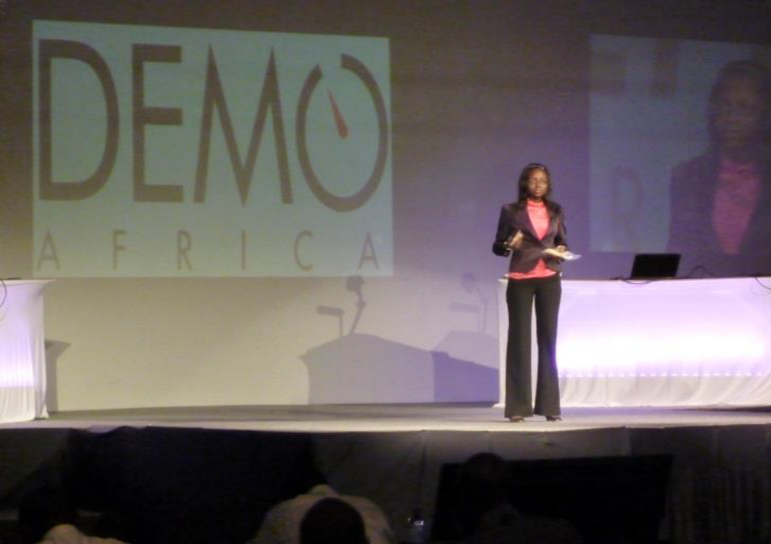
Demo Africa – Kenya - 2012

Slide 6
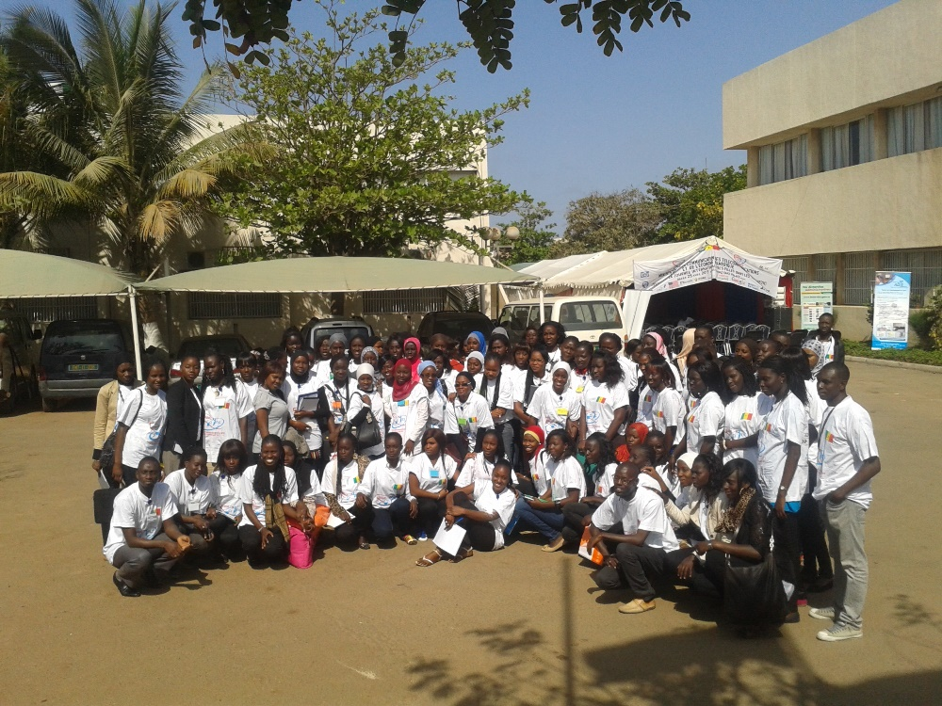
Girls in ICT Competition – Dakar - 2013

Slide 7
