Slide 1
5th Global Forum on Innovation & Technology Entrepreneurship:
East London, Eastern Cape Province
30 May 2013

Slide 2
Presentation Outline
South African ICT RDI Policy Evolution
Context – South African ICT RDI Implementation Roadmap
Vision and Strategy
Building South Africa’s Ambition
The 10-year Investment Portfolio
Structured Engagements

Slide 3
ICT RDI Policy Timeline
ICT R&D
and I Roadmap
10Yr Innovation
Plan
To build a knowledge-based economy
ICT R&D
and I Strategy
Approved by SA
Cabinet
Identified ICT as Key Tech Mission
Creation of
Meraka
Developing the NSI
Creation of
DST
Approved under
ISAD Plan
R&D
Strategy
To conduct: R&D, Application Dev and HCD
S&T White
Paper
1996
2002
2004
2005
2006
2007/08
2012/13

Slide 4

Ten-Year Innovation Plan
Enablers
Technology development and innovation
Grand challenges
Bio-Economy
Space Science
Energy
Global Change
Human and Social Dynamics
Human capital - Centres of excellence, South African research chairs initiative, professional development programme, etc.
Cross- cutting enablers
Knowledge infrastructure – Science councils, state-owned enterprises, global projects
International cooperation; regional and continental partnership
ICT RDI Roadmap supports the Grand Challenges as a cross-cutting sector .
ICT is one of the technology missions identified in the National R&D Strategy of 2002

Slide 5
The Economic and Social value of ICT
Economic Growth
When Internet penetration rises by 10% in emerging economies, GDP increases
by 1 to 2 %
The GDP growth rate of a developing country can be boosted by 0,59 % per annum for every 10 mobile telephones added per 100 inhabitants
For the U.S. economy, every $ invested in broadband provides a tenfold return. Faster broadband deployment in Europe could create 1 million jobs and growth of €850 billion through 2015.
“ICT has been the main driver of Kenya’s economic growth over the last decade. … Since 2000, Kenya’s economy grew at an average of 3.7 percent. Without ICT, growth would have been a lacklustre 2.8%”
ICT is a driver of economic growth
In South Africa
"the Internet economy is worth R59 billion (2011) and contributes some 2% to GDP"
Sources:
ICT for Economic Growth: A Dynamic Ecosystem Driving The Global Recovery - World Economic Forum, 2011
Kenya Economic Update, December 2010
Worldwide Worx Report
Notes:
Key points of this slide:
1. ICT has brought about tremendous changes over the last twenty years, but this is only the beginning.
- We are in the middle of a major disruption that is termed "digital convergence"
- Technology is changing our business models and consumer experience faster than ever
- ICT is now part of the fabric of developed economies
- ICT has become an intrinsic part of everyday life to the extent that, like electricity, modern society could not function without it
2. ICT enables significant economic growth as highlighted by the points on the right.
3. For SA to benefit from ICT
- We require a high degree of national ICT capability
- With the right investments in our national ICT capability, we can address our national priorities and become more than a distribution market by positioning ourselves to capture more of the value of the new digital value chain

Slide 6
Underinvestment in ICT R&D, in international comparison
2009 data, pa | Population (million) | GDP $Bn | GERD % GDP | ICT R&D as % GERD | ICT R&D as % GDP | ICT R&D Expenditure ($Bn) | ICT Sector Size ($Bn)
South Africa | 50 | 286 | 0,92% | 13,1% | 0,12% | 0,34 | 29
Brazil | 191 | 1 572 | 0,9% | 19,4% | 0,46% | 7,3 | 110
South Korea | 49 | 929 | 3,0% | 44,8% | 1,73% | 16,1 | 261
Australia | 23 | 925 | 1,7% | 15,9% | 0,43% | 4,0 | 129
Taiwan | 23 | 379 | 2,3% | 19,0% | 1,85% | 6,4 | 200
  South Africa spends close to 10% of GDP on ICT goods and services, of which most are imported
  R&D intensity of South Africa has stabilised at around 0.92% of GDP over the past few years, but is still well below the global norm of 2%
  Government, universities and science councils have a keen interest in ICT RDI, but funding and current spending on ICT R&D is limited compared to other fields
To harness the socio-economic benefits of ICT and to be a player in ICT,
we must significantly increase investment in ICT RDI
Notes:
Key point of slide: Currently South Africa are underinvesting in ICT RDI both in terms of our GERD (Gross Expenditure on Research and Development) and the % of GDP spend on ICT RDI. This is significant when compared to other relevant countries:
Brazil as another BRICS country
Australia as another commonwealth country with whom we have strong relationships
South Korea and Taiwan as countries recognised by the ITU (International Telecommunications Union) that are leading ICT RDI globally.
Note that data was taken from 2009. For 2010 GERD had dropped to 0,87%, but ICT RDI as a % of GDP has risen slightly to 0.14%.

Slide 7
Three key investment levers for creating Impact via ICT
R&D enabling Access
R&D enabling Services
Readiness
Accessible ICT infrastructure
Use
Portfolio of
e-services
Impact
Outcomes
Capacity
Critical mass of ICT skills
Advanced
Skills Development
DST Role:
Promote R&D and Strengthen National System of Innovation relating to enablement of Readiness and Use
Advanced Skills Development to underpin technological leadership to benefit from Digital Convergence
Source: ITU – Measuring the Information Society
Notes:
This slide is based on the Measurements used by the ITU to describe an Information Society. To achieve impact you need investment in three dimensions:
Readiness, which speaks to ICT infrastructure (eg. Telecommunications lines or Broadband infrastructure) and how accessible they are to the general public
Capacity: the technical know-how and skills to both manage ICT infrastructure and develop technical innovations on top of the infrastructure
Use: the ability to use, via services or applications, the available infrastructure
The purpose of this slide is to highlight DST’s role in terms of promoting R&D and strengthening the national system of innovation in regards to the 3 dimensions above.

Slide 8
ICT RDI Roadmap Development
Intent
Enable increased public and private investment in ICT RDI
Provide a framework to plan and coordinate technology development,
in order to enable efficient and sophisticated investment
decision-making
Background
DST initiated the development of a 10-year ICT Research, Development and Innovation (RDI) Vision and Implementation Roadmap, intended to:
Take the national ICT RDI Strategy to the next level, in a way that strengthens the local ICT ecosystem
Enable DST to develop and implement a set of specific interventions required to guide and direct ICT RDI activity in South Africa
Position South Africa more competitively in the global market, taking cognisance of and addressing the challenges facing a developing economy
DST and CSIR Meraka Institute partnered to develop this Roadmap for South Africa
Notes:
This slide gives the background as to why an Implementation Roadmap was required and the intent of the Roadmap.
8

Slide 9
Vision

Slide 10
Vision: Create Digital Advantage for South Africa
– from individual to society
Principal focus: satisfaction of National Needs (deliver Impact against 12 Outcomes)
Focused export activity as
technologies arrive on-market
(ie AFIS)
Test technologies with local customers before broader export
Our vision is for a South Africa that has overcome the Digital Divide; by leveraging advances in ICT to address socio-economic challenges it has created Digital Advantage
This will be done through sound investment and effective coordination of ICT R&D and innovation activities
Notes:
The Key point in this slide is that the vision is to create Digital Advantage for South Africa through ICT RDI investment.
The conditions for Digital Advantage is:
- Advanced human capital. Strong and institutional capacity
- Tight engagement with research communities; fast uptake and promotion of research results, indigenous innovation
- A healthy innovation ecosystem focused on achieving impact in society
- Advanced ICT infrastructure connecting South Africa
- Local content and applications that address local needs and also create export opportunities
The bulleted points on the right speaks to our initial focus:
We want to create ICT RDI that enables the delivery on the 12 national outcomes and impacts national needs.
We will have targeted and focused activities to create technologies that has export potential (eg. Advance Fire Information System – AFIS that already has been exported to Southern California and Eastern Africa)
But these technologies will be tested with local customers (as AFIS was first tested with Eskom) before broader export.

Slide 11
South Africa’s Ambition: Built from the Bottom up

Slide 12
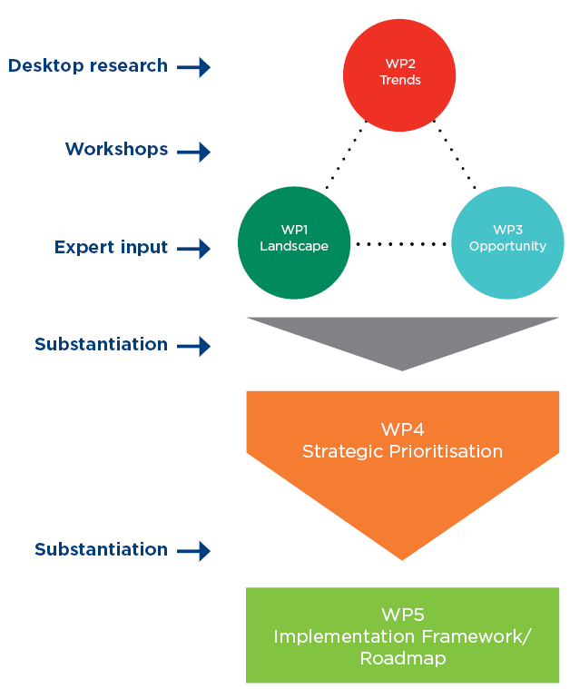
Developing the ICT RDI Roadmap – Ecosystem Triangulation Methodology
Notes:
We developed the ICT RDI Roadmap through extensive interaction with all relevant role players in which an Ecosystem Triangulation Methodology was used. Thus we looked at:
The Landscape (work package 1) to investigate the local capability and capacity to deliver and that which require development
Trends (work package 2) to ensure we are globally and locally relevant
Market Opportunities (work package 3) to ensure sustainability and attractiveness for funding
Information was gathered through desktop research, 5 workshops (3 Regional Landscape workshops in Western Cape, Inland and KwaZulu-Natal; 1 Trends workshop and 1 Market Opportunity workshop). A strategic prioritisation exercise was conducted with relevant stakeholders which lead to the development of the final Roadmap. Throughout, everything was substantiated with expert inputs and relevant stakeholders.
12

Slide 13
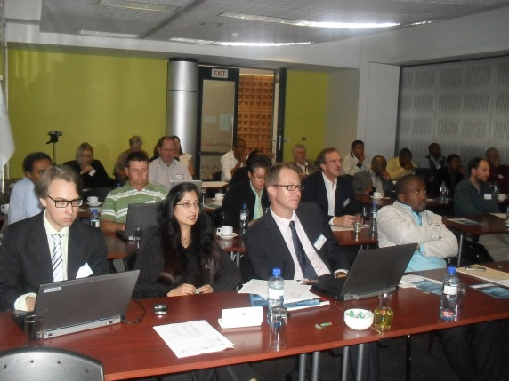
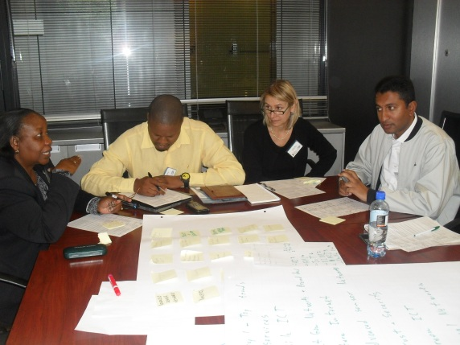
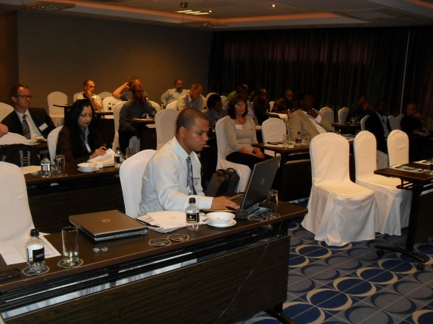
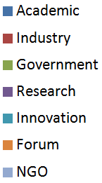
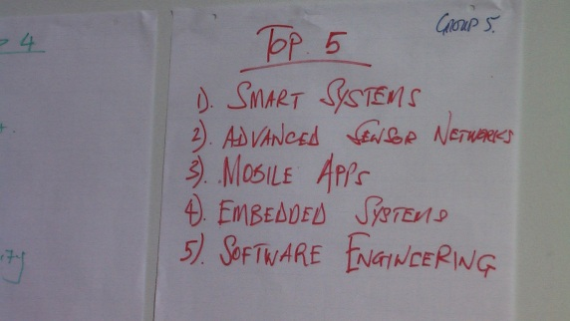
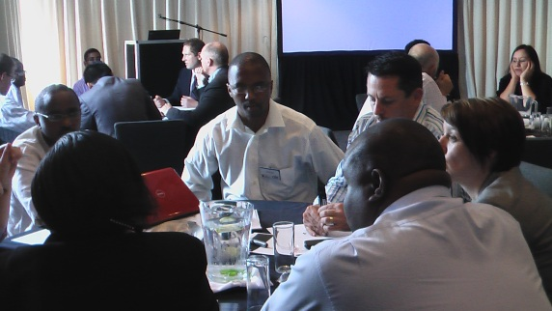
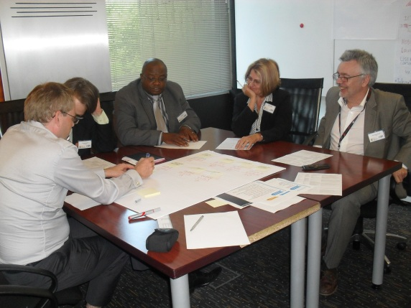
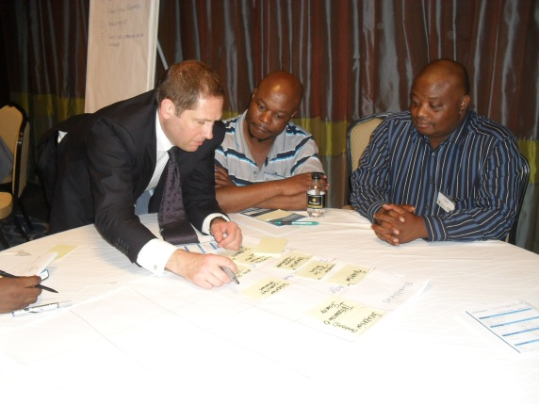
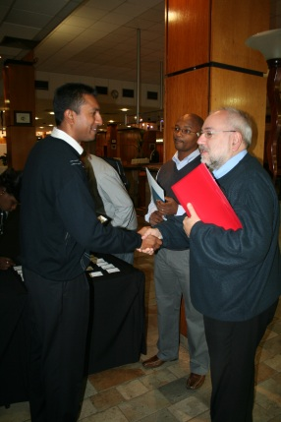
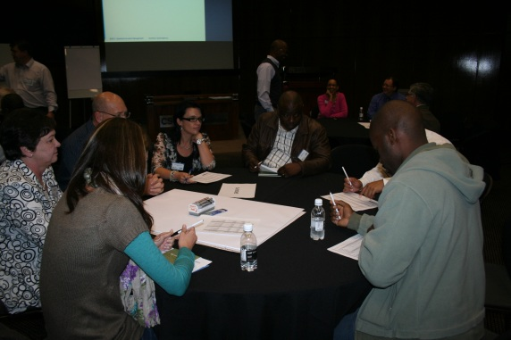
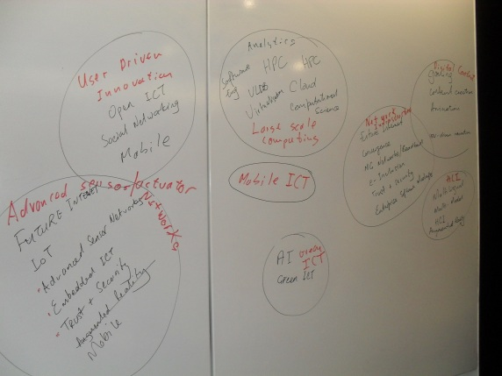

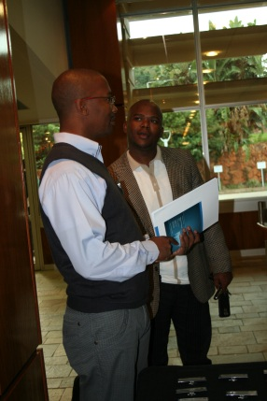
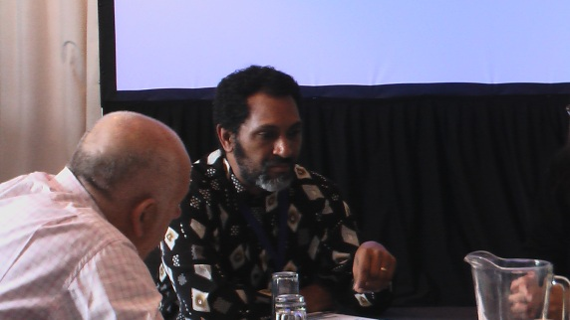
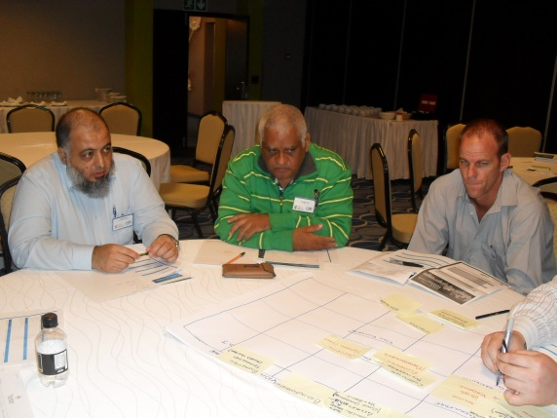
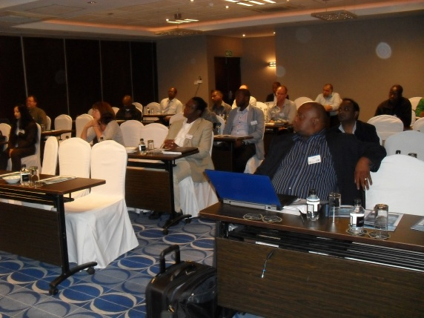
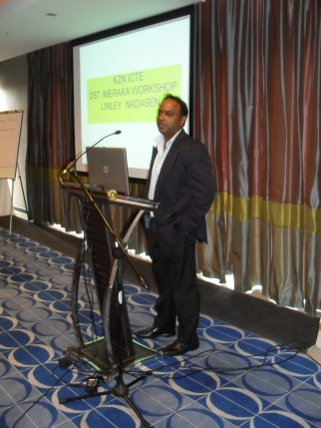

Broad Participation in ICT RDI Roadmap Development
127
106
44
40
17
2
1
Notes:
The key point of this slide is to highlight that 337 individuals representing 83 organisations took part in the development of the Roadmap.
13

Slide 14
ICT RDI Strategic Prioritization
Trends
  Identification of Drivers of Need and Demand for ICT – Global and for South Africa
  Analysis of Hot Topics (Desktop Research)
  Trends Prioritisation (Workshop)
  The Global ICT Ecosystem
Landscape
Market Opportunities
Notes:
14

Slide 15
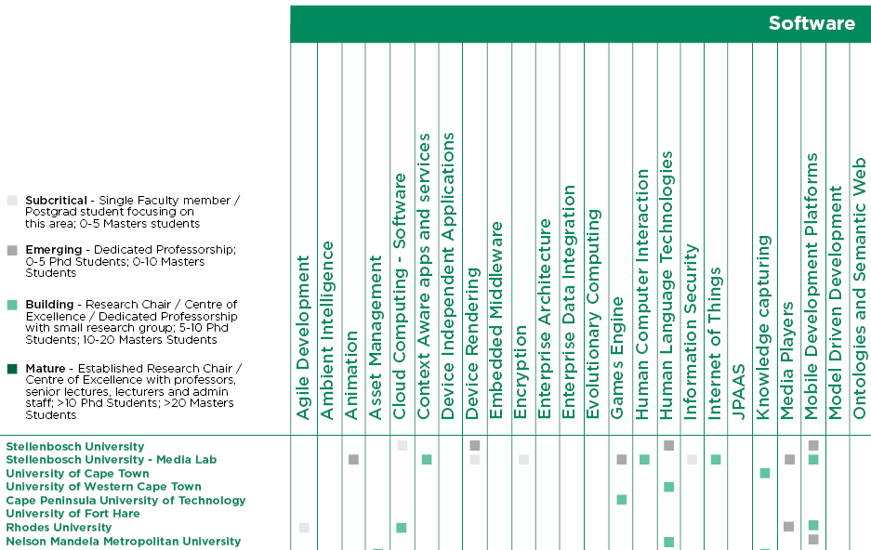
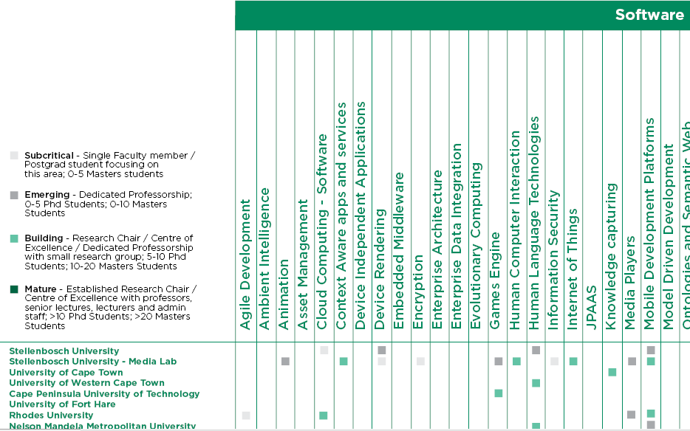
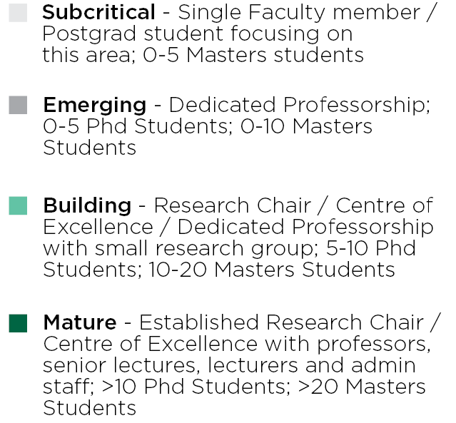
Building the ICT RDI Ecosystem
Strength and Maturity identified in more than 140 capability areas

Slide 16
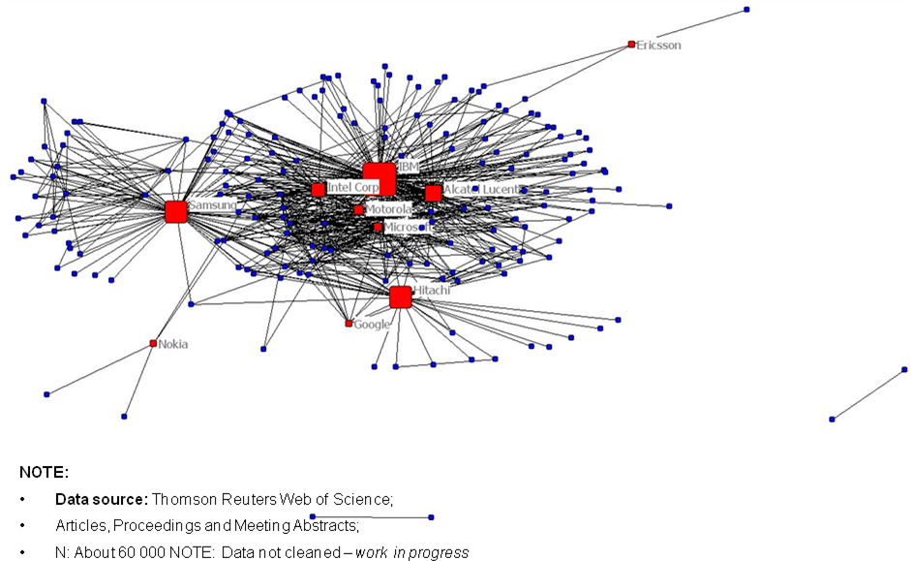
Global ICT ecosystem
Data source: Thomson Reuters Web of Science, Articles , Proceedings and Meeting Abstracts.
N:about 60 000
Note: Data not cleaned – work in progress

Slide 17
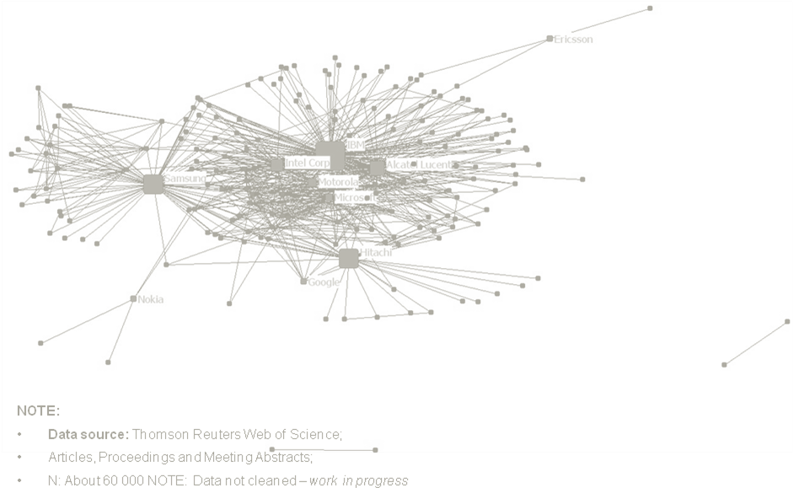
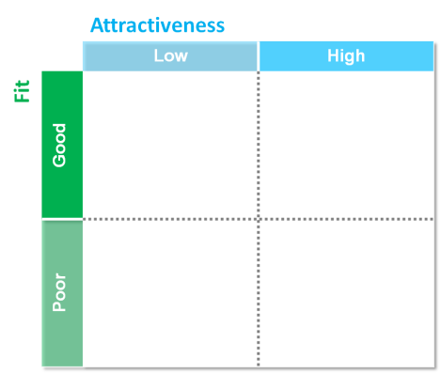
Clear intent and direction
More attractive partners; more active and Smarter Buyers
Opportunities
Options
Partners
N
Develop
alone ?
Case for Action
?
Import
Y
Ecosystem
Strategy?
Positioning ?
Objectives ?
Benefits?
Strategic ?
Value, Impact ?
Addressable ?
Collaborate ?
Build for...
Result: Increased national investment and FDI; with more balanced and mutually beneficial relationships

Slide 18
The 10-year Investment Portfolio

Slide 19
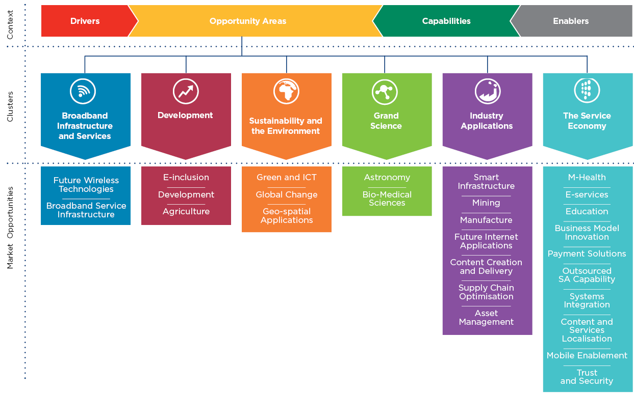
Digital Advantage: 6-Point Cluster Driven Strategy
Presentation www.dst.gov.za

Slide 20
Geo-Spatial Applications: Intervention and Impact
Intervention
^{RDI Activity}
^{Build Capacity} | Competence very spread out, so needs better coordination. Set up Centre of Competence to prime and focus relationship between industry, science councils and users. Develop Top 3 prioritised list of applications, then establish a community around each of these –status, R&D efforts, investment opportunities
^{Underlying Science} | Advanced remote sensing, sensor web enablement and OGC web services, geomatics, spatial databases, EO data structures & algorithms, image processing, machine learning and time-series analysis, scientific workflows, HPC for EO
^{RDI Infrastructure}
^{Install, Expand} | Leverage Earth Observation Data Centre, CHPC. Expand storage, broadband connectivity to share data. Own space assets, in-situ sensing networks, ground, field, water, meteorological data and systems
^{Knowledge}
^{Competence} | ^{HCD, HRD} ^{Via Centre of Excellence}
^{IP} | Techniques for development of massively scalable algorithms
^{Ecosystem}
^{Industry Participation} | Set up Centre of Excellence – Stellenbosch, Pretoria, UCT Marine
^{R&D Institutions,} ^{Science Councils} | GIS and Geo-spatial companies. Industry customers – users of geo-spatial information to provide services
^{Partnerships} | RCMRD, US geo-spatial institutes, ESA and Frame Work Programme participants
^{Innovation} | Via market-focused Centre of Competence and network of industry customers
^{Commer-} ^{cialisation} | Focus on services, software packages, knowledge application (consulting and advisory services)
Impact
^{Wealth}
^{Contribution to economy} | ^{2.6Bn}
^{New businesses} | ^{7 medium, 35 small}
^{Job Creation} | ^{700 high-tech, 2800 other}
^{Society}
^{Quality of Life} | Access to localised geo-spatial services
^{Service Delivery} | Improvements enabled through availability of local geo-spatial applications for public sector institutions
^{Strategic Advantage}
^{Foreign Policy Objectives} | GEOSS and participation in global forums and meeting global targets and initiatives. Participation and support in Africa ^{Self sufficiency}
^{Science Objectives} | ^{Localised solutions}
Government Action
^{Policy}
^{Regulation}

Slide 21
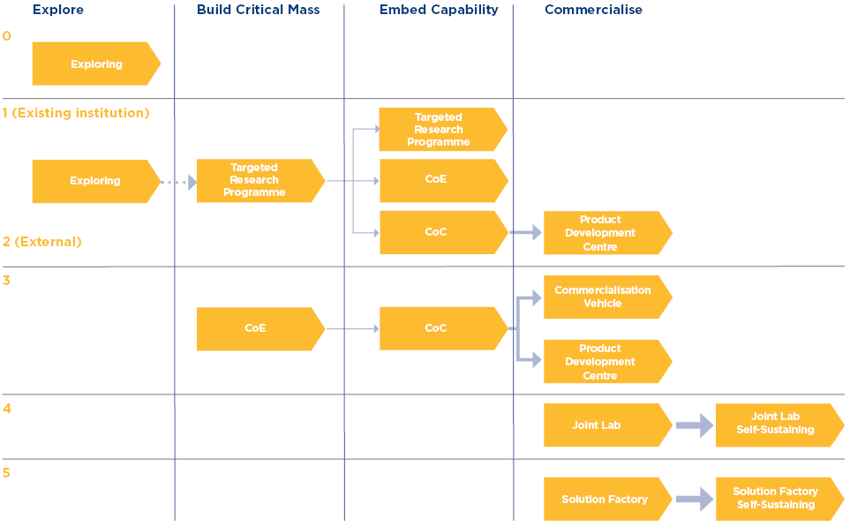
Progression Paths
Guide Investment and evolution of Interventions towards delivery of Impact

Slide 22
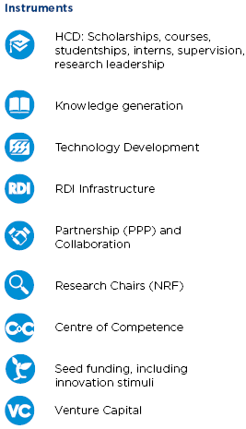
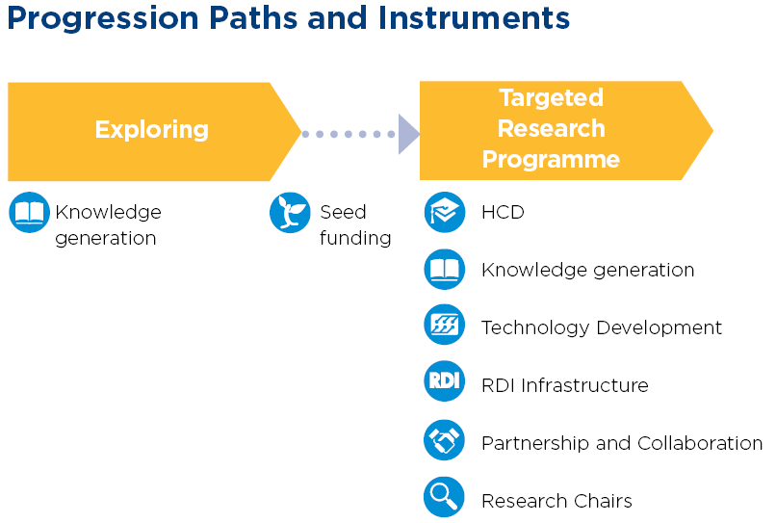
At each stage of evolution, different Instruments are required
Illustration

Slide 23
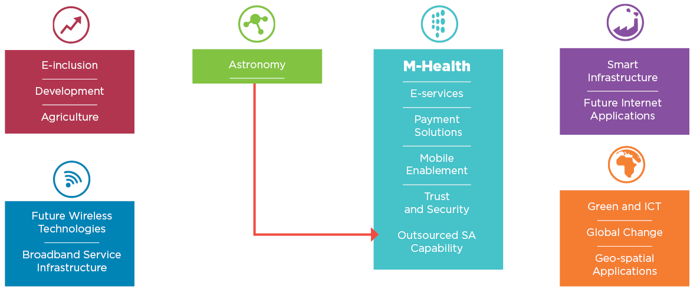


Initial focus is on Six Strategic Priority Areas
5
2
1
3
6
4
Notes:
From the 27 Market Opportunities, 6 priority areas were selected for the initial MTEF cycle (2013-2016) to kick-start the investment strategy: As illustrated in the figure above, these are:
M-Health: The initial focus in the Service Economy Cluster will be on innovation in mobile technologies, particularly in their use for Health applications. These will leverage developments in related Market Opportunities in this Cluster: E-services, Payment Solutions, Mobile Enablement and Trust and Security
Astronomy: As a Market Opportunity in the Grand Science Cluster, this area will focus on leveraging the ICT components of large projects like Meerkat and SKA to create new industrial and service capability, that will become Outsourced SA Capability in the longer term
Smart and Green Infrastructure: Two Market Opportunities, “Smart Infrastructure” (Industry Applications cluster) and “Green And ICT” (Sustainability and the Environment Cluster) are focused on developing and further enabling physical and digital Infrastructure so that it is optimised for efficiency, whilst reducing its impact on the environment, whether natural or built
Geo-Spatial Applications and Global Change: Both Market Opportunities are also part of the Sustainability and the Environment cluster which seeks to use ICT to optimise the management of assets, resources and environments, including more effective management and preparedness for the eventualities of climate change
Broadband Infrastructure and Services cluster, with a focus on the 2 Market Opportunities: Future Wireless Technologies and Broadband Service Infrastructure with both the required building blocks for providing innovative means of future access
ICT for Development has three Market Opportunities: E-Inclusion; Development and Agriculture. These are focused on enabling individuals to empower themselves economically, socially and democratically

Slide 24

Structured Engagements: Govt. Intervention for RDI Driven Impact
Technology
Expertise
People
Research
Outputs
Outcomes
Government
Improved quality of basic education
A long and healthy life for all South Africans
All people in South Africa are and feel safe
Decent employment through inclusive economic growth
A skilled and capable workforce to support an inclusive growth path
An efficient, competitive and responsive economic infrastructure network
Vibrant, equitable and sustainable rural communities with food security for all
Sustainable human settlements and improved quality of household life
A responsive, accountable, effective and efficient local government system
Environmental assets and natural resources that are well protected and continually enhanced
Create a better South Africa and contribute to a better and safer Africa and World
An efficient, effective and development oriented public service and an empowered, fair and inclusive citizenship
Research Institutions
Service Delivery
Policy
and Strategy
Services
Products
and services
Higher
Education
Value Chain
Strategy
People
Industry

Slide 25




Structured Engagement with International and Local Industry Partners
 | Priority Area | Partner
 | Broadband Infrastructure and Services | CISCO
 |  | Parsec IBM ZTE Microsoft Redline Communications Nokia Siemens Networks CellC MTN
 | Astronomy and Data Science | IBM SDRI
 |  | SAP
 |  | Intel
 | Development | Microsoft
 | M-Health | GSMA Cell Life GeoMed Mobenzi Hello Doctor M-Lab
 | Smart and Green | ESKOM Tellumat
 | Geo-Spatial and Global Change | Sasol Absa ESKOM International Eskom equivalents NASA
Engagement Model | Partner
Student / Researcher Exchanges | Google
Early Access to Technology | Intel (MIC Chip)
Joint Facilities | SAP, IBM SDRI
Technical Support | DELL, Nokia Siemens Networks
Joint Projects | Nokia, Microsoft, DiData
Access to Expertise | Microsoft, IBM

Slide 26
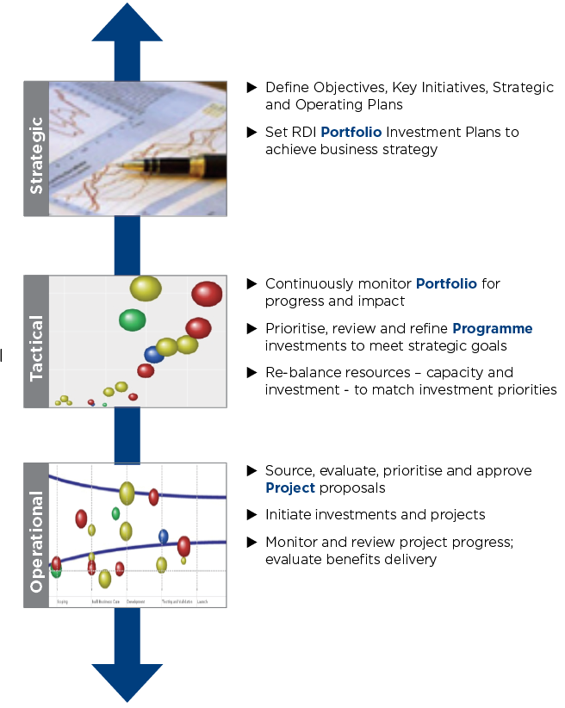
Monitoring and management of objectives and investment via Portfolio Management approach
Manage Investment
“To ensure efficient and transparent coordination, monitoring and active management – across strategic, tactical and operational levels - of the portfolio of RDI investments made by South Africa in ICT”
Grow Ecosystem
Improved coordination of research activity
Inherent incentives to cooperate
More targeted engagement with industry
Focused international collaboration
Stronger connection with innovation channels
More comprehensive and transparent monitoring
(of investment and impact)
A better basis of tracking HCD outputs
Define Objectives, Key Initiatives, Strategic and Operating Plans
Set RDI Portfolio Investment Plans to achieve business strategy
Continuously monitor Portfolio
for progress and Impact
Prioritise, review and refine Programme investments to meet strategic goals
Re-balance resource allocation – capacity and investment – with investment priorities
Source, evaluate, approve and Project proposals
Initiate project investments
Monitor and review project progress; evaluate benefits delivery
Notes:
2626
26

Slide 27
THANK YOU
Jeanette Morwane
Director: ICT & Services Industry
Tel: +27 12 843 6439
Email: Jeanette.Morwane@dst.gov.za
ICT RDI Implementation Roadmap
www.dst.gov.za/images/ICT_RDI_Roadmap.pdf

