Slide 1

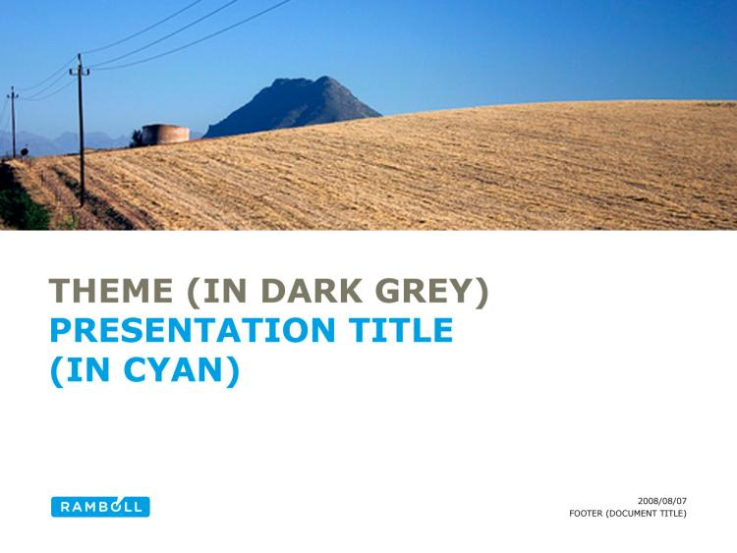
Innovation ecosystems
Alternative title slide
Setting the scene
Kimmo Halme
Notes:
Alternative title slide. Image size: 7,97 cm x 25,4 cm or 301 x 960 pixels

Slide 2
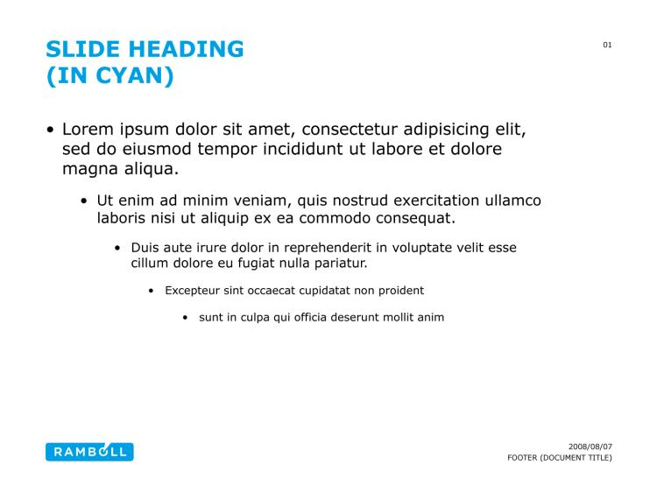
Key messages
The world is changing – how do we respond?
  Trends and drivers of change
  Role of innovation and innovation policy
Traditional policies may not be sufficient
  Changing values, uncertainty, grand challenges, complexity,..
What are the new approaches?
  Challenge-driven innovation policies
  Experimental policies
  From systemic policies to systemic innovations (ecosystems)
Content slide
Notes:
Content slide

Slide 3
Change = innovation
ECONOMY
ENVIRONMENT AND NATURAL RESOURCES
EDUCATION AND SCIENCE
SOCIETY, INDIVIDUALS AND COMMUNITIES
POLITICAL ENVIRONMENT
INNOVATION

Slide 4
Evolution in policy thinking
From sector policies (education, science, industry,…)
To the development of innovation systems (national, regional – support organisations and instruments)
To the promotion of systemic innovation (clusters, demonstrator, ecosystems)
What does it mean in practice?
What’s next?

Slide 5
Future of innovation policy
From the development of innovation systems to the development of systemic innovations
  Innovation ecosystem policy
Policies addressing societal challenges
  Challenge-driven innovation policy
New themes and values of innovation
  Exploratory innovation policy

Slide 6
What makes an innovation ecosystem?
Reciprocal / complementary collaboration of a large number of different kinds of actors (‘you scratch my back, I scratch yours’)
Often for a greater purpose / common objective (‘win-win-win’)
Soft and flexible structures – do not necessarily require infrastructures, organisations or rules
People, competences and the availability of services are essential
It is dynamic, adaptive and it works!

Slide 7
forms of innovation ecosystems
Large Scale Demonstrators (economic/industrial renewal)
Smart Cities / Future cities / Sustainable cities
Regional / provincial ecosystems (‘Creative Wallonia’)
Collaborations around large scale innovations and clusters (CERN, Airbus)
Active user communities (applications for sports, healthcare, education,…)
New forms?

Slide 8
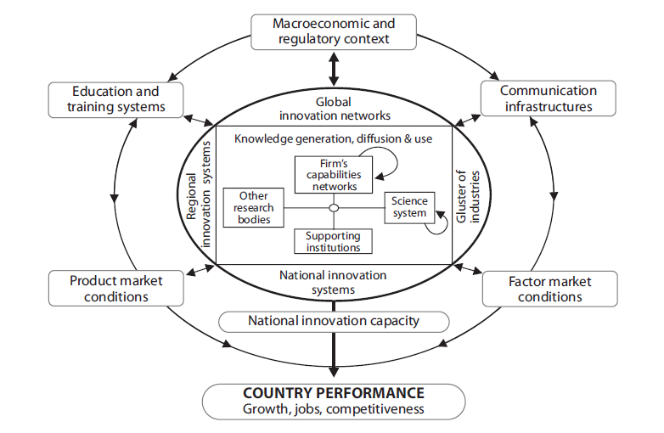
Innovation system approach
Source: International evaluation of the Finnish NIS

Slide 9
SHOK organisation (finland)
WP
WP
WP
SGEM
WP
MMEA
CTO
WP
WP
WP
WP
PSG
WP
WP
PM
PM
PSG
WP
WP
Support functions
CEO
Scientific management
Legal Counsel
Control-ler
Strategic management
Shareholders
Programme activity
Board
Comms
PM
WP
FCEP
PM
WP
PSG
Scientific council
CCSP
PSG
WP
WP
WP
WP
WP
WP
WP
WP

Slide 10
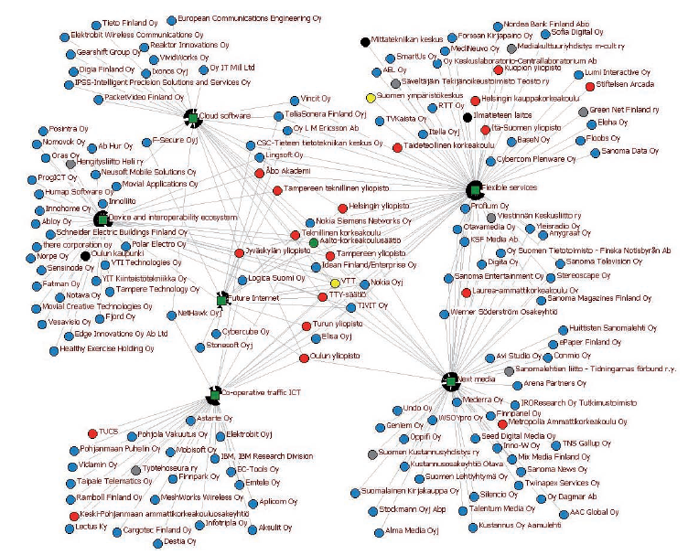
SHOK informal structures (FINLAND)

Slide 11
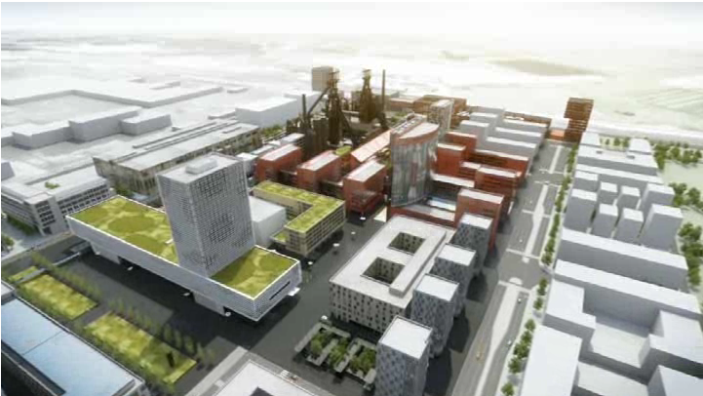
Large scale demonstrator in luxembourg (health) – infra

Slide 12
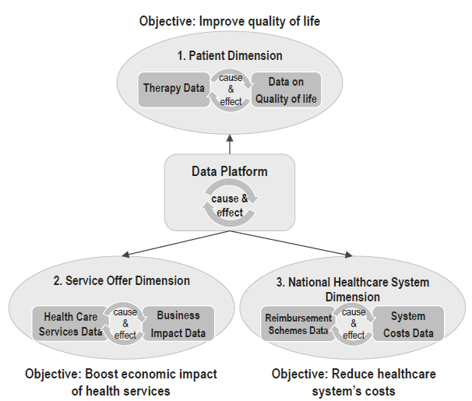
Large scale demonstrator in luxembourg (health) - perspectives

Slide 13
What is Ecosystem policy?
Self-guiding
Networks of actors, clusters
Ecosystems, demonstrators, living-labs
Strategic interventions
Mission-oriented programmes
Closed community
Open community
Coordinated

Slide 14
The role of government?
Identification of ecosystems
  Value chains, clusters, regional conglomerations,…
Activation of initiating ecosystems
  Joint interest /purpose /rationale (‘Linux operating system’)
  Operational context (network, location,…)
  Reciprocal benefits (win-win-win situations)
Enhancement of conducive framework conditions
  Boosting & scaling up platforms, test beds, living labs,…
  Incentives: funding for innovation projects, start-ups, etc
But not coordination, setting the rules or boundaries

Slide 15
Suitability for the african context?
Soft structures –> less investments in infra, organisations, etc
People & service-driven
Dynamic, agile, adaptable
Links well with other concepts, such as living labs, etc –> possibility for scaling up?
Benefits from ICT, social media and mobile communities –> active in Africa
Often addressing common / community challenges
-> very good! Can we mobilise them?

Slide 16
Thank you! kimmo.halme@ramboll.com

