Slide 1
Ngozi Bell
INNOVATION ECOSYSTEMS
Platforms and the ecosystems that grow up around them have the power to “drive innovation and transform industries” (Evans, Hagiu, & Schmalensee, 2006).

Slide 2
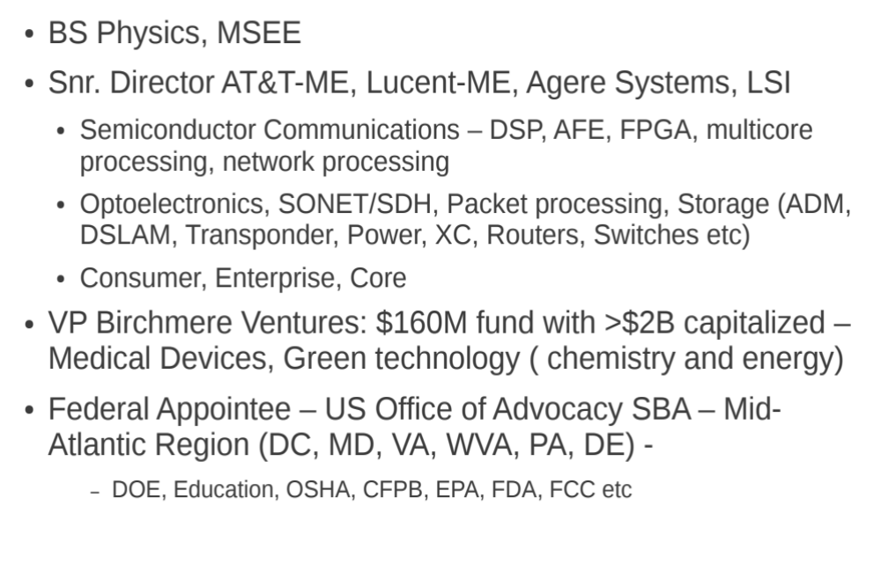
Introduction of Ngozi Bell

Slide 3
Fundamentally
When our entrepreneurs transform their ideas to business, those businesses transform to job creators – for the innovator and others that is a fundamental plus!
Ground zero - is cultivating entrepreneurs and innovators and the environment that supports them - the ecosystem!
Ecosystem - comprises of the key components whose interdependence produces a cohesive environment in which entrepreneurship thrives!

Slide 4
Enablers For Serious Growth
Regional Innovation Clusters
  Segments like ICT, Life Sciences/Healthcare, Nanotechnology, Energy
Focus on High Growth Companies (typically high technology fueled)
Large Capital footprint
  Access to democratized capital
Converge a Robust and Effective Ecosystem
  Incubation to Acceleration
    Collaboration and partnerships
  Commercialization Partnerships
    Includes Industry partners
Government
  Policy / Regulatory
  Public – Private Partnerships

Slide 5
Value of The Innovation Ecosystem
Critical!
  Without the Ecosystem you get little to nothing i
  With the ecosystem you get something or everything!
Evokes Teams – The Village Concept
  Scaled / Robust Collaboration– Intra/Inter
  Partnerships
Enables Sustainability and Growth
Notes:
Critical: If you go shopping and have no means of exchange ie goods for equivalent value resource – you come back with nothing
If you have no access to the market / who to buy or exchange with – you come back with nothing
If you don’t know what to buy/or what you give to get what you want, you come back with nothing
The ecosystem is all of that something and more
i – my upside down exclamation which expresses Omg (Oh My goodness)

Slide 6
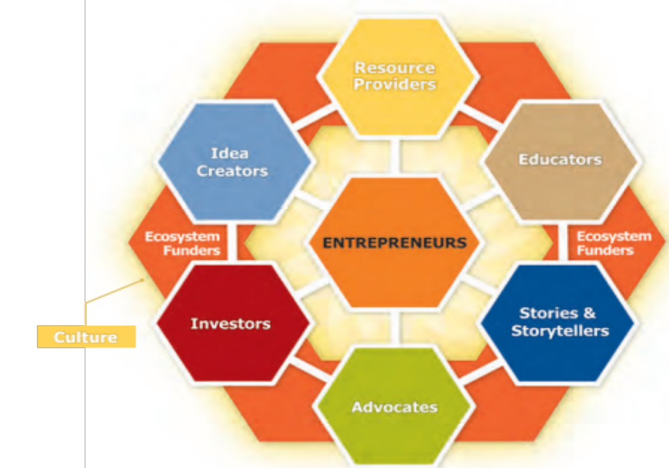

The Innovation Ecosystem Cycle
A rendering by the NE Ohio Ecosystem Coordinator Jumpstart
Innovators /
Effective Interdependence of key elements produces a cohesive evolutionary innovation environment
Most ecosystems are some variant of this model each octagon represents many sub functions

Slide 7
Key
Idea Creators: Group/Entity: sources of IP/commercialization, research centers (Bell Labs, NETL, etc) Individual: entrepreneurs /innovators – The Anchor of the cycle
Investors: Risk / Patient Capital – FFF, ED/CDFI, Angel Groups, VC, Specialized Loan Programs/Investment Bankers
Resource Providers: University wet/dry labs, industry access, Developers, Market Research etc. Hacker/Maker Spaces, Incubators, Accelerators, Idea Competitions Co working spaces etc.
Advocates: Policy Makers (local/state/Federal), Advocacy Groups that impact policy / regulatory climate, Small Business Advocacy groups, Chambers of Commerce, Domain Experts etc.
Stories and Storytellers: Inspirational / success stories from / to key demographics – Youth, Women, Mothers, Green Sector, Techies, Leaders etc. Bloggers, Media (Audio, Web/Internet, Vide/TV, Print), Webinars, Lifestyle publications etc.
Educators: Entrepreneurship curriculum through agencies, organizations or institutions
Ecosystem Funders: Foundations, Accelerators, Incubators, Corporations
Culture: Glue that holds it all together – process of living and enhancing the ecosystem experience, and learning from the failures and challenges – it evolves, stays for a while and evolves again – it helps create the continuum!
Notes:
Idea Creator Examples – Bell Labs, Cisco Labs, Bill Gates, Zuckerberg, Jonathan Sposato, Frances (Prowork)
Resource Providers – UPITT / CMU research center and entrepreneurship schools, Standford is a living lab, Techshop, Innovation Works, StartUPTown, HackPittsburgh, Ben Franklin Centers, Teqcorner
Advocates – OOA, SBA, NSBA, NFIB, USCC (US Chamber of Commerce), Commerce Dept, Governors office, Green/Environmental Groups, Youth, Mothers, Children, Industry – mobile, health, Energy, Safety, Agencies – EPA, OSHA, CFPB, Domain Experts, Bloggers, Media etc
Storytellers – Bloggers, Media (Print, Audio, Video/TV, web/Internet), Targeted Advocacy Goups / Domain Experts, Sector Inspiration - Youth, Women, Minority, Environmental

Slide 8
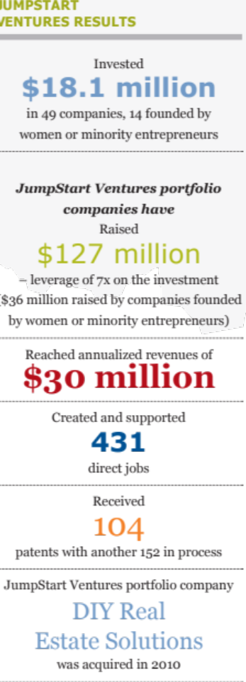
Evolutionary Characteristics of an Effective Ecosystem – Simple Depiction of Essential Functions
Core Ideation / Innovation pool (Birth)
  Sound science, feasible, reproduce able and scale able, experienced technologists and originators, crowd work, crowd source, Tech standards
Ubiquitous Technology Access (Nurture)
  R&D, IP Licenses/Technology Transfer, resources/know how, markets (domestic / global), Partnerships, Advanced Manufacturing (Rapid Prototyping, Additive Manufacturing), Media (ingress / egress), Public Policy, crowd work.
Business / Technology Accelerators (Growth)
  Access (Physical / Virtual/hybrid) to successful entrepreneurs (EIR) / mentors, Business Development, Investors, Seed Capital, incubation space, Industry, Workforce development/Internships/leadership team, Policy makers, Regulatory Agencies, Commercialization tools, Access to Capital / Investors
Results
  Capital Leverage
  Resource Leverage
  Tools Leverage
Notes:
Technology: Improvements to quality, reliability, performance through research and development, Prototyping tools for quick TTM
Market access – through media/web/Internet, you are working on a super malware prevention technique and need some innovative decision tree algorithm – you can go to a university and licence some off the shelf IP to incorporate into your solution – many universities spend hundreds of millions of dollars for basic research and are continuously seeking paths and translational funding to package their research for commercialization. – work with government agencies that have access to technology or are looking for solutions – USDA, DOE, NASA, DOD – many issue grants like the SBIR Grant, NASENI and its strings of technology labs in Nigeria have technologies looking to commercialize.
Resource Access: Market / Industry Research, Human and Organizational Resources
Access to collaborative partnerships

Slide 9
3 Essential Big Concept Elements in the value chain of Innovation Ecosystem that are universally translatable and transferable
Birth
Nurture
Grow
Innovators / Idea Generators (aka Entrepreneurs)
Core Ideation / Innovation Pool
Sound Science, feasible, reproduce able
Technology
Bridges Gaps – Technical, Market, Partnerships
Accelerators – Virtual / Physical
Capital
Education and Training
Creates Access – Tools, Markets, “The Crowd”, Media
Workforce Development
Commercialization
Public Policy Advocacy/ Regulations

Slide 10
Evolution of the Ecosystem – Best Practices Required to build the innovation economy
All roads must lead to commercialization
  Timely access to Government – Public Private Partnerships
    relevant policy and regulations, Tax Incentives, Grant/Capital, Big Research
  Workforce and leadership development
    EIR, Intern, Seasoned Entrepreneurs
  Build Community
    Virtual / physical, Industry, Technology Transfer/Academia
  Tools
    Education / Training, Testing / Research, Marketing, Maker / Hacker Spaces, Idea Competitions
  Access to Seed, Early Stage and Startup Capital
    Grants, ED, Government, Foundation, Loan Programs, Crowd Funding
The common denominator in the listed Best Practices is a well run robust Accelerator!
  A good accelerator program is where the cloud settles!
Notes:
A platform that ensures that all roads lead to commercialization
Access to regulations and policies that affect product or market (Chambers of commerce, Technology Organizations and Standard Bodies, Trade Organizations, Public/Private Agencies and publications, Tax Credits / Grants and Incentives, Institutions of learning
Workforce development – Leadership pool via EIR who know industry and can bring in seasoned entrepreneurs to help raise funds, access to key interns can merge interest and produce significant dividend in quality work (research regulatory and policy requirements), create robust product diagnostics, do market research – field and virtual, assist in building out project
Build community: Onliine and physical, collaboration, crowd work, crowd source, crowd fund
Where there is a cloud we know there is a potential for rain, when the clouds are heavy and thick we know it will rain!

Slide 11
Key Attributes of an Accelerator
(Control and Command Center)
Access to wide pool of Startups / Innovators / Entrepreneurs
  University Technology Transfer, Self starters, Industry etc.
Access to Wide pool Capital
  Not for Profit Economic Development (Direct Investment Seed / Follow on)
  Non dilutive (Grants), marginally dilutive seed funds
  Public: Loan Programs, Foundations, Investment Funds
  Private: Angel Groups, Venture Capital, Corp Development, Equity Crowd Funding
Access to Industry / Market
  Business Partnerships
  Technology Commercialization / Market Makers
  Customers
Access to Resources
  Tools – Education / Training
  Mentors / Executives In Residence
  Cluster Organizations
Flexible and Adaptable Infrastructure
  Sector Focused – Clean Tech, Energy, Life Sciences, ICT, Social Enterprises, Lifestyle, Proof of Concept etc.
  Demographic – Women, Young, Urban, Veteran etc.
  Regional / Location – State, multi-states, multi city, Rural, Economically Disadvantaged etc.

Slide 12
Examples of Accelerators
Innovation Works, Pittsburgh PA
  Invested $52.3M in 168 companies
  29 companies raised additional $1M + in outside investment
  Generated clients with $1.1B in revenues in 2011
Jumpstart, NE Ohio – Industry Development
  Invested $26M in 87 companies,
  $126M in leverage nearly 5x
  generated clients with $80M annual revenue rate
Some Accelerators with specific Focus
  Tech Town Detroit Michigan – University Partnerships
  Teqcorner, McLean Va. – Growth Business
  Capital Factory, Austin Texas – Pubic Private Economic Development
  MIT Deshpande Center Boston, MA– Proof of Concept Center
  Ycombinator, California –” Entrepreneurship Boot Camp”
  Pittsburgh Life Science Greenhouse, Pa – Life sciences, Biotechnology, Healthcare

Slide 13
Going Global
A Growth Imperative and nation building tool
  China: Poverty Rate 85% (1981), 15% (2010)
  India: Poverty Rate 60% (1981), 33% (2010)
  Sub Saharan Africa > 70% (1981), 43% (2010)
Engine of Growth has shifted from a centrally controlled (US and a handful of countries)one to a distributed one (Global play with strong emerging markets)
  2/3 of $ circulates outside of US
  70% of global spend is outside of US
  95% of market is outside of US
Information Revolution powered by ubiquittous technology and accelerated by the Internet (and the cloud) has created the most phenomenal paradigm shift of all times!
  Leading to Democratization of Innovation (crowd sourcing), Resources (crowd work), Capital (crowd funding)
  Crowd funding (Power of the Crowd): $3B (2012), $3-6B (2013), with 1% shift in US long term investments to small businesses = $300B capacity

Slide 14

Globalization of Innovation Ecosystems via Accelerators
Investors
Startups
Accelerators
Industry
Objectives
Build Accelerator Network as Commercialization channel
Increase Startups Served and quality of Startups
Increase/improve Outcome on innovation, commercialization and Jobs via Global resources
Resources

Slide 15
Globalization of Innovation Ecosystems
Investors
High Growth Companies
Startups
Accelerators
Industry
Effective commercialization Value Chain
Access to wide pool of Capital
Access to Wide Pool of Resources
Robust Access to Industry / Market
Access to wide pool Entrepreneurs/Startups
Resources
Ecosystem Impact
Accelerated Growth Companies/ Increased commercialization
Lower Fail Rates
Stronger Partnerships
Sustainable / Scale able Companies
Industry Growth
JOBS
Strengthen Ecosystems

Slide 16
Role of Government
Regulations
  Understand Economic Impact to Innovation and Entrepreneurship Ecosystem
    Implement good regulations
    Eliminate Obstructive regulations or use less burdensome alternatives
Policy
  Establish and communicate Sector Policy Domestic / Global
    Energy, Biotechnology, Cyber Security etc.
  Intellectual Property /Patent
  Immigration
  Talent Acquisition (STEM, STEAM, STEMM) etc.
  Tax
  International Partnerships – Export, Import, Co-development/marketing, Product Deployment
Public Private Partnerships
  Big Ideas
  Best Practices
  Barriers / Enablers

Slide 17
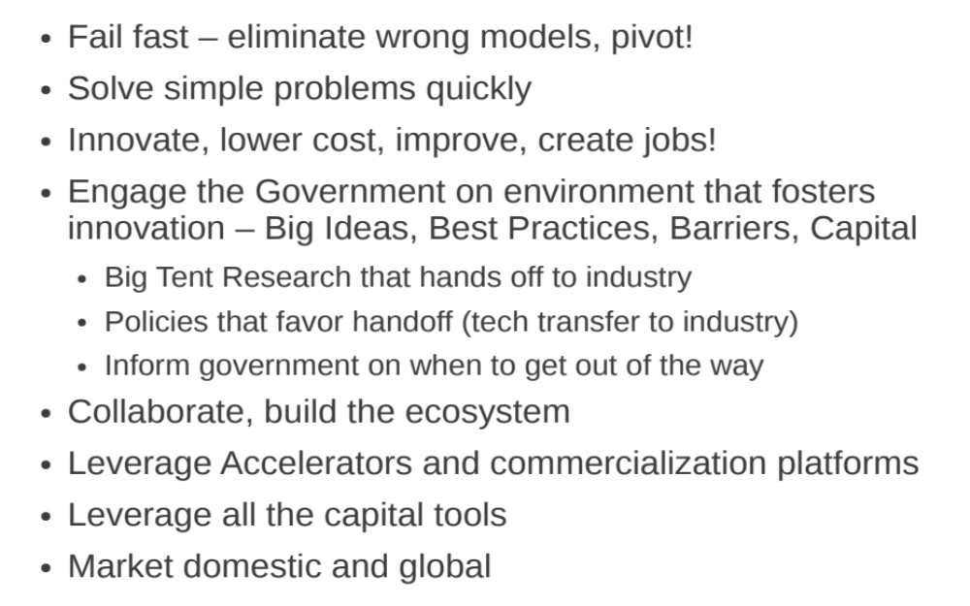
Innovators and Entrepreneurs
Marching Orders!

Slide 18
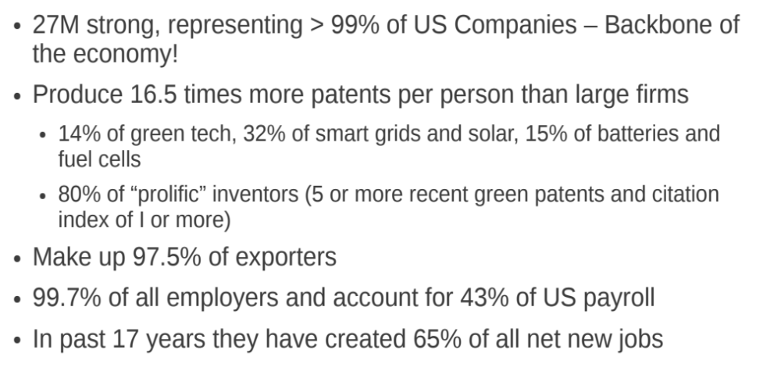
US Small Business Statistics (>500 employees)

Slide 19
Back Up Slides

Slide 20
Public Private Partnerships
Access to non dilutive funding
Access to Big Concept Research:
  Global: (Today: Human Genome Project, Prior: AIDS), Domestic
Big Idea development -
  Finance / Capital: Tax Incentives, Grants, Guaranty Loan Programs; (Global / Domestic)
  Partnership: Industry to Government, Government to Government beyond Export and Import
  Policy Advocacy: Domestic / International
  Organizational/Agency (NFP, NGO, Gov Agency, Trade Organizations): Domestic / International
Barriers
  Regulations: Domestic and International
Best Practices
  Accelerators / Technology and Business Partners / Ecosystem

Slide 21
Key Steps to developing an ecosystem
The architecture of the ecosystem:
  Useful to establish Single main distribution and Centrally Managed Code (platform tools such as source control, hosting services, email lists, change management are centrally resourced)
  Uniform or compatible Licensing model
  IP owned by single foundation or a single license that binds ecosystem community
  Open source ecosystem strategy to encourage enhancements available to the ecosystem
  A viable Application Programming Interface (API) through which functionality is exposed
The technical characteristics of the platform:
  In many cases project cannot be separated neatly to form an underlying platform with applications that run on top of it.
  Ecosystems differ considerably on how large the platform is relative to the entire distribution, and nature of the Application Programming Interfaces (APIs) through which the platform functionality is exposed.
  A platform will typically consist of a set of applications sufficient for a fairly wide range of uses to help spur adoption and grow market share.
    Including too much can reduce business opportunities, such as the ability to sell the included functionality.
    Including too little suppresses adoption and growth of the market.
Technical and social collaborative infrastructure:
  Ecosystem community converges on a common set of tools to support collaboration, communication, and coordination.
  Develop cultures with norms and values about cooperation, transparency, and citizenship.
Governance structures:
  Establish a governance structures can be around foundation, standard body (IEEE) etc.
    A number of key decisions were made centrally, by governing body often in consultation with members or advisory boards. Councils and committees, some with firms as members others required individual members
    Other decisions, such as what products to build, services to offer, and business models to pursue, are completely up to participants – ensures innovation and competiveness – eg. “meso” level allow projects have considerable authority over their own schedules, processes, and what features to build.
A critical role for research.
  Enhancing and growing the ecosystem will push the boundaries of practical experience and the current state of knowledge. For this reason it is critically important for ecosystem development to;
  proceed in close collaboration with a research community committed to addressing the essential unknowns, anticipating issues, applying state of the art solutions,
  take on key issues that will help the ecosystem thrive over the longer term.
  Research should be well funded and ample opportunities for interaction between researchers and ecosystem thought leaders
Craft an Outcome
  Robust platform (if a product it can be free or licensed) that reflects or results in systems or products with fundamental applications to a targeted or the broader community that is highly reliable, secure, and standard‐compliant, and is naturally adopted by a substantial segment of the market.
  Service providers of various sizes and specialties can readily install, configure, customize, and train.
  Vendors supply upmarket versions of the applications to large entities and networks.
  All the participants, including governing organization, benefit from the huge market created by adoption of the free version, and by sharing the cost of maintaining the platform and basic applications.
Notes:
A
From a business perspective, we believe the appropriate incentives can readily be put in place to establish the four key elements of an ecosystem‐based strategy:
Governing org performs or directs the vast majority of platform maintenance and enhancement.
Vendors will provide small, focused platform enhancements for free.
Vendors will provide the bulk of application development, enhancement, and maintenance
for a free distribution.
Governing org. will fund application enhancements required by governing org, and release the enhanced versions
to the ecosystem.
Key choices about the structure of the community and the role of governing org are:
Will the governing org commit to full participation in the ecosystem, and adopt an ecosystem‐ based software strategy?
Community: Will the community continue to maintain several distributions or will it rally around a single distribution with uniform or compatible licenses?
B
Will a platform be “cored” from the project? What will it include?
What APIs will be defined and developed? What functionality will be exposed for each? In
what specific way will the API make the functionality available?
Will free, open versions of applications be included in a distribution of the platform? If so,
which ones? With what level of functionality (will it, for example, qualify for “meaningful
use”)?
Will the governing organization choose contractual arrangements with vendors that will make all useful platform
code available to the community, or will vendor code continue to be regarded as proprietary?
C
Will all participants agree on and use a common set of tools, including a hosting service, mailing lists, source control, change management, etc.?
Will all participants (including governing organization and participating firms) agree to openly discuss important technical decisions in advance in agreed‐upon public forums?
ii
• Will all participants agree to take on the values and follow the norms appropriate for open source, even when this causes some friction with organizational values and norms?
D
Will a foundation be recognized as the legitimate steward of the ecosystem? Will it have ownership of the intellectual property, or be granted the power to insist on compatible licenses?
What kind of input will VA and the community have in the technical direction and evolution of the platform?
Will an organizational structure include a meso‐level with independent development projects, or will a foundation be the main decision‐making entity?
What will be the scope of the foundation’s decision‐making, and what kinds of decisions will be left to Councils or members?
How would a foundation be funded?
Will companies participate, for example, as members, board members, council or committee
members in such a foundation? If yes, how?
E
What social and technical collaborative infrastructure – tools, practices, and norms – will support an ecosystem on the scale and with the interconnectedness that the platform could achieve?
What delivery models make sense for the platform – cloud deployment? Providing applications as a service? Providing the platform as a service?
How can the very large‐scale platform legacy system be evolved into a desired architecture?
For individual and corporate participants, what is the business case for contributing to the creation and maintenance of a platform and a fully‐functional free distribution? How can it be modeled in convincing fashion so participants will have a sound basis for their decisions about participation and contribution?
How can the critical performance, security, availability, and other quality attributes of deployed systems be assured?
How can open source governance mechanisms – foundations, projects, councils, committees, user groups, vendors, service providers, health professionals, standards bodies – be orchestrated to provide effective policies, dispute resolution, and guidance for an ecosystem of unprecedented scale and complexity? Will novel mechanisms be needed?
In order to guide overall decision‐making, how can the socio‐technical ecosystem be modeled so that the effects of establishing or changing various design parameters can be predicted, and the space of parameter combinations explored?

Slide 22
Challenges
Growing a healthy ecosystem is fraught with uncertainties and challenges- design principles are uncertain and lack scientific bases in many cases – these difficult questions exemplify the challenges of developing a viable ecosystem
  Success clearly depends on much more than the quality and the design of the platform itself.
  How to create and sustain a critical mass of adopters that will provide a viable market?
  How to design the platform so that new technologies can be quickly integrated?
  How to ensure system‐level security and regulatory compliance when multiple vendors operate independently?
  How can such an ecosystem be governed so that technical coordination and coherence are assured, yet novelty and innovation are encouraged?
  Why would firms, naturally seeking profit and avoiding uncertainty, adopt business models that are tied to the success of an overarching ecosystem over which they have limited control?
Yet many have been established and scale considerably with time – the Software industry is wrought with good examples
  Mozzila, PERL, Apache, GNOME, Eclipse, Red Hart (Fedora/Linux)

