Slide 1

INNOVATION ECOSYSTEMS – FROM LOCAL TO INTERNATIONAL
GLOBAL FORUM ON INNOVATION AND TECHNOLOGY ENTREPRENEURSHIP,
EAST LONDON, 30 MAY 2013

Slide 2
Outline
Introduction and Background National Innovation System Provincial Innovation Strategy Ongoing Activities for Technology Transfer Conclusion

Slide 3
Introduction and Background
SA a developing country with various innovation instruments and infrastructure
  Apartheid isolation – creativity and self reliance
  Technological and research capacity e.g. nuclear science, military, bio-chemicals
South African NSI landscape
  DST Ten Year Innovation Plan (TYIP) – 2008-2018
  Research, Development and Innovation Strategy
  Provincial R,D&I initiatives
National Priorities
  Economic growth and competitiveness
  Contributing to Africa’s development – supporting the NEPAD/AU
  Dealing with challenges of inequality, poverty and unemployment

Slide 4
NSI landscape: Policy
NSI SWOT
Benchmarked
OECD Review
of SA NSI
New public S&T missions
Biotechnology
ICT
Advanced manufacturing
Astronomy
10Yr Innovation
Plan
Creation
of DST
Developing the NSI
R&D Strategy
S&T missions
Knowledge-based economy
Grand challenges
Human capital development
S&T White
Paper
1996
2002
2004
2007

Slide 5
Introduction and Background
Transformation towards a knowledge-based economy
      Knowledge as the basic form of capital
      Innovation as the product of knowledge generation, accumulation and exploitation
“High-end” human capital (i.e. the PhD) as one of the key drivers for innovation
Institutional and policy enablers to encourage, support and commercialize local knowledge and innovation

Slide 6


Towards a Knowledge Economy
RESOURCE-BASED ECONOMY
KNOWLEDGE-BASED ECONOMY

Slide 7
Grand Challenges – our agenda
Innovation Grand Challenges
  “Farmer to Pharma” (value chain to strengthen the bio-economy);
  Space S&T (including ICT) e.g. the Square Kilometer Array (SKA project)
  Energy Security – green, nuclear, wind, etc.
  Global Change (incl. climate change)
  Human and Social Dynamics (innovation for social development)

Slide 8
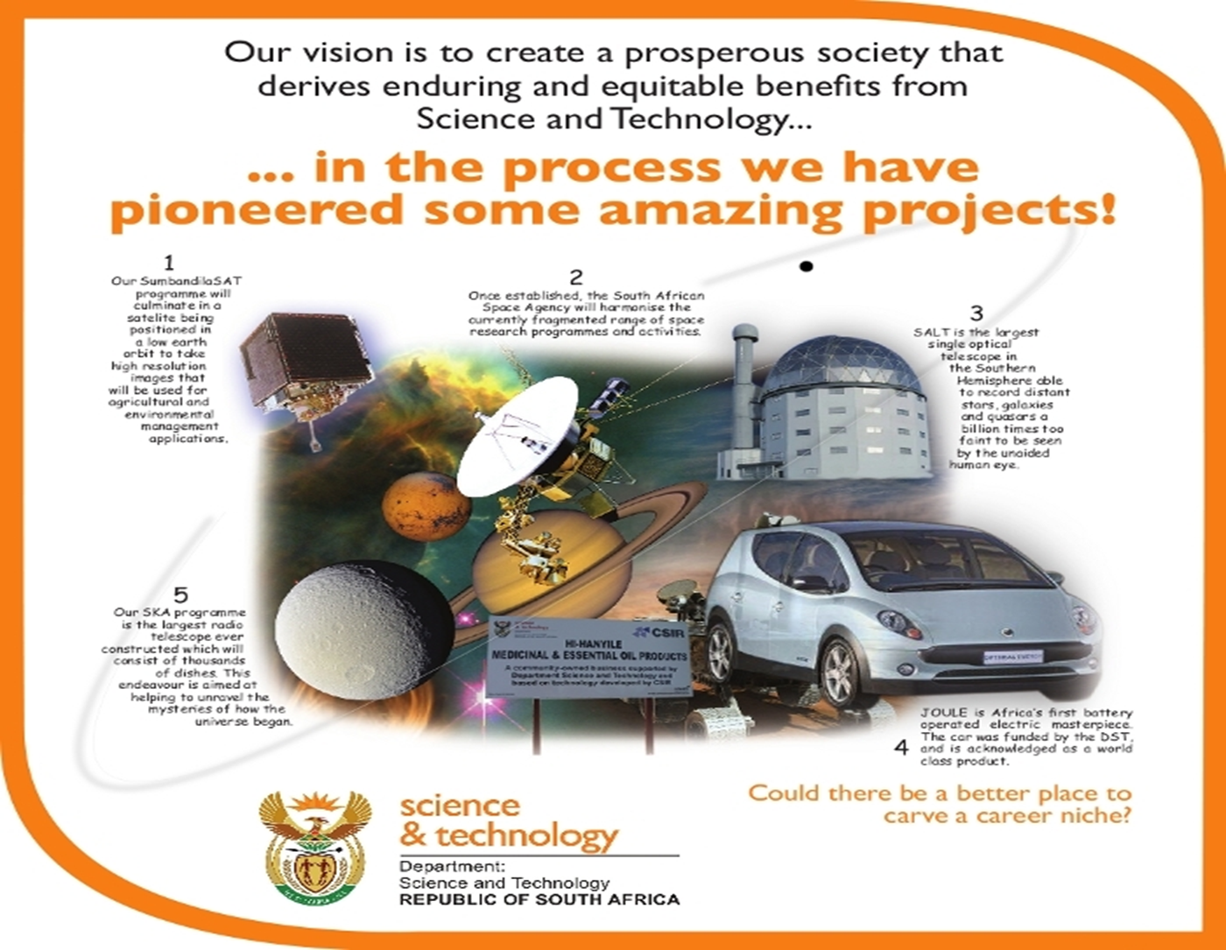
NSI Vision

Slide 9
Multi-dimensional innovation system
International & regional Innovation Systems
Sectoral Innovation System B
National Innovation System
Sectoral Innovation
System A
Regional Innovation System
Local / Regional Sectoral Innovation System C

Slide 10
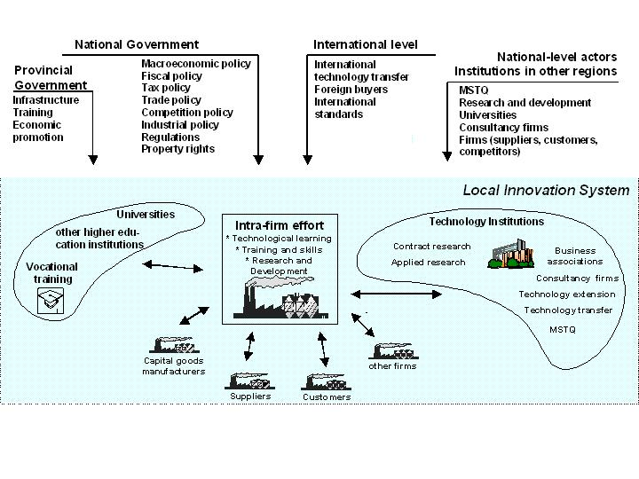
Our PSI

Slide 11
Provincial Innovation Value Proposition
The main role of innovation in the province in the next five years would be three fold as follows:
Step 1: Mobilization of Innovation Inputs
  Profiling and branding the innovation initiative and solutions
  Establishment of a database of innovators and inventors in the province and provide a platform for collaboration and networking
  Setting up requisite governance arrangements, capacity, technology, infrastructure, and knowledge systems
Step 2: Management of the Innovation Process
  Assessing the state of research output and product development by the various innovation players
  Fostering collaborative arrangements among innovation players within the province and beyond
  Setting up of knowledge/research protection and commercialization arrangements
  Identification of critical innovation issues/challenges and sourcing research and funding of innovation solutions to these
Step 3: Fostering of Innovation Outputs
  Mobilization of funding partnerships, pooling and focusing of current resources available
  Marketing of innovation products
  Collaboration with other entities and structures for incubation, enterprise development, research prototyping, etc.
  Innovation education and advocacy to create innovators and entrepreneurs
  Focus on policy and process innovation to unlock developmental potential
  Focus on innovation enterprises development, skills building and retention

Slide 12
Ongoing Activities for Technology Transfer
    Electrical machinery, apparatus & equipment
      Electric cars
      Medical appliances
      Wind turbines
    Sustainable Agriculture and Agro-processing
      Bio-Fuels / Renewable Energy
      Aquaculture & Fisheries
      Chemicals / Pharmaceuticals:
        Botanical and Medicinal (medicinal plants, essential oils, aloe ferox)
      Food products (local production)
      Timber & wood-products, Furniture
      Niche Textiles – Natural fibres: Wool & Mohair, leather
    Transport Equipment
      Automobiles, boats, motorcycles
    Metals & Minerals (electrolytic manganese dioxide)
    Electronics
      Audio/visual
      robotics

Slide 13
Ongoing Activities for Technology Transfer
Business Needs
  Technology Applications (business model)
    Electronics/Software
    Electronic control systems – industrial processes
  Electronic / Operator Skills
  Product Development
    Niche markets/products
    New applications
    New materials

Slide 14
Ongoing Activities for Technology Transfer
Product Development
    Applications for new technologies
    Production process
    Niche products
    Sectors: Textiles, food processing, electrical machinery, etc.
Skills Development
    Electronics
    Electrical equipment
    Information technologies (eSkills)
    Sectors: all

Slide 15
Ongoing Activities for Technology Transfer
Two Industrial Development Zones
Two Science and Technology Parks
Research entities – CSIR, ARC, MRC, etc
SKA Research Chair
Nano Technology
Platinum beneficiation, marine research, shale gas, nuclear science, ICT and others
  Multi-helix collaboration – Regional Innovation Forums
  Social Innovation platforms

Slide 16
Conclusion
Exciting period of setting up our innovation instruments, systems and partnerships
  Participation in innovation platforms and forums nationally and internationally e.g. IASP
  After conference legacy ICT projects
  Continental research on fibres under Commonwealth
  Collaboration with EU on Renewables and Green technologies

Slide 17
Thanks for the Opportunity

