Slide 1
2013 Global Forum on Innovation & Technology Entrepreneurship
Carlos Marques
30 May 2013

Slide 2
ICT as a platform for innovation – breaking down barriers & increasing collaboration
Cisco’s thoughts on creating a platform for innovation
Ecosystems for Inclusive Innovation

Slide 3

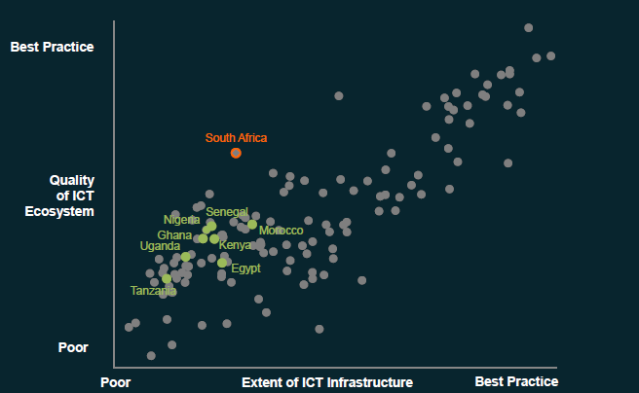
Africa Lagging – WEF GITR
  Africa lagging in with regards to infrastructure & having the right ICT platform
  2013 WEF GITR – African countries are among the worst performing with regards to network readiness

Slide 4
Broadband Strategies
SUPPLY
DEMAND
Competition and Investment
Affordability of Devices and Access
Spectrum Allocation and Assignment
Government Leadership in Broadband Use and Online Activity
Reducing Infrastructure Deployment Costs
ICT Skills Development
Core Network Expansion: Market-led, Govt-led, or a Mix
Online & Local Content, Applications, New Technologies & Services
Inclusive Broadband Availability (e.g. with USOs or USFs)
Consumer Protection and Empowerment
4
Notes:
Governments need to, and are creating policy’s to address this, Cisco has recently done extensive work on this looking at best practice
Competition & Investment
Permit entry and efficient use of assets (new licenses)
Attract private (and foreign) investment in broadband networks; Consider activity by foreign operators
Technology- and service-neutral rules or policies giving operators greater flexibility
Consider direct/indirect financing; tax credits
Tax flexibility for venture capital investment
Affordability of Devices and Access
Reduce luxury import taxes / eliminate import barriers or quotas
Targeted subsidies for device purchases for students in low-income households
Subsidized devices with broadband packages
Tax / other financial incentives for device sales
ICT Skills Development
Digital literacy programs for students and adults
IT resources in libraries, community centers, etc.
Networking Academies
Improvement to technical education (secondary and tertiary)
Training grants for businesses
Online & Local Content, Applications, New Technologies & Services
Promote creation of digital content
Support local language content development
Implement IP protections
Support for research and development
Business incubators (ICT-focused)
Improve ease of starting / doing business
Establish Technology Parks
Support secure e-transactions with legislation

Slide 5




Private Sector Initiatives
  Cisco has a number of best practice initiatives that we have applied successfully in various countries, such as:
  Network Academies
  Cisco Entrepreneur Institute
  Cisco British Innovation Gateway
  Your Country Your Call
  Cisco I Prize
Africa
44
739
78,571
264,910
Countries
Academies
Students within past 12 months (30% Female)
Cumulative Students since inception (30% Female)
Notes:
Network Academies -
CEI - The Cisco Entrepreneur Institute is focused on fostering entrepreneurship around the globe. Working with local public and private sector organizations, Cisco’s mission is to help communities and nations harness the power of entrepreneurship for economic and social prosperity.
BIG - Following on from Cisco's sponsorship of London 2012, our investment in BIG will help to create a lasting legacy from the Games by providing a set of resources to support and nurture entrepreneurs and startups. BIG aims to inspire a new generation of businesses and offer practical help, mentoring and advice, with the specific goal of accelerating innovation and growth and having a significant impact on the SME sector of the UK economy.

