Slide 1
Inclusive Growth
INFODEV GLOBAL FORUM – INNOVATION ECOSYSTEMS STREAM F
EAST LONDON – SOUTH AFRICA – THURSDAY 30 MAY

Slide 2
Current Situation
Indian villages are increasingly becoming economically unsustainable
Demographics of rural India:
  82% of the population is rural
  About 800 million people live in approximately 640,000 villages
  75% of the poor are in rural villages
  30% live under chronic poverty
India’s GDP grew at over 8% during 2003-10, rural India grew at a meager 2.1%
40% of the total population of India lives on less than $1 a day
Leading to
Increasing Economic
Unsustainability of a
Village Unit

Slide 3
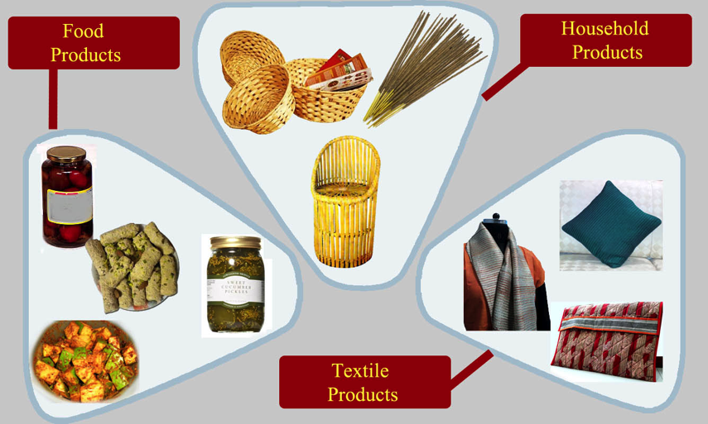
No Consolidated Market for Rural Products

Slide 4
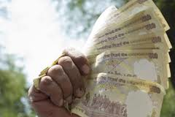
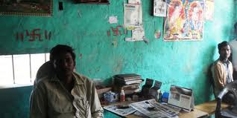
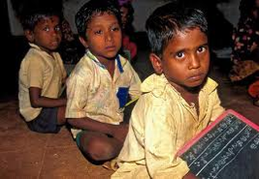
No Access to essential services
Banking
Health
Education

Slide 5


The Drishtee Sustainable Solution
VILLAGE SUSTAINABILITY
By creating a supply chain network that offers distribution to urban product and service companies, and provides rural micro-enterprise with training, access to capital and channel for selling their product, Drishtee supports the three key pillars that are necessary for a village community unit’s sustainability
INFRASTRUCTURE
L I V E L I H O O D
S E R V I C E S
COMMUNITY

Slide 6
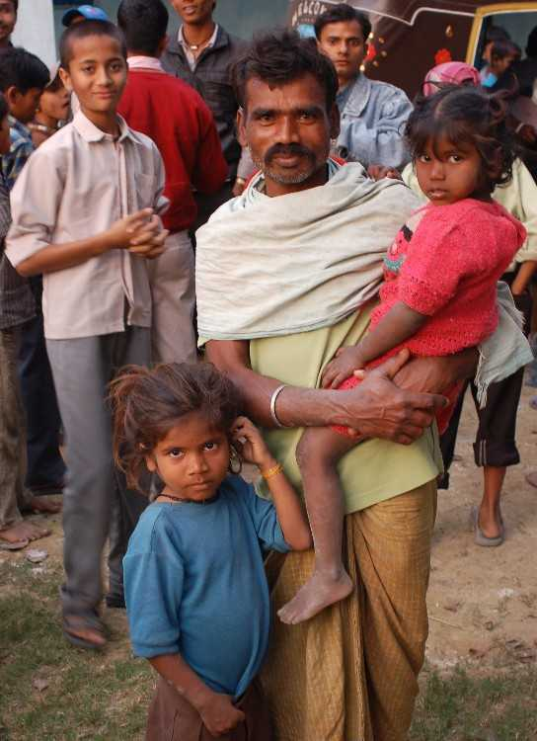
Creating Impact
Two ways Drishtee creates impact
  Creating Savings
  Generating Income

Slide 7




Creating Impact by Creating Savings & Income…
Government
Products
&
Services
Rural Stakeholders
RURAL
Corporate
Market
DRISHTEE
COMMUNITY
Entrepreneurs
New Market & Source
Information on need
Product development/ Innovation
Aggregated Market
Market feedback
Sustainable Social Business
Transaction revenue for product and service delivered
Creation of Local livelihood
Impact
Access to quality product, services & information.
Lowering of opportunity cost.
New livelihood opportunities & Access to new market.
TWO WAY PHYSICAL & VIRTUAL CONNECT

Slide 8
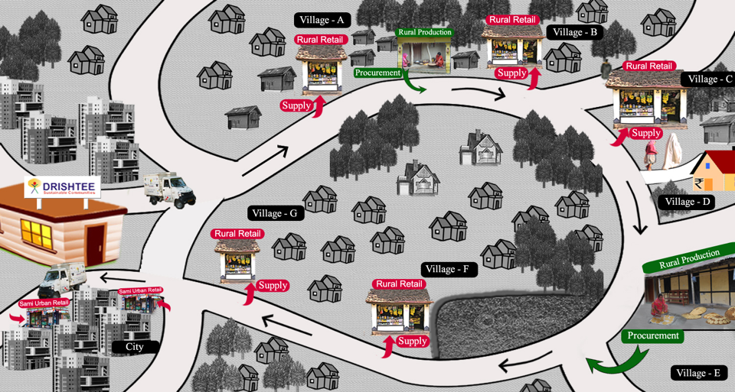
DRISHTEE RURAL SUPPLY CHAIN
One vehicle one day procures from 2 rural enterprise & sells to 20 rural retail, 5 semi-urban retail
Semi-Urban

Slide 9
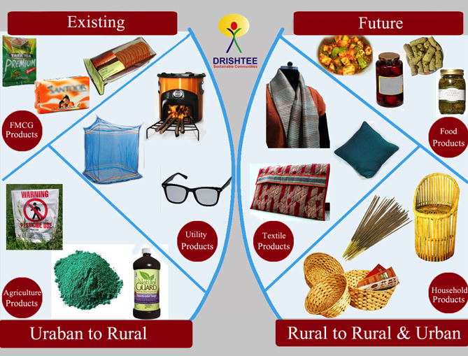
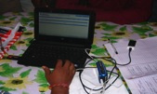
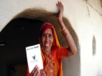
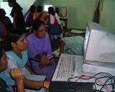
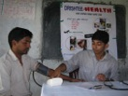
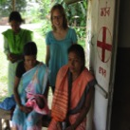
Products and Services
Services
Products to village
Products from Village
Financial Inclusion
Training Capacity Building
Health

Slide 10
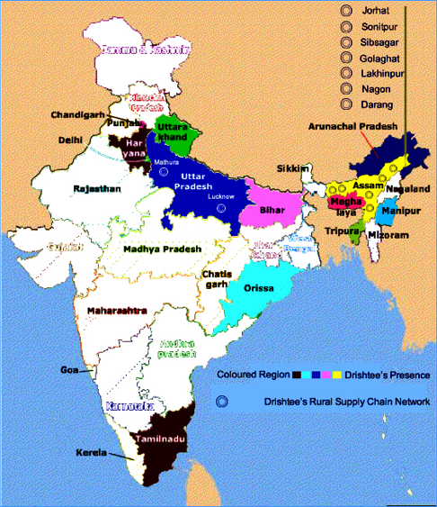
Drishtee Presence
We are present in:
  10 states
  Focused on Uttar Pradesh, Bihar and Assam (combined = 40% of rural population)
  5000 villages
We’ve supported livelihood for
  15000 rural entrepreneurs
Since our inception, we’ve served:
More than 1,000,000 families

Slide 11
Drishtee – Historical Account
Drishtee Business Evolution
Drishtee’s business evolved from a pure ICT (Information, Communications and Technology) kiosk operations in the year 2000 to a full fledged rural-distribution platform that provides the last mile to an urban producer for their rural outreach and first-mile and last-mile for rural producers
FY12
FY09
FY08
Piloted Rural Enterprise with capacity, capital channel support – A sustainable rural community
FY06
Developed a distribution network for efficient delivery of product and services in the villages
Conscious change for long-term sustainability. Started developing services on financial inclusion, health and livelihood
FY04
eGovernance model seen as unsustainable. Started other services such as IT education and digital photography
We broke even
FY01
Started government services in villages

Slide 12
Rural Markets: Drishtee Learning
Drishtee’s learning of rural markets over a decade has shaped the rural distribution platform we have built
MILESTONES
LEARNINGS
2000-03: Worked with government on e-governance services
2003-06: Focused on developing rural entrepreneurs
2006-10: Focused on developing the rural distribution network
2010-till date: Focus on Rural Micro Enterprise development for leveraging the distribution network for creating a sustainable village.
Technology is a tool and not an end for a rural focused business.
Partnership with a local entrepreneur is the key to success for doing business in rural India
Diversification of services is required to spread risk and to have a significant value offering for the rural community
Villages have similar needs but different priorities which need to be looked into
Drishtee’s sustainability is directly linked to the sustainability of villages

Slide 13
Service Identification Process
Top Down
Service Provider/ Government/Drishtee HO
Govt. info service
Insurance
E-Commerce
Services
Digital Photo studio
Rural Livelihood
Bottom up
Villager/Entrepreneur/Drishtee field level

Slide 14
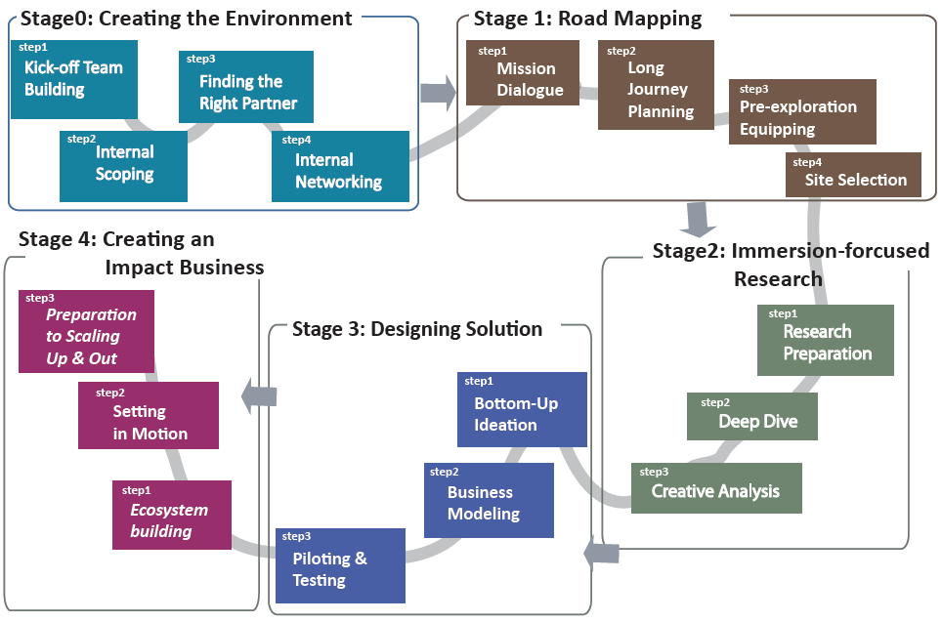

Impact Business Creation Toolkit

Slide 15





Financial Inclusion – Inclusive Innovation
Policy
Need
Central Bank in India
Community
Product
Reach
TECH
With more than 1000 entrepreneurs

Slide 16
Awards & Recognition
2011 IBM Centennial Grant Winner
2010 Ashoka Changemakers Award
2008 Invitee Clinton Global Initiative
2007 Technology Pioneers- World Economic Forum
2006 Red Herring “100 Asia Award”
Zdnet “Technopreneur of the year Award”
Deloitte Winner, Top 50 Companies
2005 Schwab Foundation- “Social Entrepreneur of the Year Award”
2004 Ashoka – Fellowship for Social Entrepreneurship
2003 World Bank” Development Market Place Award”
2002 Digital Partners “Most Promising Social Enterprise
2001 World Bank Infodev’s “Best ICT Stories”

Slide 17






















Strong, Lasting Partnerships With Leading Organisations

Slide 18
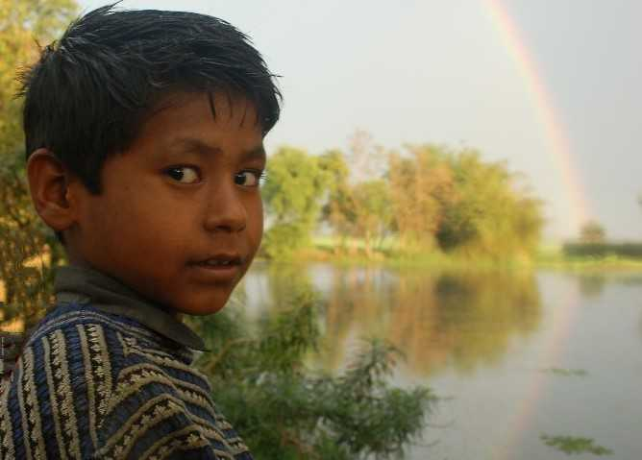
Thank You
nitin@drishtee.com

