Slide 1
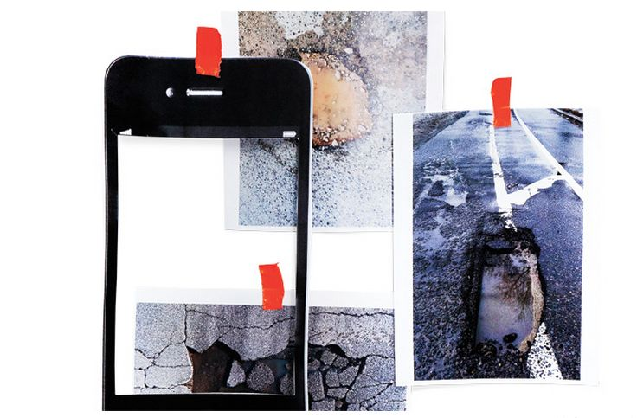

Code for Africa
Sharing Technology for the Public Good
May 29th, 2013 – East London, South Africa
Notes:
asked us to talk about how ICTs can strengthen GPE supported projects and we have come to do that today.

Slide 2
What
The Lagging Innovation Curve
Rising Needs
Rising Costs
Limited Reuse
How can we leapfrog?
Notes:
How can Africa avoid failures of innovation

Slide 3
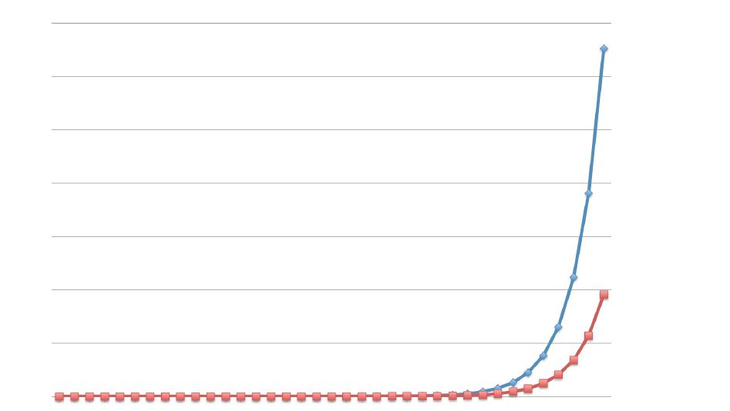
The Problem
Getting on the innovation curve
Rest of the World
Governments
Source: Catherine Bracy, 2013, Code for America
Notes:
Moore’s law is driving exponential growth in sectors that harness digital technologies: communications, computer processing, data storage, information services, location services, nanotechnology, digital medicine, 3D printing…
Effective optimization requires constant adaptation to changes in tech and human behavior as the realm of possibilities is constantly changes
Government does not operate in an environment of continuous change
Proximity to the blue curve implies optimsed harnessing of technologies that ride moore’s law
“Civic technology – the use of digital technologies and social media for service provision, civic engagement and data analysis – has the potential
to transform cities and the lives of low income residents.”

Slide 4
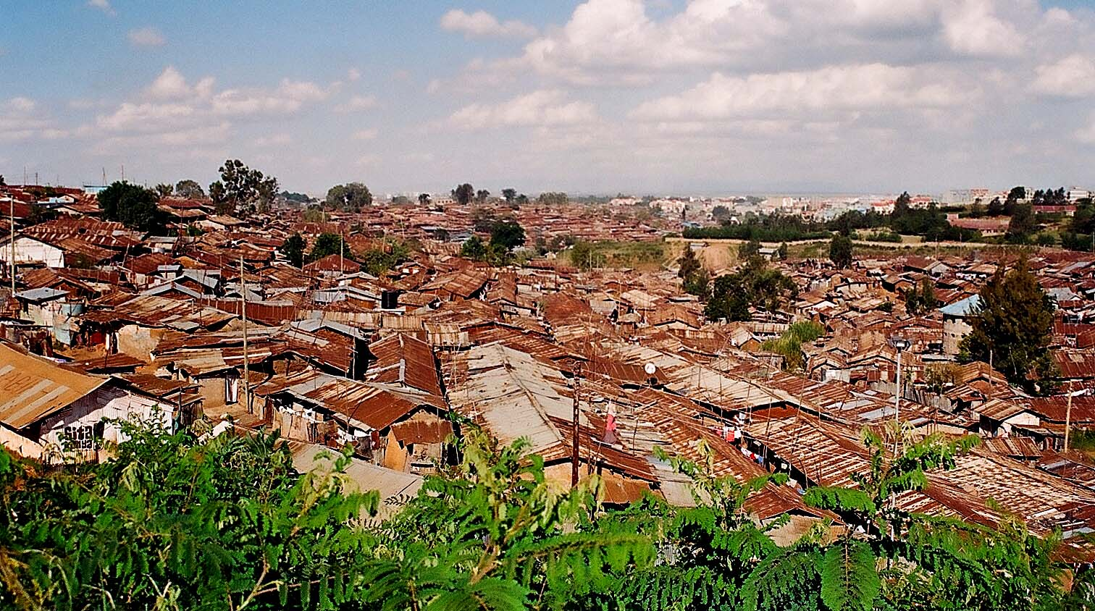
Rising Needs

Slide 5
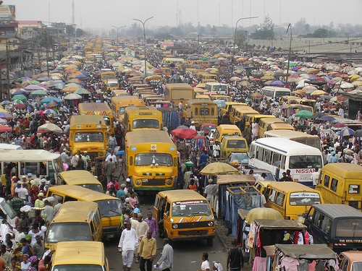
Transport

Slide 6
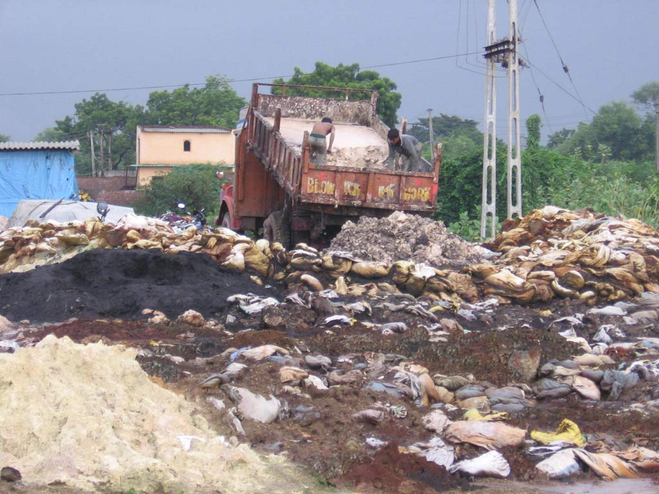
Waste Management
Image: Vapi, Credit: Earth Observer

Slide 7
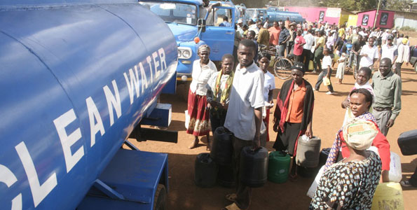
Water Supply

Slide 8
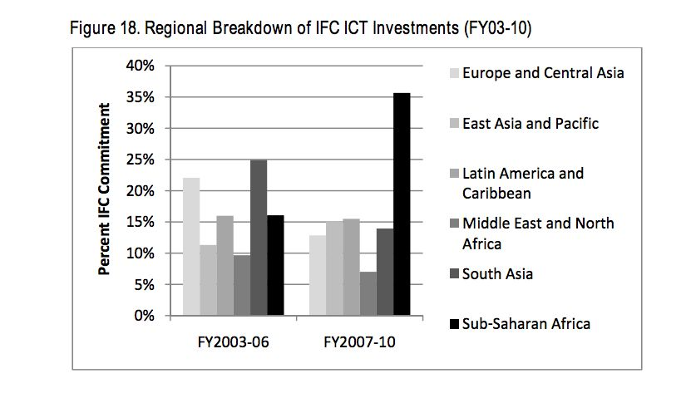

Rising Costs
Need graph on increasing ICT expenditure in Africa by WB
Notes:
For example:
Story 1: often ICT in education is characterized by getting computers into schools and providing the electricity to run them

Slide 9
Complexity + Legacy
World Bank projects with legacy ICT systems
Financial Management, Procurement
4 projects
100%
Public Sector Governance
106 projects
98.1%
Economic Policy, Poverty Reduction
17 projects
89.5%
Education
140 projects
85.9%
Agriculture and Rural Development
258 projects
81.4%
Financial, Private Sector Development
83 projects
78.3%
Health, Nutrition and Population
144 projects
78.3%
Social Protection
75 projects
72.1%
Environment
35 projects
71.4%
Urban Development
96 projects
70.1%
Transport
144 projects
64.9%
Water
77 projects
58.8%
Social Development
24 projects
58.5%
Energy and Mining
94 projects
56.3%
Notes:
asked us to talk about how ICTs can strengthen GPE supported projects and we have come to do that today.

Slide 10
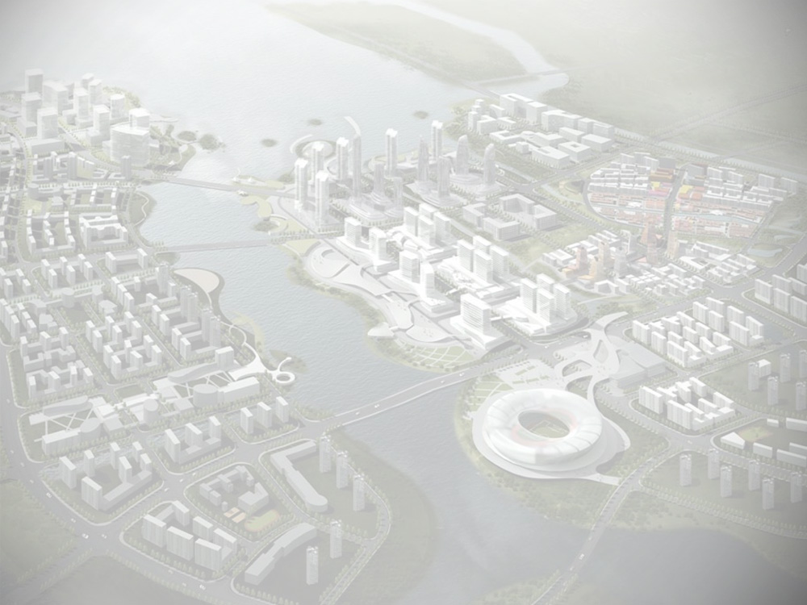
Limited Reuse
Urban Management Systems
Community-Based Information Systems and Services
Property
Management Systems
Land Titling, Registries,
Cadastral Systems
Urban Planning Systems
Transport Information Systems and GPS Applications
Source: “World eID Seminar,” Samia Melham, 20-21 September 2011

Slide 11
How
Mobile reach
Mass Participation
Peer production models
A Commons for digital goods
Civic Tech: Software as a public good
Notes:
The good is that they produce for free because you are creating the community.

Slide 12
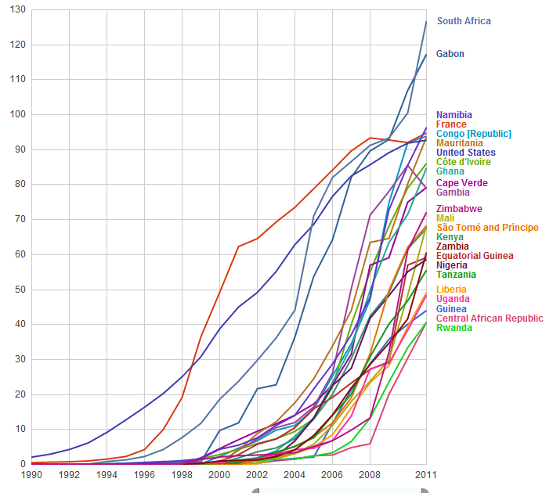
Opportunity
6.8 billion
mobile subscriptions
worldwide
Mobile Cellular Subscriptions in Selected Countries per 100 population; Source: ITU (2013)

Slide 13
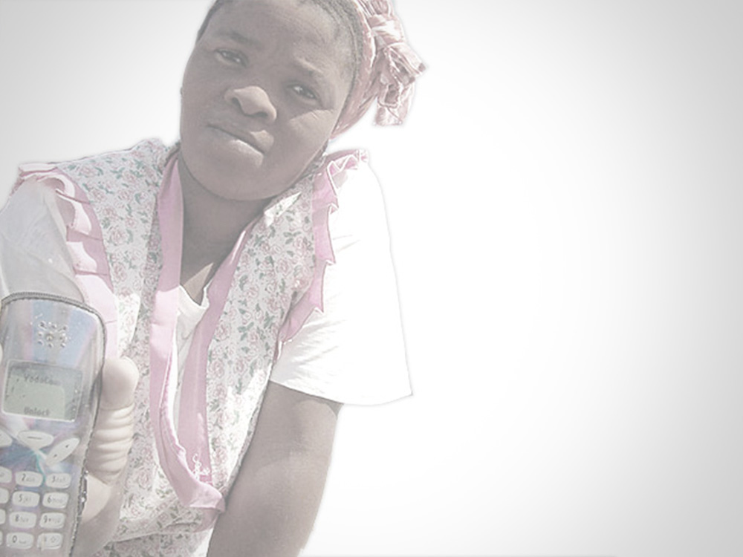
Easy, Cheap, Ubiquitous
1
The average mobile device is
million times cheaper
thousand times
more powerful
than the first computer in 1946

Slide 14


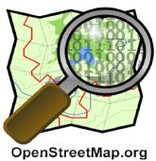
Commons based Peer Production models
How would a government procure wikipedia?
19 million articles in approximately 270 languages
English Wikipedia over 50 times larger than Encyclopedia Britannica
Over 1 million contributors

Slide 15

Open Data is the fuel for digital goods and service

Slide 16
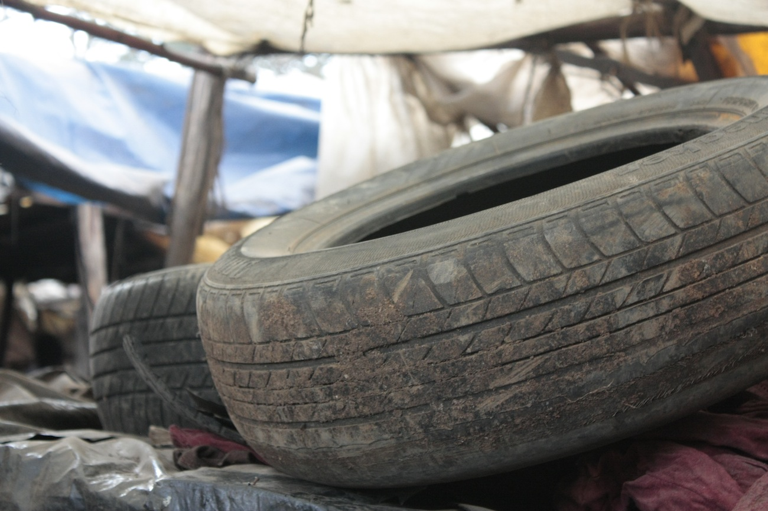
From raw material

Slide 17

To real life applications

Slide 18
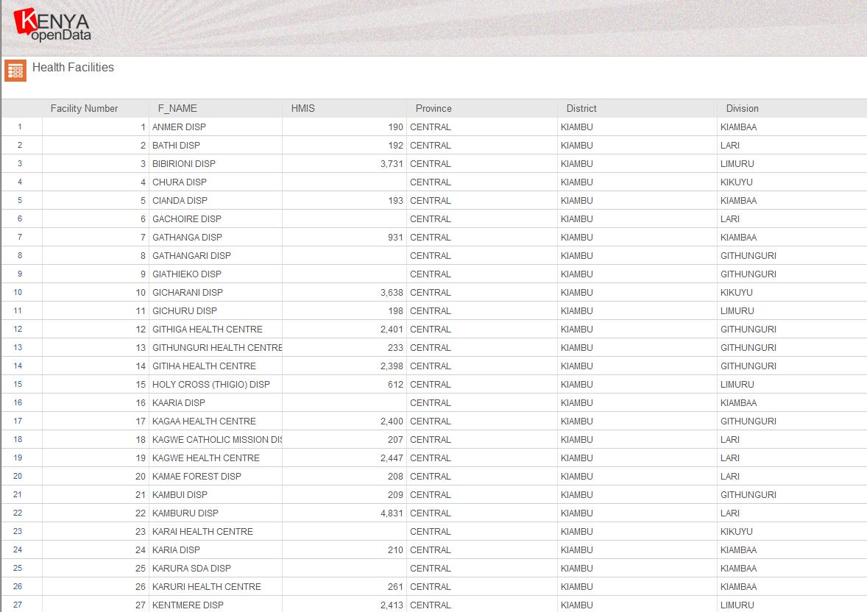
Open Data

Slide 19
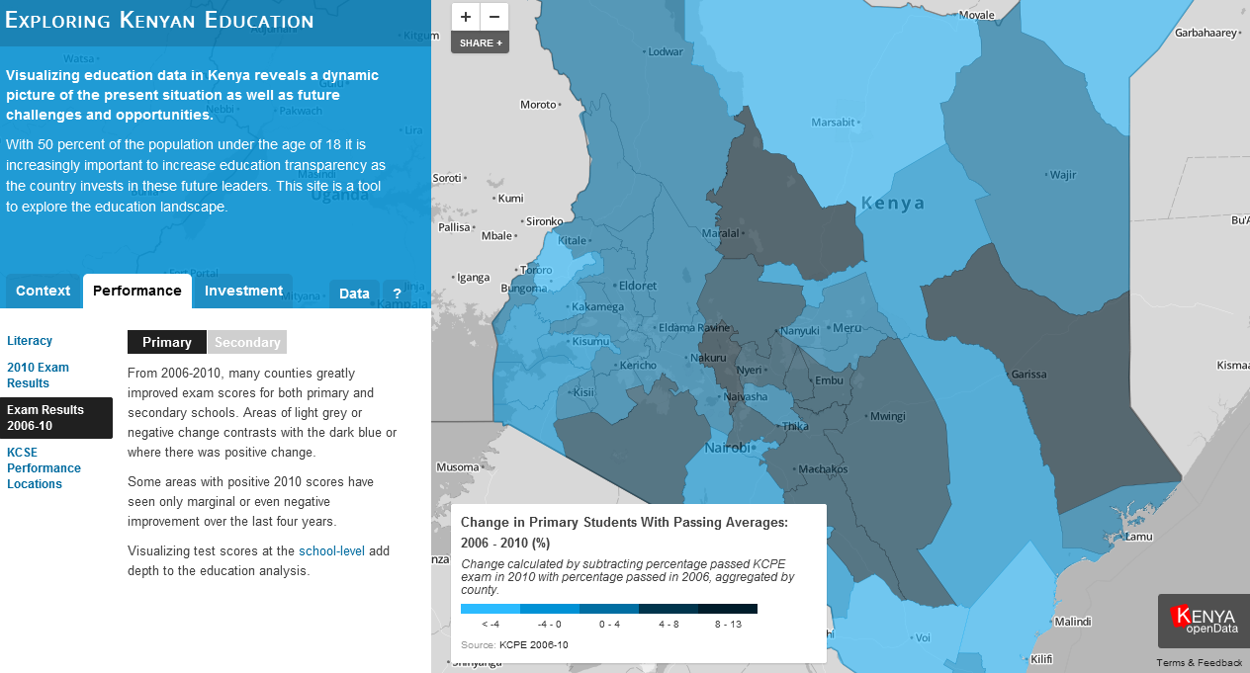
Applications
Notes:
Verifying School buildings in Afghanistan – EQUIP Project 2004 – 2009

Slide 20
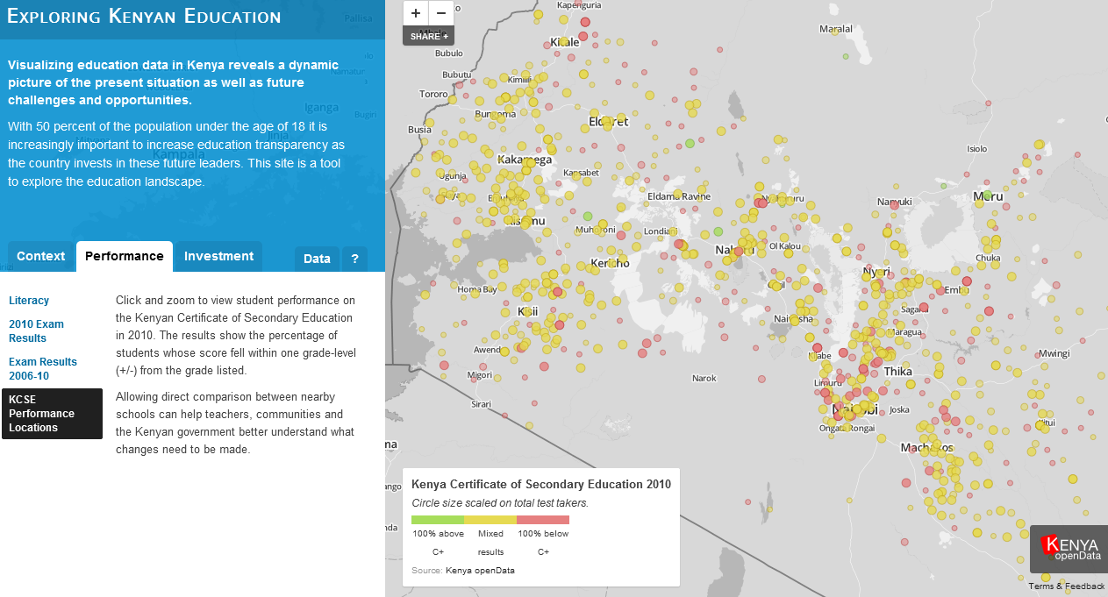
Value Added
Notes:
Verifying School buildings in Afghanistan – EQUIP Project 2004 – 2009

Slide 21
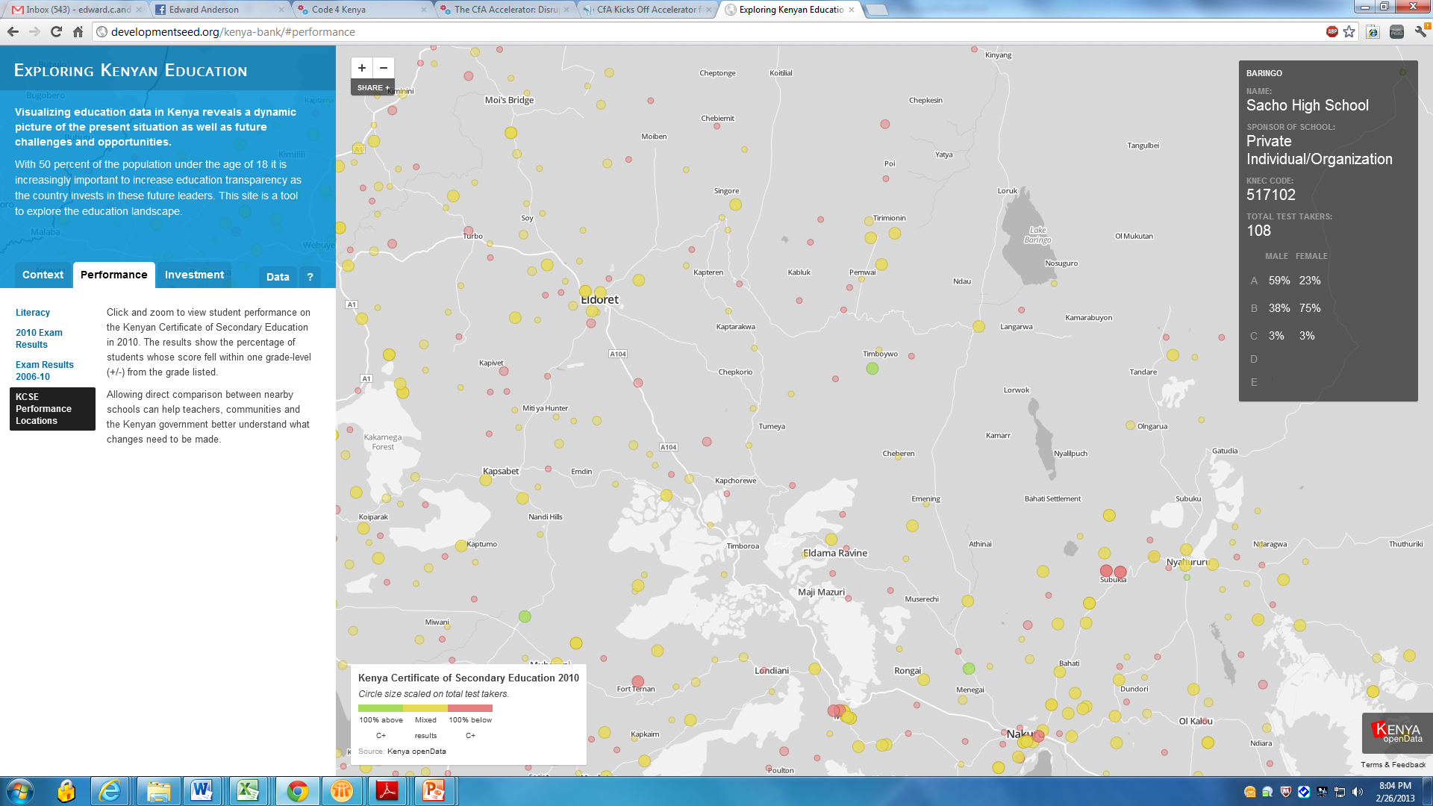
Services

Slide 22
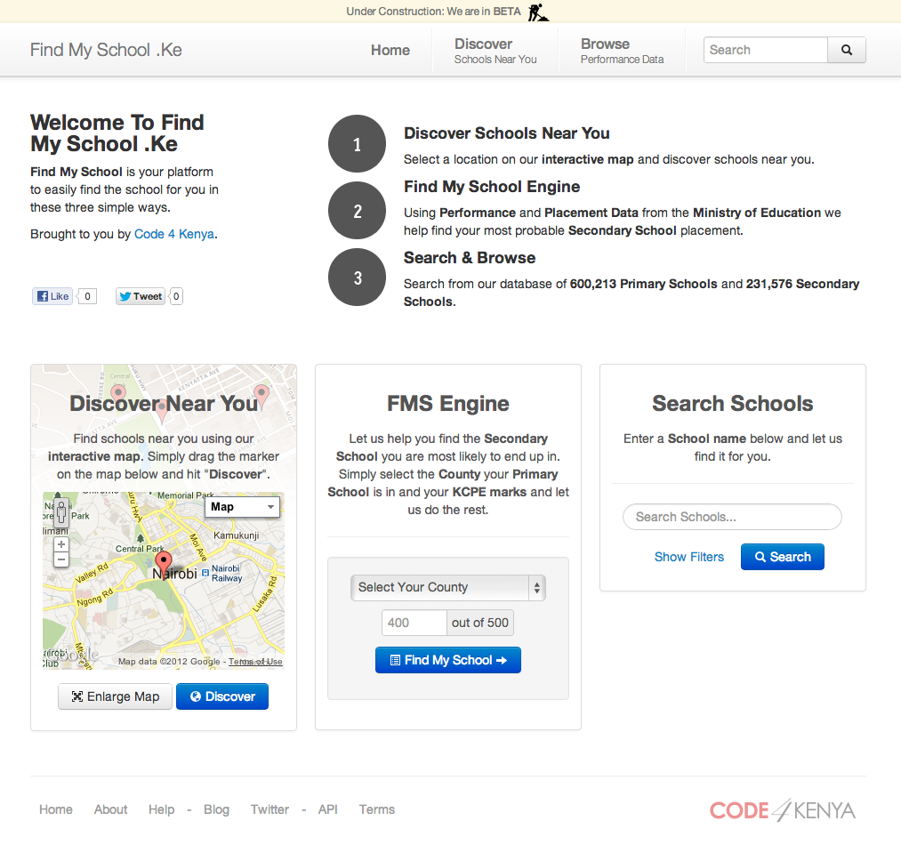
Find My School in Kenya

Slide 23

Civic Tech: Software as a Public Good
Quality & Accountability of Public Services
Facilitating Citizen Driven Works
Participatory Decision Making
“Civic Technology – the use of digital technologies and social media for service provision, civic engagement, and data analysis – has the potential to transform cities and the lives of their low-income residents”
(Filed Scan of Civic Technology, Prepared for Living Cities by Open Plan, November 2012)
Notes:
http://www.jeffbullas.com/2011/09/02/20-stunning-social-media-statistics/

Slide 24
Code for Africa
An African Civic Stack
Design Principles
Networked Code
Networked Human Capital
Civic Marketplace

Slide 25
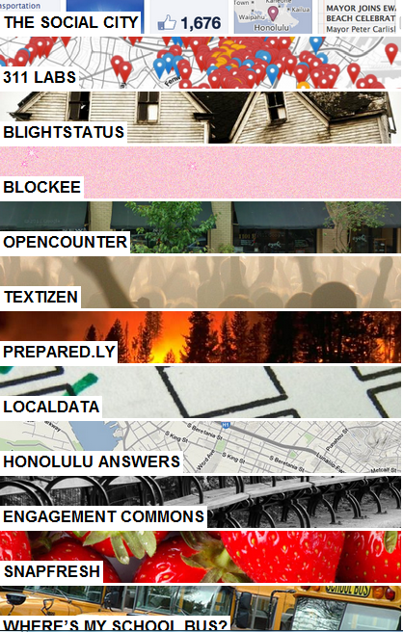
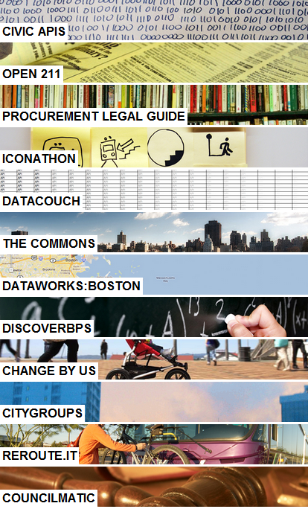
Code Projects
Code for America Projects

Slide 26
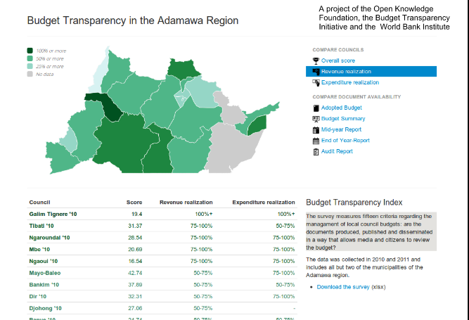
Where Does My Money Go in Cameroon?
Notes:
Verifying School buildings in Afghanistan – EQUIP Project 2004 – 2009

Slide 27
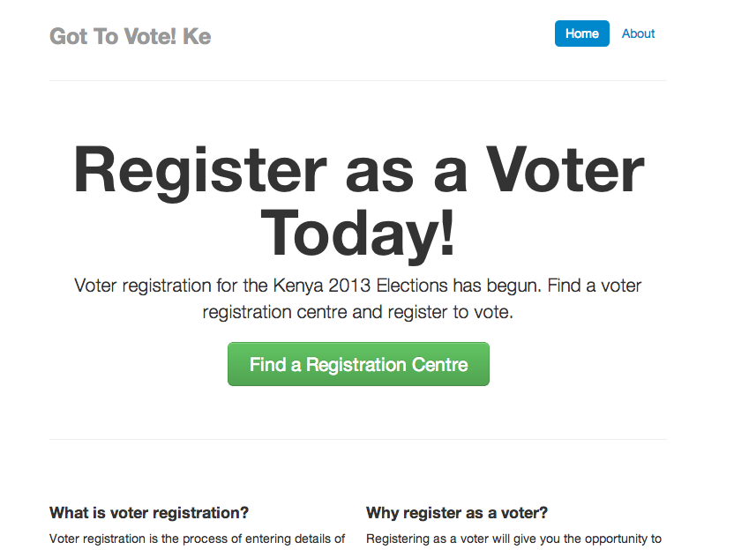
Register to Vote in Kenya

Slide 28
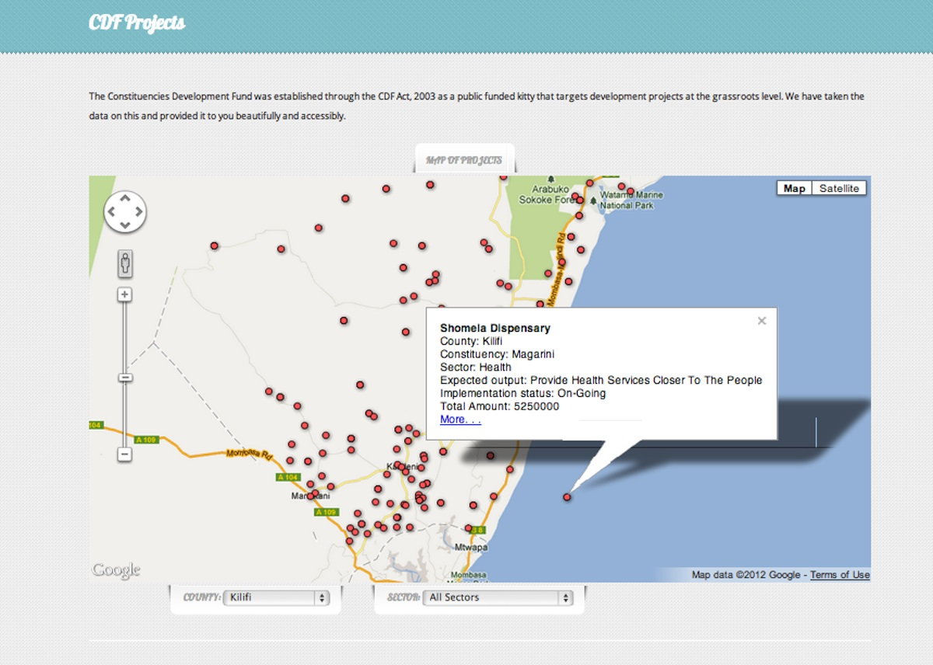

Slide 29
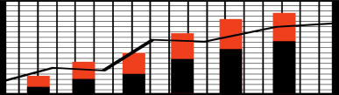



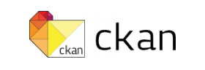
Civic Tech and Civic Stack
Budget Apps
Where Does My Money Go?
Citizen Feedback
Seeclickfix
Apps
Civic Stack
Facilities data
Find My School
eServices
Birth Registration, Driver’s License
Complaints Handling Systems
Taarifa
Frameworks
Spatial Data Sharing
Geonode
Participatory Monitoring Platforms
Management Information Systems
Platforms
Data and Apps Repositories

Slide 30
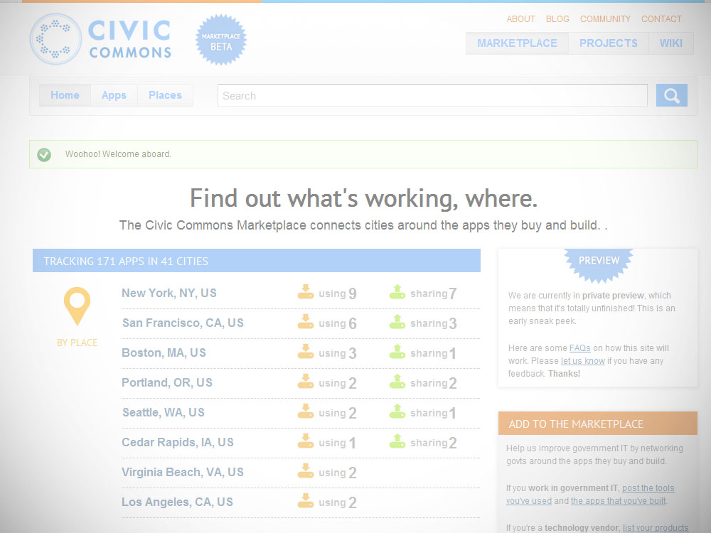
Network the Code

Slide 31
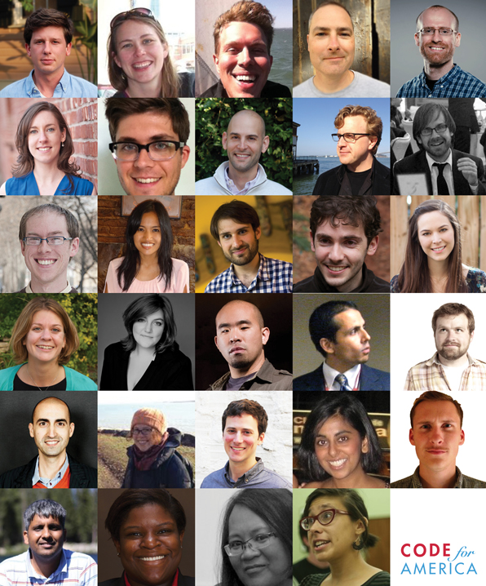
Change Agents
2013 Program
28 Fellows
Developers
Designers
Community Managers
Urban Planners
Data Scientists
9 Municipalities
1 Year
Notes:
Our main program is the fellowship program. We have just begun our third year of the program and have 28 fellows in teams of three or four working with nine cities for the next 10 months.

Slide 32
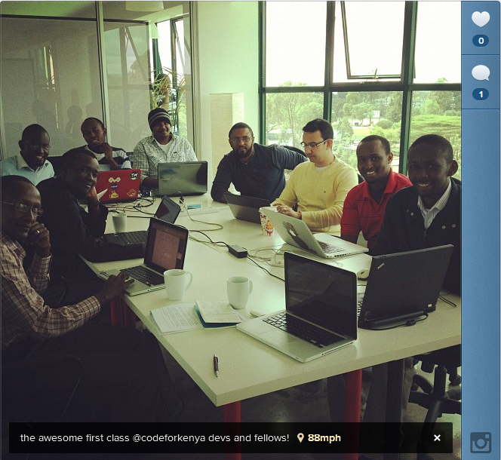
Network the Human Capital
Notes:
Verifying School buildings in Afghanistan – EQUIP Project 2004 – 2009

Slide 33
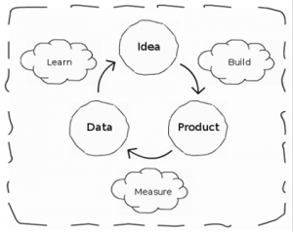
Lean Development Principles
User Centric Design
Rapid Prototyping
Minimum Viable Service
User test beds

Slide 34
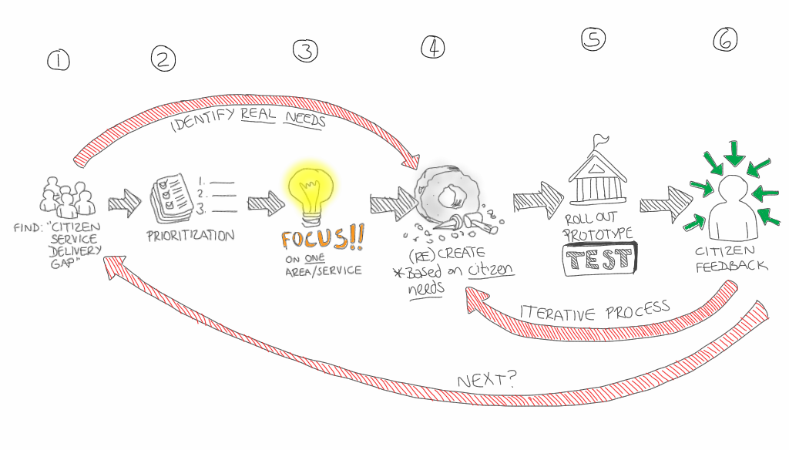
Adding computers to classrooms
Feedback Loops
Notes:
For example:
Story 1: often ICT in education is characterized by getting computers into schools and providing the electricity to run them

Slide 35
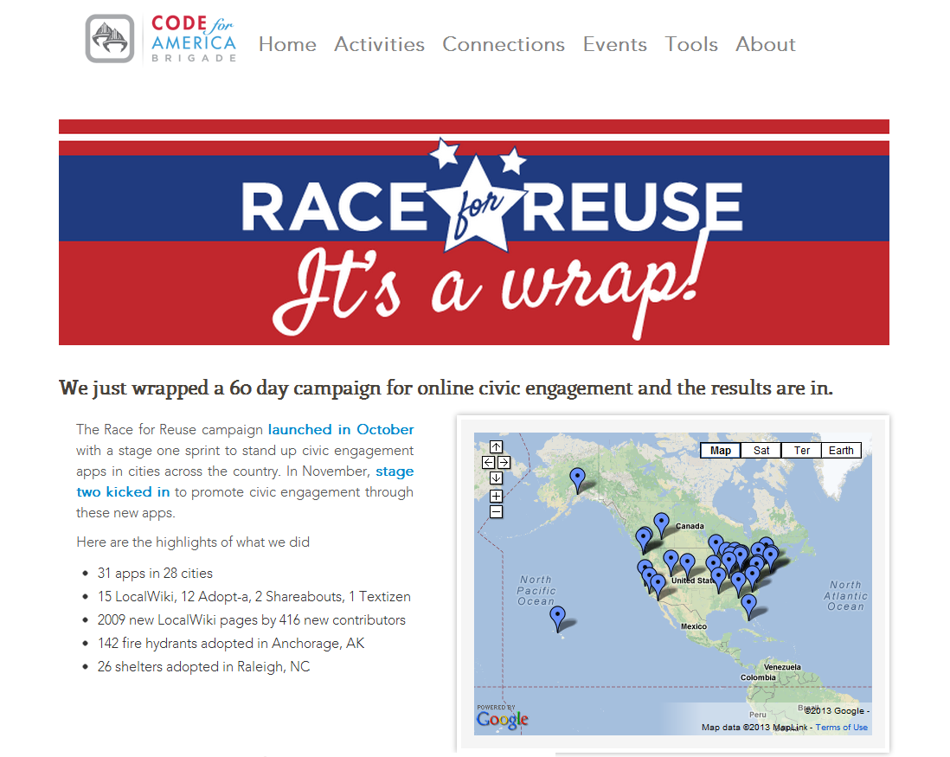
Reuse

Slide 36
A Networked Model
Open data
Notes:
Verifying School buildings in Afghanistan – EQUIP Project 2004 – 2009

Slide 37
A Networked Model
Code repositories
Open data
Notes:
Verifying School buildings in Afghanistan – EQUIP Project 2004 – 2009

Slide 38
A Networked Model
Fellows
Code repositories
Open data
Notes:
Verifying School buildings in Afghanistan – EQUIP Project 2004 – 2009

Slide 39
A Networked Model Ecosystem
Licenses
Standards
Fellows
Code repositories
Open data
Documentation
Communities
Notes:
Verifying School buildings in Afghanistan – EQUIP Project 2004 – 2009

Slide 40






What’s next?

