Slide 1


PROSOFT JALISCO

Slide 2
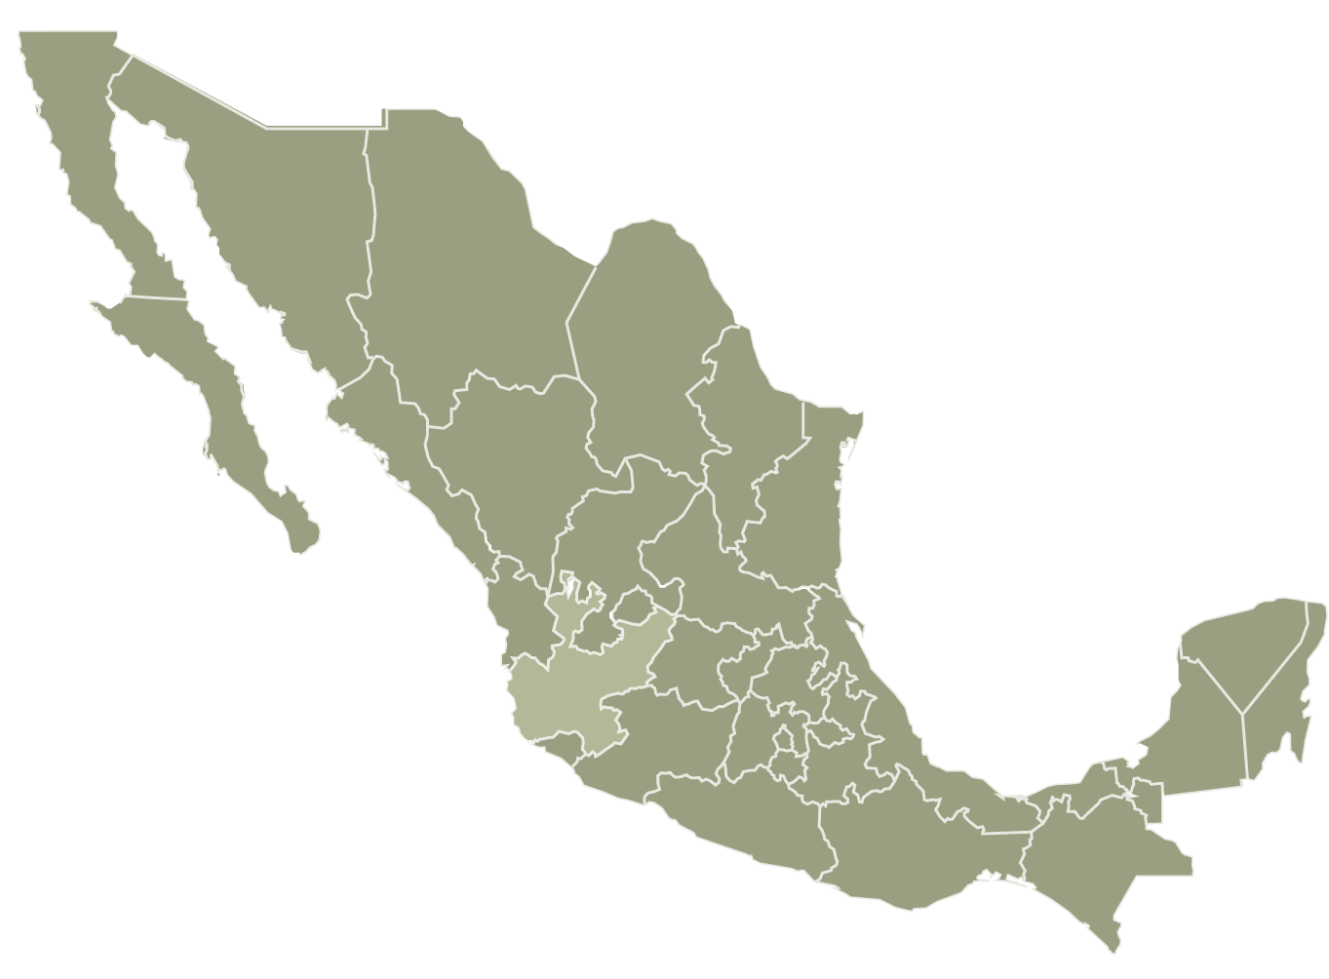
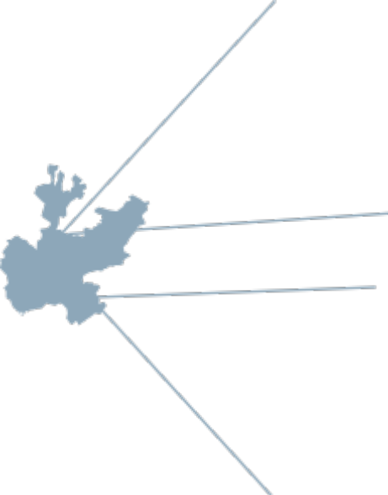


Jalisco
Surface: 78,588 km2
Population: 7.3 million, 6.3% of Mexico´s total
6.6% Mexico´s GDP
Jalisco GDP 2003 - $37.5 mil millones USD*
GDP
6.26% Agriculture
24.5% Manufacturing
19.5% Commerce
2003
2011
Jalisco GDP 2011 - $66.6 mil millones USD*
EAP primary sector
GDP
EAP secondary
sector
6.88% Agriculture
21.6% Manufacturing
EAP tertiary sector
22.8% Commerce
2001: First Jalisco State of Innovation Appraisal
As a result of this Appraisal, a new model of socio-economic development was formulated, based on innovation, Science and Technology, S&T+i
*Current Mexican Pesos. Exchange Rate as of 12/12/12

Slide 3
What is an Ecosystem
It is a natural system formed by a collection of living organisms and their physical environment where they relate to each other.
It is a unit composed of interdependent organisms that share the same habitat.
How does this biological definition apply in the innovation process?
An innovation ecosystem is formed by actors (people) who are living organisms and these actors interact in a pysical environment (a region) where they relate to each other to achieve common goals.
These actors are as varied as people are bound to be. It is very common throughout Latin America to refer to the Triple Helix (actually Sabato´s Model of 1968): Government/Industry/Academia

Slide 4
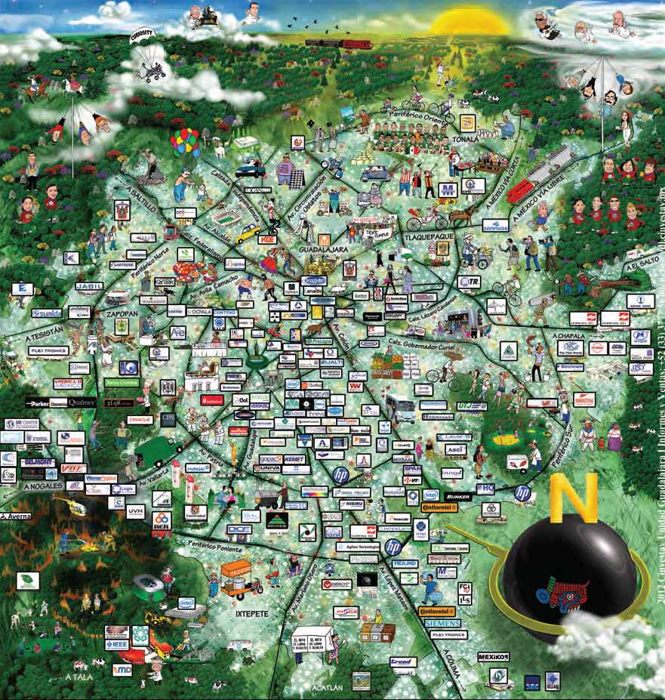
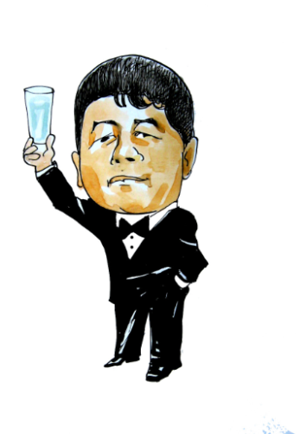

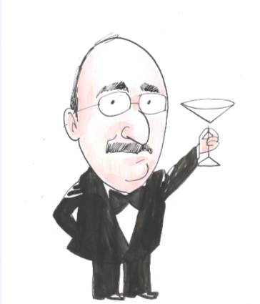
What does the Ecosystem look like?
Academia
Governments: Federal & State
Industry
CANIETI

Slide 5
The Ecosystem is Pivotal for Jalisco´s
Socio Economic Development
Lots of ignorance in Mexico regarding the Ecosystem concept
What has made Jalisco so different is:
  a long term vision. This vision has been adopted by all the major actors
  an unfaltering belief in team work: One Voice
  an absolute faith in a strong leadership
  a consistency in applying the same policy instruments over the last 12 years
We believe in the Power of Policy (PROSOFT)

Slide 6
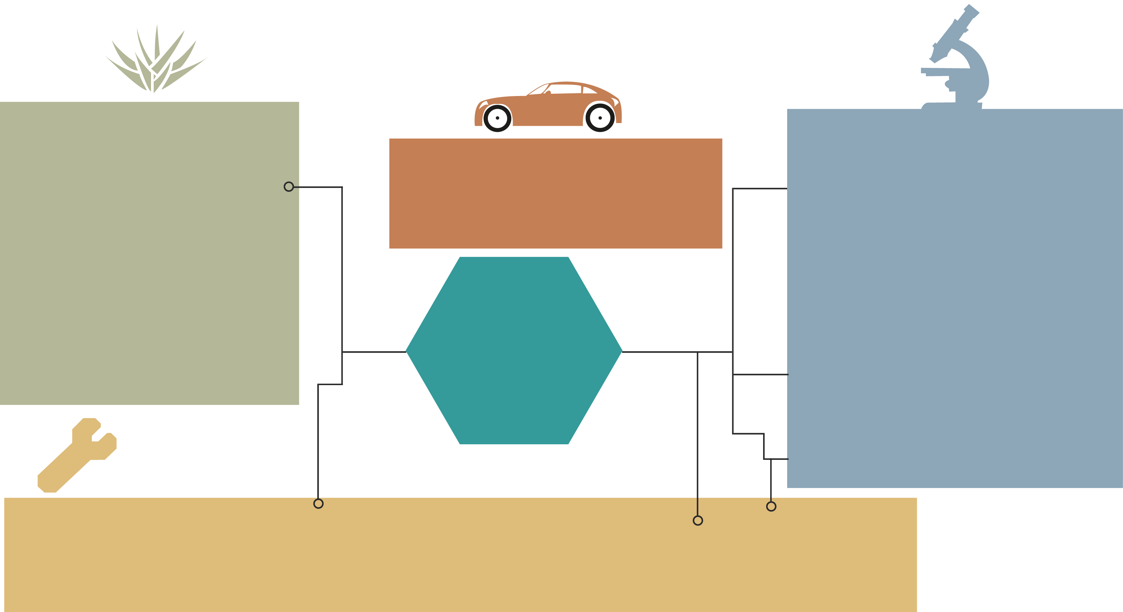
One Vision: Jalisco´s S&T+i based socio-economic development model
TRADITIONAL CHAINS
HIGH TECHNOLOGIES
Agribusiness: Tequila
Leather–Shoes
Textile – Apparel
3. Wood, furniture,
handicrafts, interior design
5. Mining & jewellry
INTERMEDIATE TECHNOLOGIES
6. MEDTEC/BIOTEC/FARMA
Ag Biotech
Food Biotech
Biotecnología para la Salud
Environmental Biotech
Biomedical
Pharmaceutica/l
7. MICROELECTRONICS, ADVANCED ELECTRONIC MANUFACTURING ICT, DIGITAL MEDIA
8. AEROSPACE
9. GREEN TECHNOLOGIES
5. Metalmechanic: automotive
& autoparts
Strategic
Sectors
identified
10. SERVICES TO INDUSTRY
Capital Goods, Plastics, Rubber & Latex, Transportation and Logistics, Construction, Printing Arts,Restaurants & Hotels
Top Priority: Establish the State´s Vocation

Slide 7
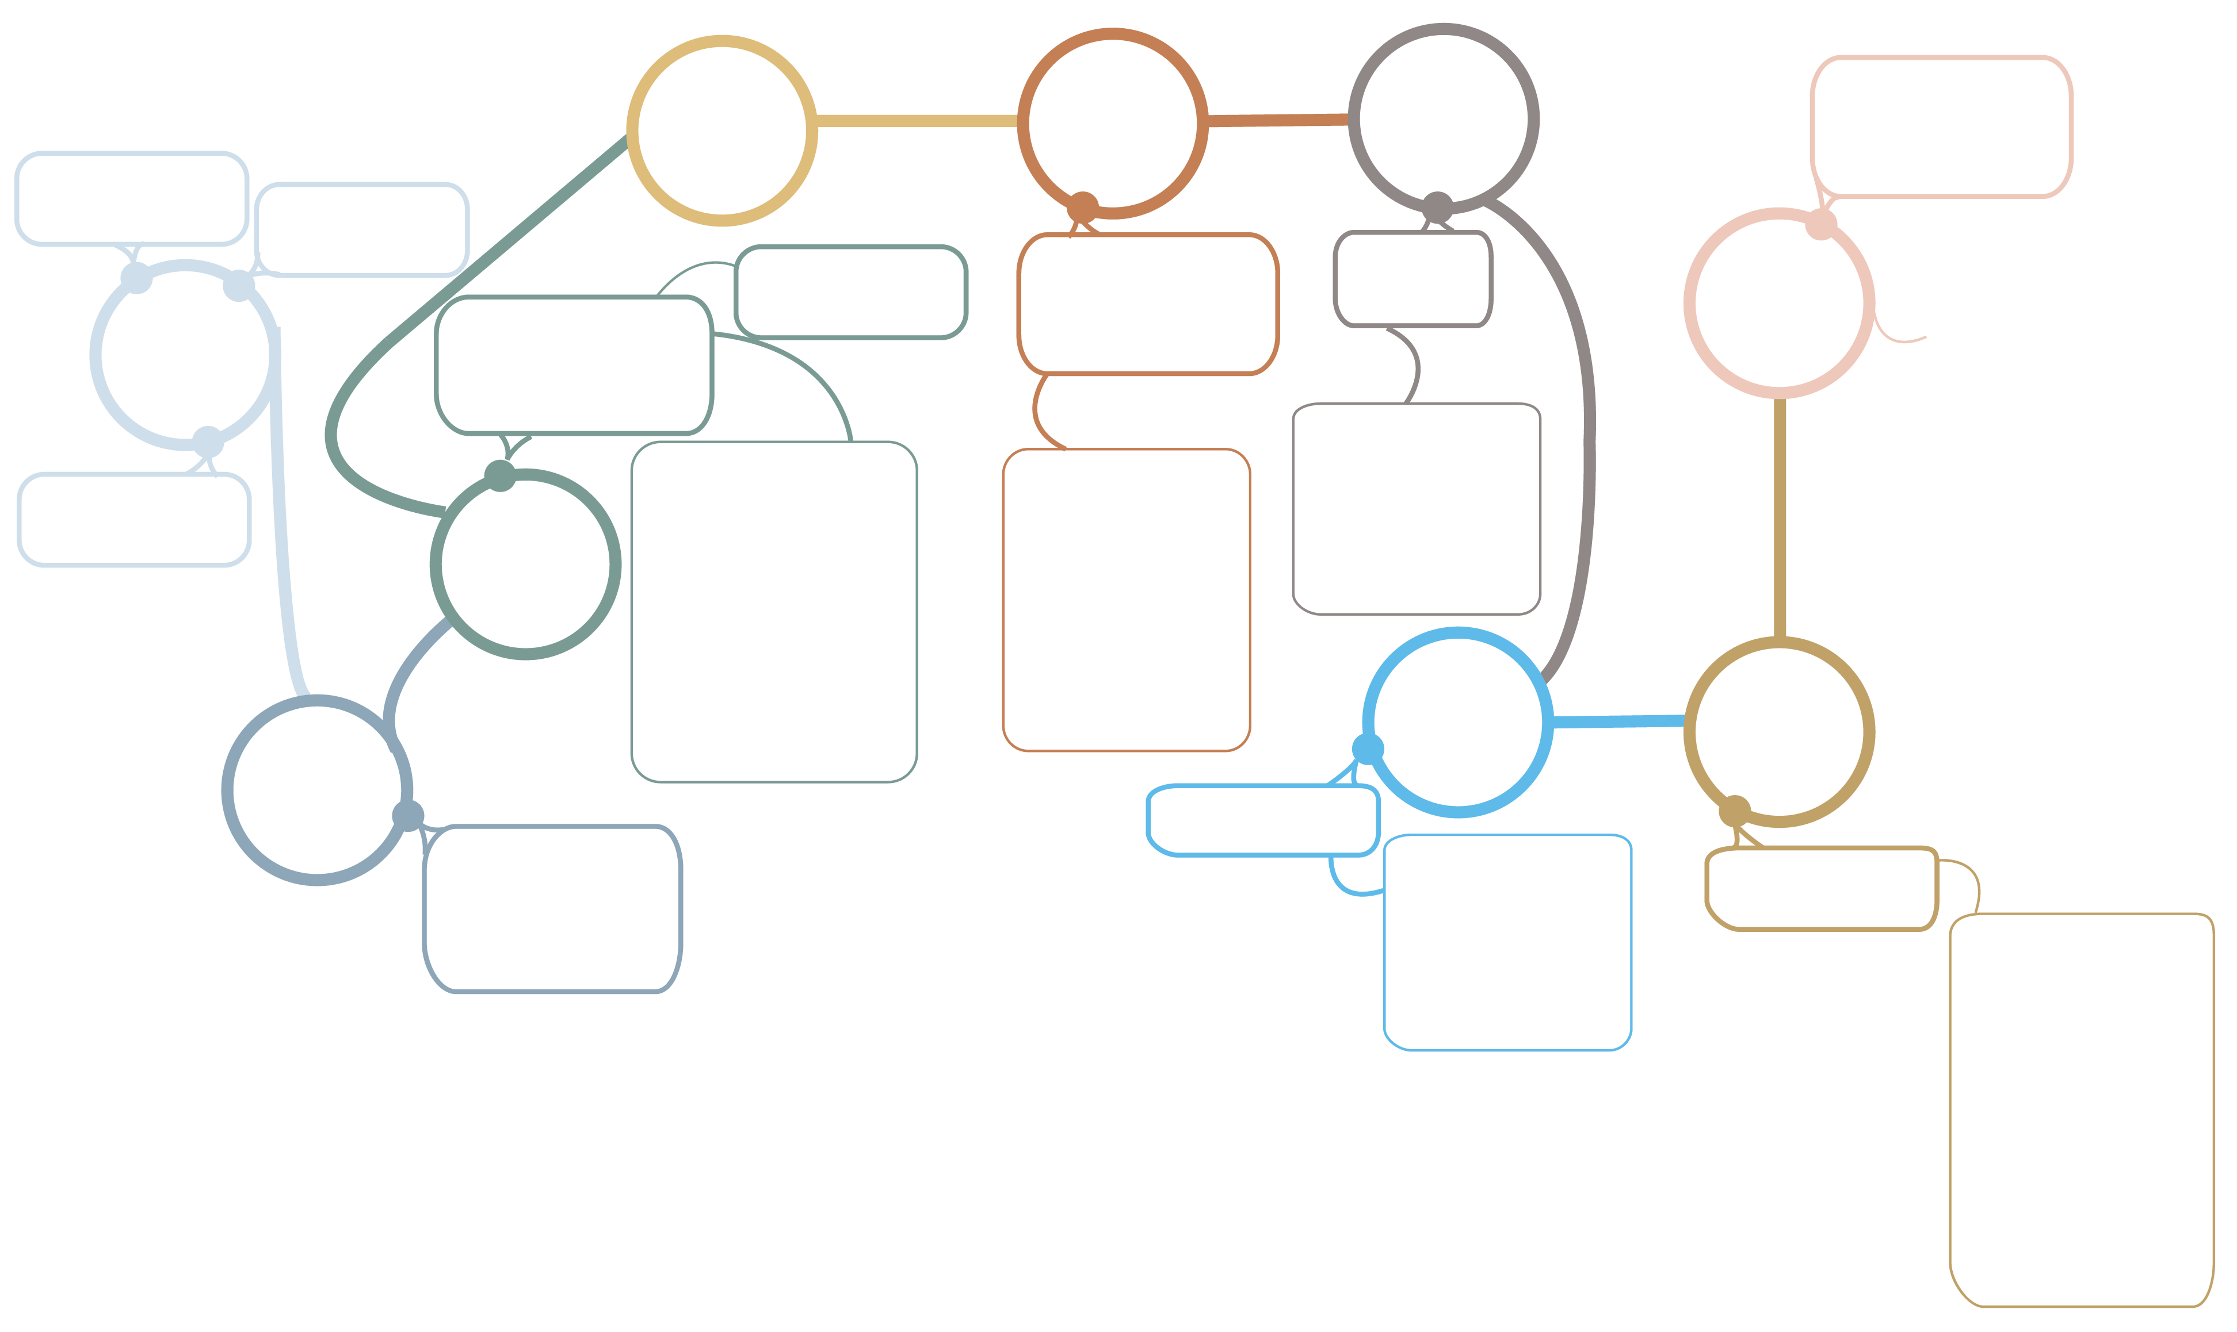
How did the High Tech Innovation Ecosystem Evolve:
Organically after the vision
Jalisco´s S&T+i based strategy for ICT4D
2003
2004
2005
ICT User Projects
Science and
Technology Law
COECYTJAL
Founded
Prosoft Jalisco begins
Prosoft
Jalisco + Prosoft México joins in
Capacity Building
2008
2012
Jalisco generates 40% of Mexico´s user projects, as well as 75 % of total added value
2000
S&T+i based
Development
Model
Information (BI)
Design
Automation
Engineering + Rapid Prototyping
Innovation Public Policies
Public – Private partnerships
Human Capital Formation:
PADTS
PAFTI
PROFAR
PRO/TEST
APORTIA
Capacity Building
Certifications
Entrepreneurial
Skills Development
APORTIA
Jalisco S&T+i Programme
2002
2006
2007
2001
Infrastructure
S&T + innovation
Appraisal
Centro SW
Cd Guzmán Green IT Park
Chapala Media Park
Incubators
Productive Projects
SW Development
Firmware,Testing,
emulation,
verification
Semiconductor Design
Advanced BPO
Animation
Visual Effects

Slide 8
Leadership
The Ecosystem is managed through the Triple Helix and some of Jalisco´s policies are enacted through a Public Private Partnership: IJALTI (Jalisco State institute of Information Technologies)
Everyone is rewarded for their contribution:
  Industry gets grants
  Academia gets grants and students
  Government gets jobs and taxes
The State Government has maintained the rectorship of the complete Ecosystem

Slide 9
Jalisco State Investment in Prosoft & Expenditure in S&T+ i

Slide 10
Jalisco State Investment in Prosoft & Expenditure in S&T+ i
?

Slide 11
Advances in the State Programme of S&T+i (2001-2012)
JALISCO INDICATORS (USD)
Indicator | 2012 | Accumulated 2001-2012
Total Expenditure in Science, Technology and Innovation en Ciencia y Tecnología | 0.04% Jalisco GDP | $1,197.52 million
Co-current Funds (industry+academia) | $99.17 millones | $ 819.07 million
Approved Projects | 622 | 4,368
Specialized Jobs Generated | 4,098 | 28,603
Jobs Conserved | 3,696 | 41,674
Exchange Rate as of April 26, 2013

Slide 12
What keeps the system running? RESULTS
Jalisco´s S&T+i based socio-economic development model
Between 2008 and 2011
the upper (A/B) and
Classes of the state
Between 2006 and 2012,
Upper Middle (C+)
28,600 jobs
Increased on average
21%
ICT innovation related
were created
In 2011,
55%
Of the total
41 thousand jobs
ICT now represents,
exports
were from the
have been improved
Electronics sector
, while tequila
1.7%
of
Jalisco GDP
represented less than 5%
of exports
Wages
In the High Tech Sectors
Have increased
80%
Firms which have benefitted from
PROSOFT´s support, have demonstrated
On average
$150,000 to $2,500,000 USD
value added
per person per year

Slide 13
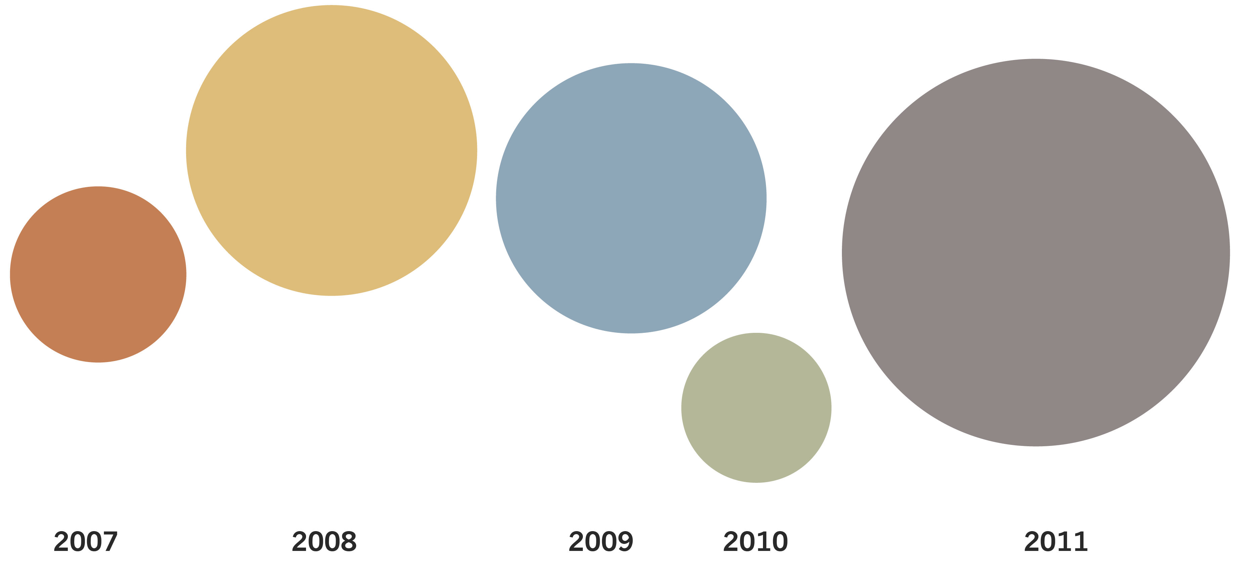
Invoicing detonated by PROSOFT 2.0 Users (Million USD)
$12.66
$10.42
$6.36
$15.77
$4.78

Slide 14
How can the Ecosystem be strengthened?
The Ecosystem is now being tested by the new State Government
The industry will be resilient, albeit slower to react to changes in the markets and to challenges in innovation
Academia has learnt a lesson or two and is now also more dynamic
Industry has come to depend on the PROSOFT subsidies as a substitute for credits which the pathetic Mexican banks are not willing to provide
The answer: Create your own bank! Provide your own financial support, circumvent the banking system

Slide 15
What is the role of policy makers/public sector, if any?
The State Government has always intervened! It has become a de facto “dictablanda” (soft dictator) given the obvious market imperfections
It has championed closing the digital divide through its e inclusion for an i society programme (leading a trailing Federal Government)
The State Government must exercise the rectorship of the State´s economy, through sound economic and innovation policies
The State and Federal Governments must stand watch over a greedy and hysterical Telecom sector and a useless financial sector

